Slide 1
Analysis of Level of Understanding (ALU): Revision of Unit 1 & 2 Chemistry
 | Chemical Equations | Number of moles | Redox | Acids and Bases | Stoichiometry
Level 1 | Write the electrovalence for the ions listed below: Lithium ion Carbonate Phosphate Aluminium ion | List two formulae that can be used to calculate the number of moles. Define the variables and state the units. | Circle the correct answer: a) Redox reactions involve the transfer of electrons/protons. b) If a substance acts as an oxidant it is reduced/oxidised. c) If a substance acts as a reductant it is reduced/oxidised. d) When a substance is oxidised the oxidation number increases/decreases. | Circle the correct answer: a) Acid base reactions involve the transfer of electrons/protons. b) An acid is a substance that will donate/accept a proton. c) A base is a substance that will donate/accept a proton. | List the mole ratio for the reactants in the following chemical equations: a) CH₃COOH(aq) + NaOH(aq) → CH₃COONa(aq) + H₂O(l) b) CH₄(g) + 2O₂(g) → CO₂(g) + 2H₂O(g) c) Na₂CO₃(aq) + CaCl₂(aq) → 2NaCl(aq) + CaCO₃(s)
Level 2 | Balance the following chemical equations: a) Zn(s) + HCl(aq) → ZnCl₂(aq) + H₂(g) b) Mg(OH)₂(aq) + H₂SO₄(aq) → MgSO₄(aq) + H₂O(l) | State the formula that would be used to calculate the number of moles when you are given the volume of a gas at STP. | Calculate the oxidation number for the bolded element in each of the following: Au MnO₄⁻ Cr₂O₇²⁻ | Classify the following reactions as a particular type of reaction pattern. For example: NaOH(aq) + HCl(aq) → NaCl(aq) + H₂O(l) is acid + base → salt + water. a) Mg(s) + 2HCl(aq) → MgCl₂(aq) + H₂(g) b) CaCO₃(aq) + 2HNO₃(aq) → Ca(NO₃)₂(aq) + CO₂(g) + H₂O(l) | Copper(I) oxide can be formed from the oxidation of copper metal as shown in the chemical equation below: 4Cu(s) + O₂(g) → 2Cu₂O(s) If 2.30 g of copper was heated in a crucible with plenty of oxygen, calculate the amount of copper oxide that would form.
Level 3 | Write the ionic equation for the precipitation reaction between Barium chloride and Sulphate ions to form the precipitate Barium sulphate. * Don’t forget to include states. | Calculate the number of moles of 42.9 L of CH₄ at 2 atm and 27ºC. | Permanganate (MnO₄⁻) reacts with iodide (I⁻) to produce manganese(II) ions (Mn²⁺) and Iodine (I₂). Write the half equations and the fully balanced redox equation for this reaction. | State the difference between a weak acid and a dilute acid. | Determine the pH of a solution in which 20.0 mL of 0.25M NaOH is added to 13.0 mL of 0.42M HCl.

Slide 2

Level 1
Level 2
Level 3

Slide 3
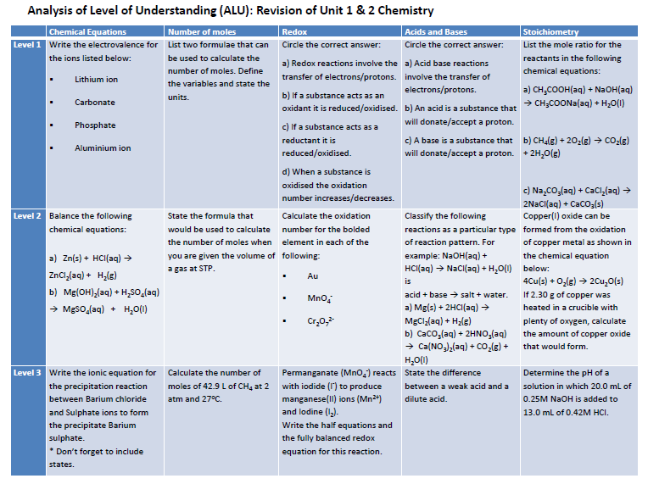
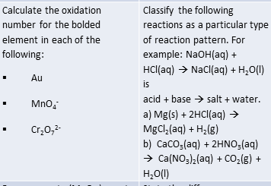

Slide 4
Analysis of Level of Understanding (ALU): Revision of Unit 1 & 2 Chemistry
 | Chemical Equations | Number of moles | Redox | Acids and Bases | Stoichiometry
Level 1 | Write the electrovalence for the ions listed below: Lithium ion Carbonate Phosphate Aluminium ion | List two formulae that can be used to calculate the number of moles. Define the variables and state the units. | Circle the correct answer: a) Redox reactions involve the transfer of electrons/protons. b) If a substance acts as an oxidant it is reduced/oxidised. c) If a substance acts as a reductant it is reduced/oxidised. d) When a substance is oxidised the oxidation number increases/decreases. | Circle the correct answer: a) Acid base reactions involve the transfer of electrons/protons. b) An acid is a substance that will donate/accept a proton. c) A base is a substance that will donate/accept a proton. | List the mole ratio for the reactants in the following chemical equations: a) CH₃COOH(aq) + NaOH(aq) → CH₃COONa(aq) + H₂O(l) b) CH₄(g) + 2O₂(g) → CO₂(g) + 2H₂O(g) c) Na₂CO₃(aq) + CaCl₂(aq) → 2NaCl(aq) + CaCO₃(s)
Level 2 | Balance the following chemical equations: a) Zn(s) + HCl(aq) → ZnCl₂(aq) + H₂(g) b) Mg(OH)₂(aq) + H₂SO₄(aq) → MgSO₄(aq) + H₂O(l) | State the formula that would be used to calculate the number of moles when you are given the volume of a gas at STP. | Calculate the oxidation number for the bolded element in each of the following: Au MnO₄⁻ Cr₂O₇²⁻ | Classify the following reactions as a particular type of reaction pattern. For example: NaOH(aq) + HCl(aq) → NaCl(aq) + H₂O(l) is acid + base → salt + water. a) Mg(s) + 2HCl(aq) → MgCl₂(aq) + H₂(g) b) CaCO₃(aq) + 2HNO₃(aq) → Ca(NO₃)₂(aq) + CO₂(g) + H₂O(l) | Copper(I) oxide can be formed from the oxidation of copper metal as shown in the chemical equation below: 4Cu(s) + O₂(g) → 2Cu₂O(s) If 2.30 g of copper was heated in a crucible with plenty of oxygen, calculate the amount of copper oxide that would form.
Level 3 | Write the ionic equation for the precipitation reaction between Barium chloride and Sulphate ions to form the precipitate Barium sulphate. * Don’t forget to include states. | Calculate the number of moles of 42.9 L of CH₄ at 2 atm and 27ºC. | Permanganate (MnO₄⁻) reacts with iodide (I⁻) to produce manganese(II) ions (Mn²⁺) and Iodine (I₂). Write the half equations and the fully balanced redox equation for this reaction. | State the difference between a weak acid and a dilute acid. | Determine the pH of a solution in which 20.0 mL of 0.25M NaOH is added to 13.0 mL of 0.42M HCl.

