Slide 1

Bonding
Bridge Building, Bongos and Bonding
Conductors, Bonding and Guitar Hero
Level 4
Level 3
Level 2
Level 1
Created by Adele Hudson, 2014

Slide 2
Summarise your findings using a mind map
Created by Adele Hudson, 2014

Slide 3
Virtual Learning Hub
Virtual Learning Hub
Virtual Learning Hub
Virtual Learning Hub
Summarise your findings using a mind map
Virtual Learning Hub
Virtual Learning Hub
Created by Adele Hudson, 2014

Slide 4
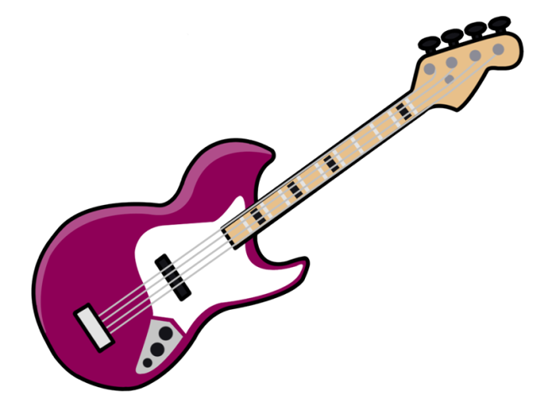
Aim
To test whether a range of materials are conductors or insulators and link the observations to bonding.
Materials
10 or 5 cent coins
Chocolate bud
Glucose
Hand sanitiser
margarine
Toothpaste
Alfoil
Paper guitar
MaKey MaKey
Virtual Learning Hub
Conductors, Bonding and Guitar Hero
Virtual Learning Hub
Virtual Learning Hub
Virtual Learning Hub
Summarise your findings using a mind map
Control Set Up
Connect MaKey MaKey to the computer as stated in the instructions.
Set up the paper guitar with ten or five cent coins connected to the ASDFG controllers on the MaKey MaKey.
Open http://makeymakey.com/hero/
Play Guitar Hero.
Virtual Learning Hub
Virtual Learning Hub
Continued on the next page
Created by Adele Hudson, 2014

Slide 5
Testing Materials
Keep one ten cent coin on the G connector as a control.
Place plastic counters on all the other connects and add four materials from the list above.
Test whether the materials are conductors or insulators by playing Guitar Hero.
Write your observations in the table below.
Virtual Learning Hub
Conductors, Bonding and Guitar Hero
Virtual Learning Hub
Virtual Learning Hub
 | Type of intramolecular bonding | Type of intermolecular bonding | Conductor or Insulator
Chocolate bud
Glucose
Hand sanitiser
Margarine
Toothpaste
Alfoil
Virtual Learning Hub
Summarise your findings using a mind map
Virtual Learning Hub
Provide an explanation in terms of bonding for why some of the materials act as conductors.
Virtual Learning Hub
Created by Adele Hudson, 2014

Slide 6
Challenge
Build a bridge that is a minimum of 20 cm long and 5 cm high and can conduct electricity using only limited materials.
Materials
5 x Wooden paddle pop sticks
4 x plastic straws
Paper towel (20 cm)
2 x plastic pegs
4 x rubber bands
Water
Computer
MaKey MaKey
Please note that not all the materials need to be used.
Test
To test the bridge you must be able to connect one end to the MaKey MaKey controller and touch the other end to play the Bongos - http://makeymakey.com/bongos/
Bridge Building, Bongos and Bonding
Summarise your findings using a mind map
Continued on the next page
Created by Adele Hudson, 2014

Slide 7
Continued…..
Bridge Building, Bongos and Bonding
Explain
Complete the table below, providing an explanation of the intramolecular and intermolecular bonding present for each of the materials listed.
State whether each of the materials are conductors or insulators.
Material | Type of Intramolecular bonding | Types of Intermolecular bonding | Conductor or insulator
Wooden paddle pop stick (assume made of cellulose)
Plastic straw
Paper towel (assume made of cellulose)
Plastic peg
Water
Summarise your findings using a mind map
Provide an explanation for why a material is a conductor.
Created by Adele Hudson, 2014

