Slide 1
Establishing a Culture of Success
In the Chemistry Classroom
Adele Hudson
Aitken College
STAV VCE Chemistry Conference 2015
Contact details: ahudson@aitkencollege.edu.au
www.mychemhub.com
Notes:
Abstract
A1 Establishing a Culture of Success in the Chemistry Classroom
Adele Hudson, Aitken College
Helping all students achieve success in Chemistry can appear to be an elusive goal. Traditionally a student’s ability level was said to be the secret behind their success, however, research has shown that high achievement is more dependent on a student’s resilience, intrinsic motivation, and ability to embrace challenge despite the risk of failure. Establishing a classroom culture which embraces these ideals can encourage students to reach for ever higher goals. This presentation will discuss a range of strategies and resources that can be used in the Chemistry classroom to enable all students to be successful.
Establishing a culture of success in the chemistry classroom –
Many of us have asked this question -“How can I achieve success for all my students?”
And this is an important question - as a teacher it is our mandate to help all students in our class achieve success. And when we talk about success we are talking about achieving goals. However, I would pre-empt the word goal with ever more challenging goals. So this means that students who have high competency levels will not just continue to achieve the highest mark in the class but rather they will see growth in their learning. This means that the students who have always sat in the middle and lowest band of the class will not continue as they have always but rather that they will progress into higher percentiles. It is an important premise that just achieving a high mark is not a measure of success– but rather whether or not the student has shown any growth in their learning.
So today I want to share some of the tools and ideas that I am using with my students to help them see growth. How I am seeing that teaching is more about learning than the teaching. How students are teachers and I am the learner. Its about seeing things from the students perspective – its about being able to think differently.

Slide 2

Notes:
Think different. Steve Jobs did and apple was born. And with apple came a revolution in how people interact with technology.
Apple doesn’t sell products they sell dreams. Buying a product from apple is buying an experience. When you buy a new iPhone, it doesn’t come in a cardboard box. No it comes in a molded white case, simply beautiful. I have to confess that I still have every box for every iPhone that I have ever owned. Also every box for every iPad and every box for every Mac book I have ever owned. What apple has done has gone beyond what other technology companies have done. Normal technology companies focus on selling a product. Apple has focuses on selling a dream. Steve Jobs built products to help people achieve their dreams. Their company culture is about people not products. And it has worked. As of late last year Apple announced that it has sold 225 million iPADs. Mind blowing especially when you consider that it was only first released about four years ago. This is what you call a success. This is what you call growth.
The challenge for us as teachers is to think different. To see that growth won’t come from a culture that focuses entirely on selling a product – that is Chemistry education, but rather a culture where we are selling a dream.
A dream where goals can be achieve and success is possible.
My premise today is that if we give time to establishing a culture that focuses on helping students become learners where they believe that they can be successful, then intrinsic motivation, resilience and embracing challenge become the norm. You only have to watch students in your class who have learnt how to learn and who believe the dream to see how much a student will invest in your subject if they believe that they will achieve a good return.

Slide 3

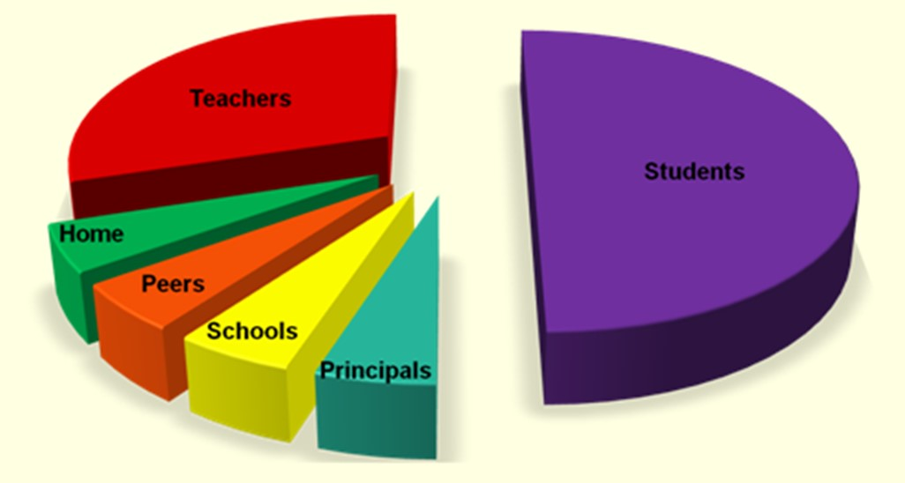
Hattie, J (2009) Visible Learning, ebook, University of Melbourne, date accessed 25th Feb 2015.
Notes:
In “Visible Learning”, John Hattie identified six main areas that contribute to learning, namely: student, home, the school, the curricula, the teacher and teaching and learning approaches.
Image: John Hatties contribution pie chart
There has been much said about the teacher and teaching and learning approaches which are known to contribute about 30% of the difference. However, I have been very much interested in the 50% that the students bring to the table as Hattie highlights that students not only bring prior achievement to the classroom, but also a set of attitudes and dispositions which can have an effect on their schooling (direct copying – p40).

Slide 4
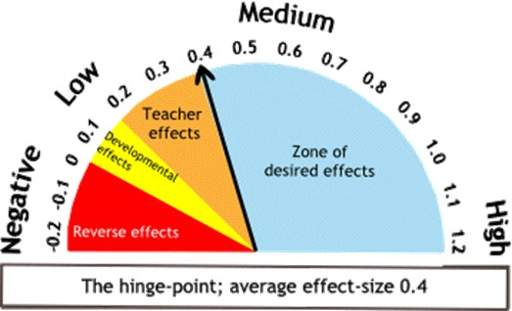
Student expectation of success (d = 1.44)
Prior knowledge
(d = 0.67)
Motivation
(d = 0.48)
Engagement
(d = 0.48)
Notes:
With effects sizes greater than 0.4 said to have a high impact on student learning, it is not surprising that student engagement has a significant influence on their learning with an effect size of 0.48, similarly student motivation has an effect size of 0.48. Students prior knowledge came in with a greater effect size, showing that it certainly has an influence on their ability to achieve in the subject. But the biggest influence on student learning was by far student expectation of success, which had an effect size of 1.44.
This clearly shows that influencing a students belief about their potential success in your subject can have a marked effect on their learning and hence their outcomes.

Slide 5
What can I do to make my
students
progress?
Notes:
There is a very interesting Ted talk by Pierre Pirard, a teacher working in Brussels most disadvantage neighbourhoods, who shares his insights on the principle of highly effective teachers. Changing from a career as a successful businessman to teaching, he observed that students’ success in all classes was not equal. He observed that students were successful learners in some classrooms and yet not in others. So he started asking the teachers at the school “What can I do to make my students progress?” For the teachers who had little effect on the students’ progress, he noted that they all spoke about the lack of education culture and resources at student’s home and the student’s language and literacy difficulties. . These teachers belief was that the student issues prevented them from making any progress and there was little that the teacher could do to change their outcomes.

Slide 6

success
What can I do to make my
goals
hard work
students
progress?
planning
Notes:
This contrasted with teachers where students were progressing their learning in that the discussion did not centre around student issues, but rather on the culture that the teacher had established in order to help students learn. Firstly the teacher believed and shared the message that every student could achieve success irrespective of their personal and educational history. Secondly teacher set ambitious and meaningful goals. Thirdly the teacher invested in the students to ensure that these goals were their daily priority and that the students worked hard in order to achieve their goals. And finally the teacher planned purposefully to ensure students achieved the set outcomes. The core belief and culture of these teachers was that all students could achieve success irrespective of their personal and educational history.

Slide 7
Sustainability
MATHS
Experimental Skills
Language
Knowledge
Critical Thinking
Creating
Evaluation
Analysis
Problem Solvers
LOGIC
Comprehension
Notes:
As a teacher of a challenging Science subject, it is very easy to be overwhelmed by the amount of content knowledge and skills requirement and to believe that teaching content should be our only focus.
We teach a subject where students need strong mathematical and language skills, can apply logic, are critical thinkers and problem solvers and have a good grasp of background knowledge. As I am preparing my students for their extended investigation I am amazed at the broad set of experimental skills that our students need and then along with these skills they need to be able to translate their theoretical knowledge to the lab bench and then be able to apply this to knowledge to new contexts and write all their findings in a clear, concise formal Scientific report or poster. Students require all levels of the cognitive skills listed in Blooms taxonomy building on knowledge, comprehension, and application of knowledge, analysis and evaluation.

Slide 8
Invest in
attitudes
dispositions
Notes:
However, today I would like present an alternative view. A view that moves away from the idea that we as teachers only influence students outcomes by imparting knowledge and skills in the most effective manner. I would say that because a students attitudes and dispositions such as their self belief as a learner, the openness to new experiences, their attribution of success to effort and their beliefs about the worth of investing in learning also make a significant contribution to their outcomes as a learner, that addressing these can also have a significant effect on their learning. And further to this I would like to also suggest that giving time to establishing a class culture where dispositions and attitudes that enhance learning are promoted can have more success than attempting to enhance achievement directly.

Slide 9
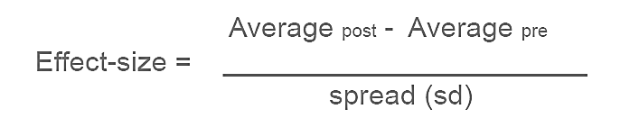
Improvements?
Effect size, d = 1.1
Notes:
Every time I talk at conferences the question is asked “So has there been any improvement in your student outcomes”. This is an excellent question that needs to be asked – however it is a harder question to answer. How do I measure the improvement in student outcomes when each year the cohort of students in my class changes. Do I measure improvement over the years for different classes or do I measure progress by how the students achieved at standard for one year compared with the next.
In terms of measuring progression between classes before and after the intervention, there hasn’t been a significant change in the average study score – however, there have been changes in that the minimum and the maximum score has increased. But again, this could just be due to the cohort themselves and I would need to see a few years of results to make any real statements here. So to answer the question I focused on the measuring the growth of the 2014 cohort by comparing their achievements at Year 11 with their final achievement in Year 12 and what I found was encouraging. All students experienced growth – which in itself is not surprising because most students put in more effort in Year 12 than in Year 11. However, as a class there was about 20 percent growth with some students achieving 43% growth. In terms of the effect size, which is used by John Hattie in Visible Learning to rank learning strategies, the effect size was calculated to be 1.1 - which is greater than the hinge point effect size of 0.4. If you are not sure about what the effect size actually means, it can be interpreted in terms of the average percentile gain where an effect size of 1 is equivalent to a student at the 50th percentile achieving a percentile gain of 34%.
So yes, at this stage although my measurement of improvement may be an inexact size due to the size of the cohort, there are some strong indicators that yes, the ideas that I am sharing about today do improve student outcomes.
There is also the anecdotal evidence. In previous years, I had found that there were always a few students who through the year would drop off the radar. Effectively they had decided that Chemistry was too hard for them so they would just go quiet. However, since I started giving time to looking at how students think about learning, and about themselves as learners, I found that students have been more willing to stick out the journey to the end. I have also found that many students have been more proactive in their learning, taking ownership for how they progress and in their own goal setting. I remember one of my students who made significant growth gains, commented that in Year 11 she used to dread coming to class and had only taken Chemistry because it was required for her prerequisites but in year 12 it had become her favourite subject.

Slide 10
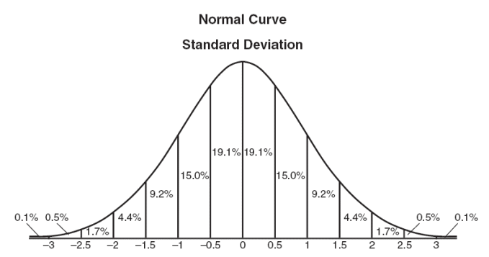
Effect size, d = 1
34%
What is an effect size? www.marzanoresearch.com/media/documents/.../AppendixB_DTLGO.pdf, date accessed 25th Feb 2015.
Notes:
Every time I talk at conferences the question is asked “So has there been any improvement in your student outcomes”. This is an excellent question that needs to be asked – however it is a harder question to answer. How do I measure the improvement in student outcomes when each year the cohort of students in my class changes. Do I measure improvement over the years for different classes or do I measure progress by how the students achieved at standard for one year compared with the next.
In terms of measuring progression between classes before and after the intervention, there hasn’t been a significant change in the average study score – however, there have been changes in that the minimum and the maximum score has increased. But again, this could just be due to the cohort themselves and I would need to see a few years of results to make any real statements here. So to answer the question I focused on the measuring the growth of the 2014 cohort by comparing their achievements at Year 11 with their final achievement in Year 12 and what I found was encouraging. All students experienced growth – which in itself is not surprising because most students put in more effort in Year 12 than in Year 11. However, as a class there was about 20 percent growth with some students achieving 43% growth. In terms of the effect size, which is used by John Hattie in Visible Learning to rank learning strategies, the effect size was calculated to be 1.1 - which is greater than the hinge point effect size of 0.4. If you are not sure about what the effect size actually means, it can be interpreted in terms of the average percentile gain where an effect size of 1 is equivalent to a student at the 50th percentile achieving a percentile gain of 34%.
So yes, at this stage although my measurement of improvement may be an inexact size due to the size of the cohort, there are some strong indicators that yes, the ideas that I am sharing about today do improve student outcomes.
There is also the anecdotal evidence. In previous years, I had found that there were always a few students who through the year would drop off the radar. Effectively they had decided that Chemistry was too hard for them so they would just go quiet. However, since I started giving time to looking at how students think about learning, and about themselves as learners, I found that students have been more willing to stick out the journey to the end. I have also found that many students have been more proactive in their learning, taking ownership for how they progress and in their own goal setting. I remember one of my students who made significant growth gains, commented that in Year 11 she used to dread coming to class and had only taken Chemistry because it was required for her prerequisites but in year 12 it had become her favourite subject.

Slide 11

Why the difference?
Notes:
But this has not always been the way in my classroom. As I mentioned earlier, in previous years I would find that students would drop off the radar, I also know that there were students who dreaded coming to my Chemistry class and who did not make any progression on their previous years result. There were also students of high ability who I know did not fill out their full potential of what they could achieve in the subject. So what has changed?
I have. And in reflecting on how I have changed it is not so much in what I do but rather in how I think about teaching Chemistry which has in turn influenced what I do. The improvements that I am now seeing in students outcomes is because I have changed my mindset on what brings student success which has directly influenced the culture that I set and the strategies that I employ in the classroom.

Slide 12

Change
mindset
Notes:
But this has not always been the way in my classroom. As I mentioned earlier, in previous years I would find that students would drop off the radar, I also know that there were students who dreaded coming to my Chemistry class and who did not make any progression on their previous years result. There were also students of high ability who I know did not fill out their full potential of what they could achieve in the subject. So what has changed?
I have. And in reflecting on how I have changed it is not so much in what I do but rather in how I think about teaching Chemistry which has in turn influenced what I do. The improvements that I am now seeing in students outcomes is because I have now a change my mindset on what brings student success which has directly influenced the culture that I set and the strategies that I employ in the classroom.

Slide 13

Notes:
As a teacher you set the culture in your classroom. Many studies have shown that a teachers’ belief that students will not succeed is a self-fulfilling prophecy and thankfully the alternative has also been found to be true. You hold the keys to how students will view Chemistry in Year 12, what priorities they will make during the year, about their beliefs of themselves as a learner of Chemistry, of Science and even their beliefs about themselves as a learner in general.
It is interesting to think that even if we do not have a plan for the culture in our classroom – this does not in any way mean that there is no classroom culture. Every classroom has its own set of hidden rules and values. You only need to follow a student for a day in high school and see how their behaviour changes dramatically as they move from class to the next to see these classroom cultures. Without a planned classroom culture, the default culture will be defined by a teachers set of personal beliefs about teaching – whether good or bad.
So as teachers we need to be intentional about the culture that we establish in our classroom. We must be conscious about why we are doing things and how we are doing things. Learning activities do not merely need to be about learning content, they can also double as another strategy to strengthen the culture which in turn will help develop students dispositions for learning.
There are four statements about culture that I use to guide my teaching.

Slide 14

1
All students can
achieve success
irrespective of
their personal
background, educational
history and ability.
Notes:
This is the biggest and most challenging statement. All students…this includes students with autism, poor language skills, low achievement levels in Units 1&2. All students. It takes a big mindset change to embrace this statement.
But when we do embrace this statement, this has the effect of working to increase students own expectations of their own success. In Hattie’s study it was found that students generally had an accurate idea of how they would perform in tasks – however, this can work against them because if their expectations are too low they are unlikely to work hard to achieve more.
A students resilience in a subject will be low if they believe that they will not be successful and they are not likely to make any investment in their learning if they do not expect to achieve a good return. You will hear students at the start of the year already making statements about which subject will be their fifth subject which in itself is likely to be a self-fulfilling prophecy as they automatically turn the burners off in that subject.
A student shared with me the other day “I was pretty sure at the start of the year that Chemistry was going to be my fifth subject, but I am really enjoying it and I am already working harder than in all of my other subjects”.
So what was the change for this student? Certainly not because I was making it easy – this is not possible in Chemistry. But by my first taking the step to believe that the student can be successful has certainly helped to engender in them a self- belief that they can be successful in the subject.

Slide 15
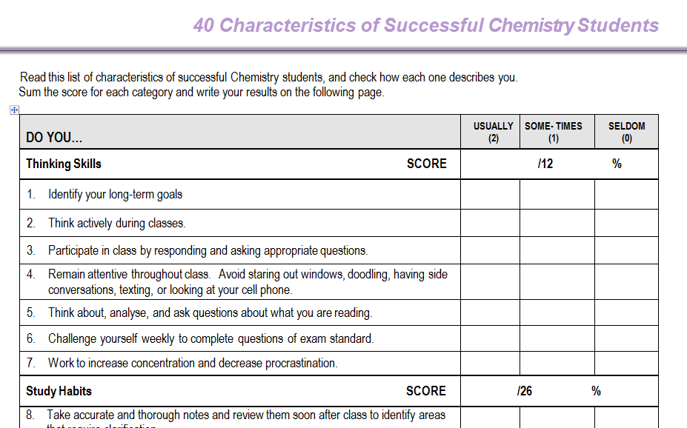
1
model success
Reference: 40 characteristics of successful students, Niagra University, www.niagara.edu/assets/.../40-Characteristics-of-Successful-Students.pdf
, date accessed 10th Feb 2015.
Notes:
For some students they don’t believe they can be successful because in school they never have. This in no way is a measure of their intelligence. It is often a measure of attitudes and dispositions that they bring with them that are not conducive to learning. Model to students characteristics of a successful student. I used a survey at the beginning of the year to on the 40 characteristics of successful chemistry students. This was useful for them – but more so for me to gain more of an understanding of what students were bringing with them.

Slide 16
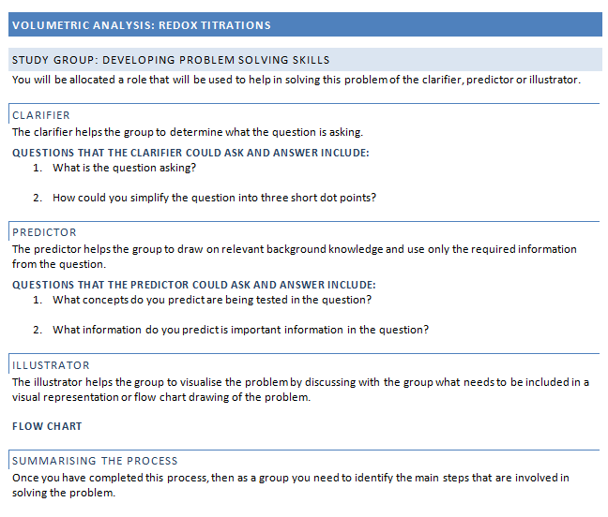
1
model success
-study groups
Notes:
This year I have am using mixed ability study groups. This was in response to a number of factors – firstly from the survey, all students scored quite low on the characteristic of studying with a study partner or a small study group. However, all students benefit from discussing their ideas with others as it helps to refine their thinking. Another reason for the study groups is that I have noticed that students who find the subject challenging can tend to become isolated in the class. They are quite aware that they take longer to understand concepts so they become quite reticent to discuss questions with the wider group.
I have found that students are not always natural communicators – so in order to help the groups function effectively I have developed the groups around the reciprocal teaching strategy where students are given particular roles for better comprehension of reading material.
Students are divided into groups of three and given the role of either the Clarifier, Predictor or Illustrator where the clarifier helps determines what the question is asking, the predictor determines what information is required and the illustrator help clarify the problem using a flow chart. When each person has completed their section, the group then summarise how to solve the problem.

Slide 17

2
Student success is
achieved through effort -students reaching for ever more challenging goals.
Notes:
As we have heard from the Growth mindset studies by Carol Dweck, , a psychologist from Stanford University and a key researcher in the field, it has been found that students had improved achievement outcomes when they focused on:
learning not performance
accepted not discounted feedback
benchmarked to difficult rather than easy goals
compared themselves to subject criteria rather than other students
possess high rather than low efficacy to learning
believed that their efforts influenced their learning rather than outside effectors.

Slide 18
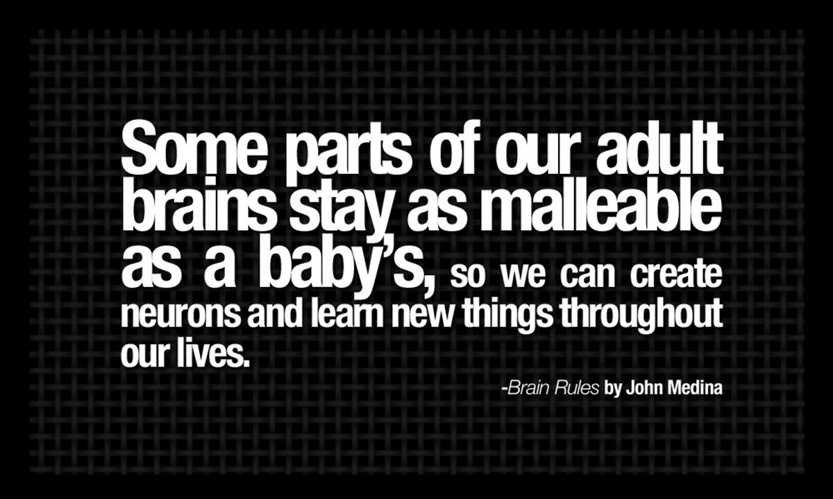
2
Reference: John Medina, a developmental molecular biologist, research interests in the isolation and characterisation of genes involves in human development,
https://frugoal.files.wordpress.com/2014/08/brain-rules-quotes-some-parts-of-our-adult-brains-stay-as-malleable-as-a-babys.jpg, date accessed 25th Feb 2015.
Neuroplasticity, Sentis, Growth Mindset - Melissa Dowling, https://www.youtube.com/watch?v=ELpfYCZa87g&index=2&list=PLwrHA9rJu3ybuh85eQ6CTLlC67iQpbY8_, (2.03 min) date accessed 25th Feb 2015.
Notes:
Over the past twenty years considerable research has been undertaken on how ones belief about intelligence affects achievement and motivation. In a number of these studies it was found that students who held the belief that intelligence was static and could not be changed were less likely to attempt challenging tasks and were more concerned with looking smart, while students who believed that intelligence could be developed were more likely to work hard even when faced with failure (Blackwell, Trzesniewski & Dweck, 2007; Good, Aronson & Inzlicht, 2003).
Carol Dweck identified that people can either have a fixed mindset, that is they believe intelligence is unchangeable and talent alone determines success or they can have a growth mindset, that is they believe that intelligence is malleable and can be developed through dedication and hard work (Dweck, 2010). Dweck further clarified the ideas of growth mindset with this statement “A growth mind-set doesn't imply that everyone is the same or that anyone could be Einstein, but it does imply that everyone's intellectual ability can grow - and that even Einstein wasn't Einstein before he put in years of passionate, relentless effort”(Dweck, 2010). It has been found that teaching growth mindset principles had improved outcomes in their learning, and teachers who had growth mindset about learning were more likely to make low achievers become high achievers by the end of the year.

Slide 19
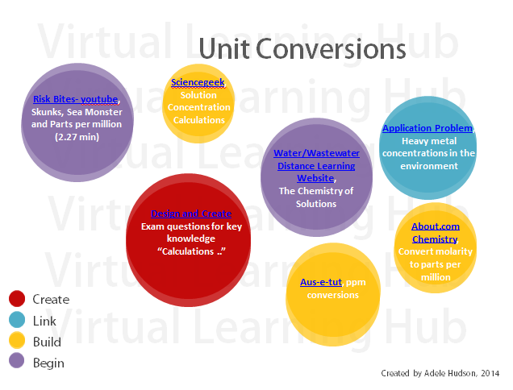
2
Virtual Learning Hubs
Notes:
Differentiation has been a buzz word in the education world for good reason. Students who are working within the zone of proximal development are more likely to be engaged, and find a good return on their investment of learning.
I use virtual learning hubs as a way for students to progress at the level of difficulty they require. Students can choose to work through four levels of difficulty in the content.

Slide 20

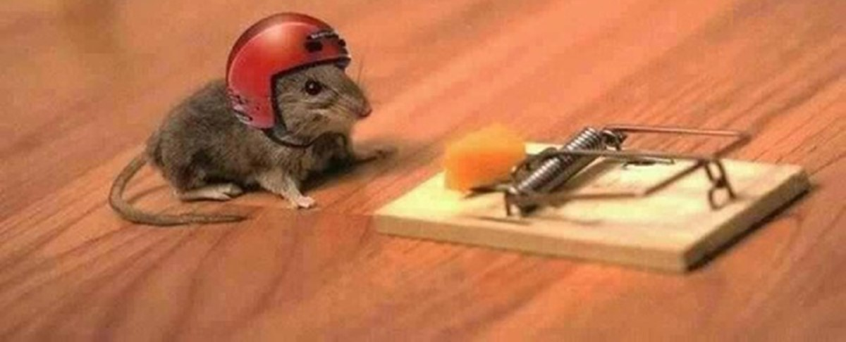
3
Success for all
students requires
purposeful planning
Notes:
However, telling students that they can grow their intelligence through hard work and dedication needs to be coupled with a specific plan that will help the students to get there. Students need to have a plan that is sufficiently challenging however not so overwhelming that they will not begin.
You are effectively adding another layer to the teaching of Chemistry. Planning of delivery of content, planning towards SACs but also planning towards the development of a culture of success for all.

Slide 21

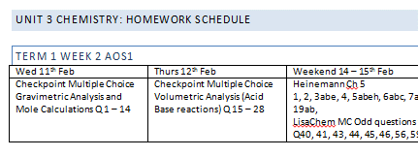
3
Personal Learning Plans
- individualised homework schedules
Notes:
One way that I have been looking at setting appropriate goals for students is to develop personal learning plans or individualised homework schedules. The learning plans are developed with the students goals in mind and are constantly monitored as to whether the load is too great or too little. I haven’t as yet had a student say that I have given them too much, however, a couple of students have expressed that they feel that the load is too light and they would like more work.

Slide 22

4
Success for all is dependent on measuring the effect of teaching on student learning.
Notes:
Hattie encouraged us as teachers to evaluate our teaching strategies and to take ownership of both the success and failure of our students; Who did I teach well? Who did I not teach well? We constantly need to measure whether we have achieved our aims and then let this determine our next step forward. It is interesting that feedback has been traditionally thought to be all about us providing students with information about where they can improve, however, Hattie found that the power in feedback is more in that we as teachers adjust our teaching practices to better serve all student needs.

Slide 23
4
ALU – analysis of level of understanding
Notes:
One method that I have devised to quick determine students understanding is the ALU or Analysis of Level of Understanding.

Slide 24
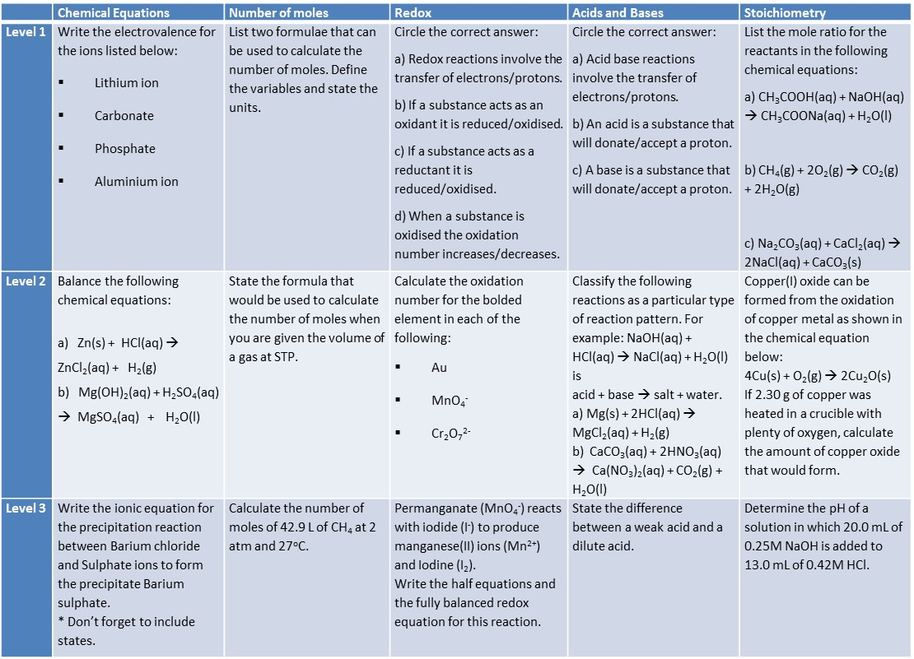
Analysis of Level of Understanding (ALU): Revision of Unit 1 & 2 Chemistry
Notes:
These tasks I called “Analysis of Level of Understanding” or an ALU and are simply a task that includes short questions based on a revision of Blooms Taxonomy of Educational Objectives which includes both the knowledge dimension and the cognitive process dimension.

Slide 25
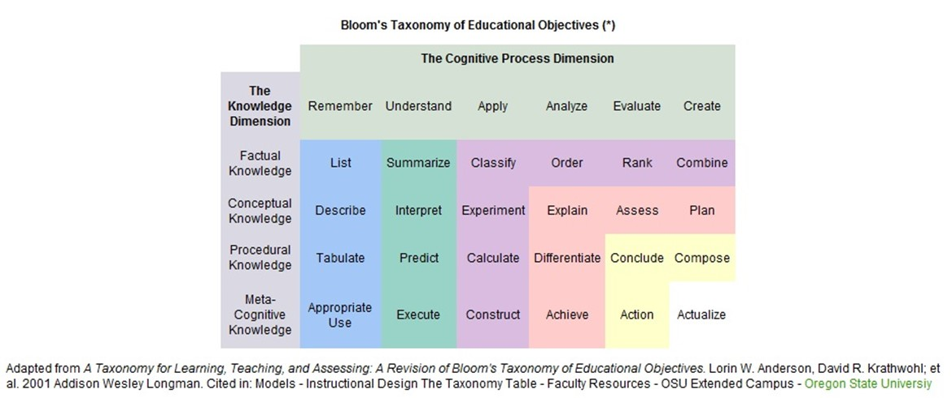
Level 1
Level 2
Level 3
Notes:
This set of descriptors provides a framework by which increasingly more difficult questions can be devised. Level 1 in the ALU is based on “Remember” and “Understand” cognitive dimensions, Level 2 is based on “Apply” and “Analyse” and Level 3 is based on “Evaluate” and “Create”.

Slide 26
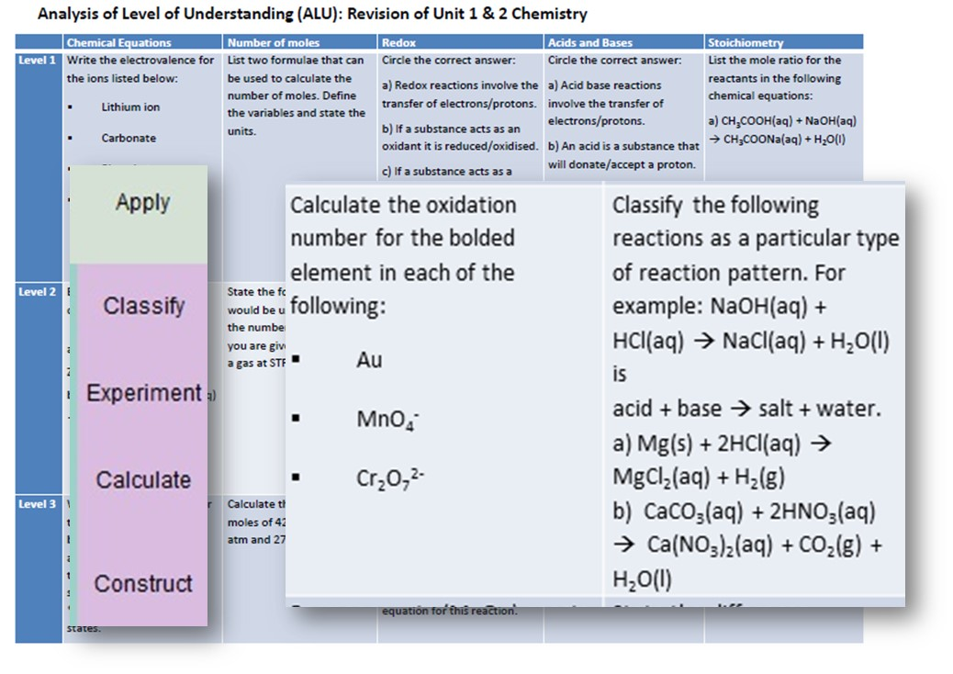
Notes:
For example in this ALU which was designed to gauge students understanding of Unit 1& 2 key knowledge areas, the second level includes questions that were written based on the apply dimension, with calculate and classify.

Slide 27
Analysis of Level of Understanding (ALU): Revision of Unit 1 & 2 Chemistry
 | Chemical Equations | Number of moles | Redox | Acids and Bases | Stoichiometry
Level 1 | Write the electrovalence for the ions listed below: Lithium ion Carbonate Phosphate Aluminium ion | List two formulae that can be used to calculate the number of moles. Define the variables and state the units. | Circle the correct answer: a) Redox reactions involve the transfer of electrons/protons. b) If a substance acts as an oxidant it is reduced/oxidised. c) If a substance acts as a reductant it is reduced/oxidised. d) When a substance is oxidised the oxidation number increases/decreases. | Circle the correct answer: a) Acid base reactions involve the transfer of electrons/protons. b) An acid is a substance that will donate/accept a proton. c) A base is a substance that will donate/accept a proton. | List the mole ratio for the reactants in the following chemical equations: a) CH₃COOH(aq) + NaOH(aq) → CH₃COONa(aq) + H₂O(l) b) CH₄(g) + 2O₂(g) → CO₂(g) + 2H₂O(g) c) Na₂CO₃(aq) + CaCl₂(aq) → 2NaCl(aq) + CaCO₃(s)
Level 2 | Balance the following chemical equations: a) Zn(s) + HCl(aq) → ZnCl₂(aq) + H₂(g) b) Mg(OH)₂(aq) + H₂SO₄(aq) → MgSO₄(aq) + H₂O(l) | State the formula that would be used to calculate the number of moles when you are given the volume of a gas at STP. | Calculate the oxidation number for the bolded element in each of the following: Au MnO₄⁻ Cr₂O₇²⁻ | Classify the following reactions as a particular type of reaction pattern. For example: NaOH(aq) + HCl(aq) → NaCl(aq) + H₂O(l) is acid + base → salt + water. a) Mg(s) + 2HCl(aq) → MgCl₂(aq) + H₂(g) b) CaCO₃(aq) + 2HNO₃(aq) → Ca(NO₃)₂(aq) + CO₂(g) + H₂O(l) | Copper(I) oxide can be formed from the oxidation of copper metal as shown in the chemical equation below: 4Cu(s) + O₂(g) → 2Cu₂O(s) If 2.30 g of copper was heated in a crucible with plenty of oxygen, calculate the amount of copper oxide that would form.
Level 3 | Write the ionic equation for the precipitation reaction between Barium chloride and Sulphate ions to form the precipitate Barium sulphate. * Don’t forget to include states. | Calculate the number of moles of 42.9 L of CH₄ at 2 atm and 27ºC. | Permanganate (MnO₄⁻) reacts with iodide (I⁻) to produce manganese(II) ions (Mn²⁺) and Iodine (I₂). Write the half equations and the fully balanced redox equation for this reaction. | State the difference between a weak acid and a dilute acid. | Determine the pH of a solution in which 20.0 mL of 0.25M NaOH is added to 13.0 mL of 0.42M HCl.
Notes:
In the ALU there are five topics with questions at three levels - so with a total of 15 questions this seems like a lot of questions for the students to get through. However, students don’t complete each question, rather they only need to complete a question in each topic at the highest level of difficulty that they can achieve.

Slide 28
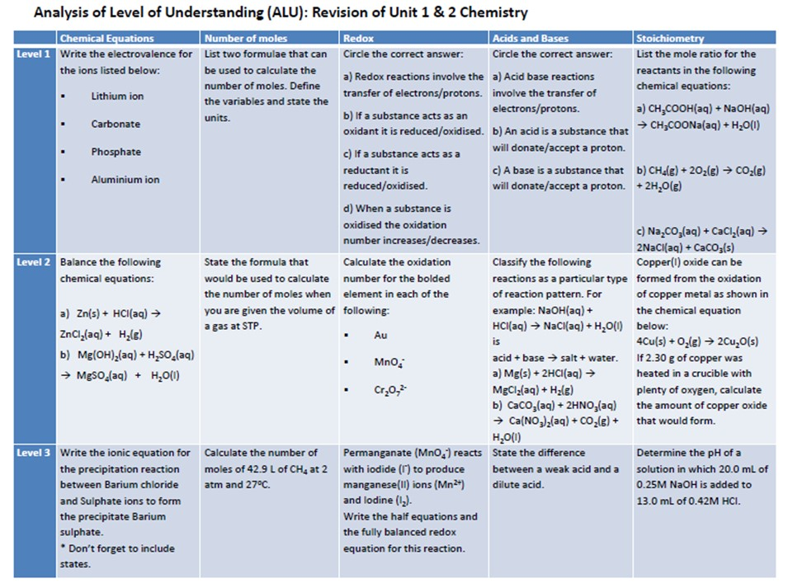
Notes:
For example, some students were able to complete all the level 3 questions across all topics….

Slide 29

Notes:
….but more often than not students completed questions from a range of levels across the topics.

Slide 30
Level 2
Level 1
Level 2
Level 3
Level 1
Notes:
The students then marked their answers and above each topic wrote down their level of understanding.
This was a quick way for students to evaluate their learning – but more importantly it helped to evaluate the effectiveness of my teaching.
In a recent Redox test, I found that 80% of the students had not grasped the foundational concepts despite teaching the concepts in a couple of different ways. A little deflating - but rather than moving on - we worked on the concept until all the students were solid in this area.
They say ignorance is bliss and this certainly applies when we choose not measure our students progress. It is tough finding out that despite your best efforts students don’t understand – but better that then students continuing on in the dark.

Slide 31

4
EQUAT – exam analysis tool
Notes:
EQUAT is an exam analysis tool which I developed using excel. This tool was helpful when providing students with feedback as it gave concrete evidence of where the student needed to target their future efforts. As well as discussing the details of what calculations they could or couldn’t do it was helpful for them to be able to discuss what their future plan would be in terms of how to improve. In surveying the students who used the tool for a number of practice exams, they felt the tool helped them to work harder as it made it really clear to them concepts that needed further strengthening and others where they had established a sound foundation.
It certainly was helpful in informing my teaching practices as both individual and class reports can be generated.

Slide 32
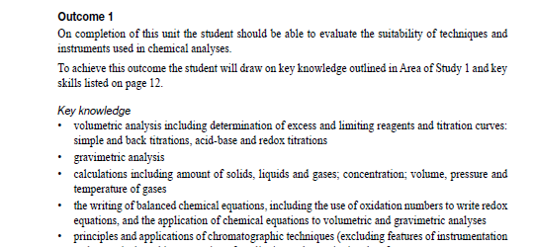
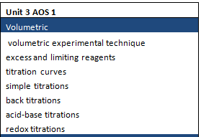
4
EQUAT – exam analysis tool
Notes:
Based on the study design, Using the key knowledge dot points as one category, I simplified the paragraph into separate key knowledge descriptors which were then used to categorise each question in the exam.

Slide 33
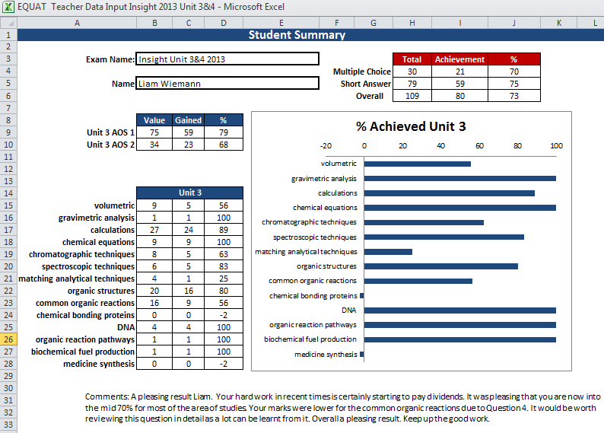
4
EQUAT – exam analysis tool
Notes:
The overall information obtained for individual students included how they performed in the key knowledge categories. For example, this student performed well in the calculation style questions, however they struggled in the questions that were based on common organic reactions. The report also overall percentage grade of the students achievements for each area of study.

Slide 34
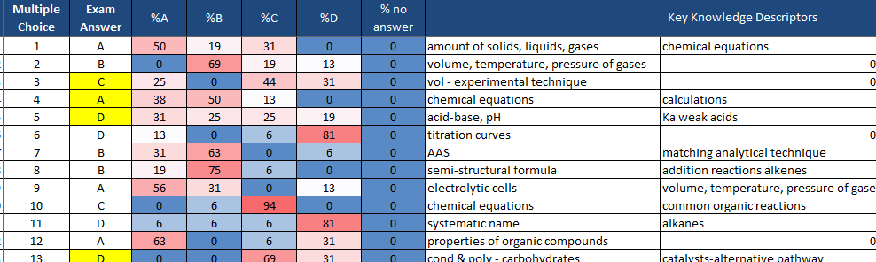
4
EQUAT – exam analysis tool
Notes:
A report is also obtained which summarises the class results as well which is very helpful when in the revision period as it can guide you in what topics to spend more time revising.

Slide 35
It is possible to establish a culture of success in your classroom.
Notes:
In summary, using a range of strategies it is possible to establish a culture of success in your classroom.
These include setting challenging but achievable goals and planning purposefully to ensure that the students work hard to achieve these goals. These strategies and along with others discussed in this talk are important; however, it has to be said that the critical element to establishing a culture of success is that there first must be a change in our own mindset. We must know and understand that all students can be successful. When we are armed with this knowledge, we are then able to engender in our students a self-belief of success which in turn becomes the foundation for them to work towards achieving their goals.
Establishing a culture of success takes hard work, but the rewards are great. When you see happy and confident students walk out your door at the end of the year, students who have proved to themselves that despite challenging content, high workloads and difficult exams, that they can be successful learners, then you know that this is a reward that is better than gold.

