Slide 1
Using Skills Based Rubrics in Area of Study 3
Reflections from the classroom
STAV VCE Chemistry Conference 2017
Cristy Herron Adele Hudson
cherron@aitkencollege.edu.au ahudson@aitkencollege.edu.au
www.mychemhub.com
Notes:
Using skills based rubrics in Area of Study 3; reflections from the classroom
In this session we will be discussing the benefits of using skills based rubrics in Area of Study 3. Using rubrics that describe increasing levels of competence enables students of all levels of ability to move to higher levels of achievement. Consistent rubrics across year 7 to 12 also provides students with the opportunity to improve their investigation and research skills as they progress through school. With over 500 student design projects conducted in the junior and middle school each year this has led to greater student engagement with the added benefit of students being better prepared for the rigors of Area of Study 3 in VCE.

Slide 2
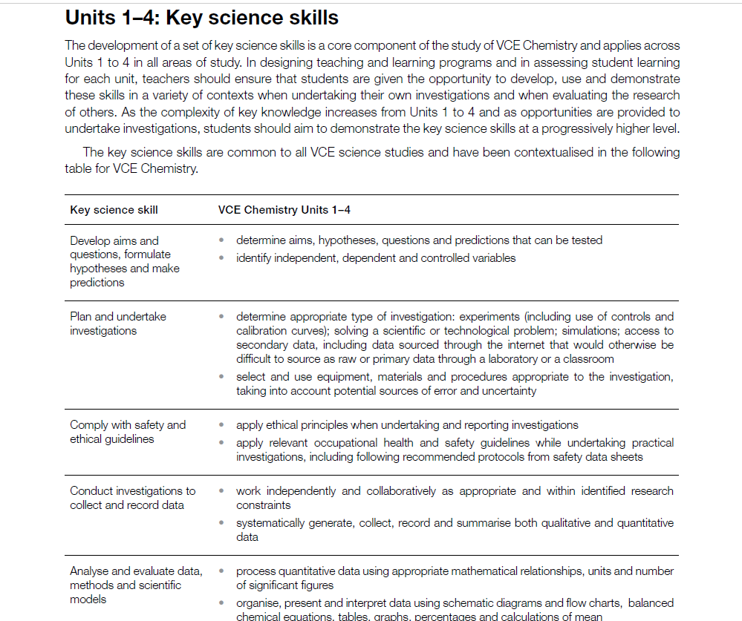
AOS3 Research Task - AOS3 Investigation Task
Assessment Rubrics based on the key science skills
Connect learning through all year levels and across Sciences
Notes:
Adele
Change is always challenging, but change also provides opportunities. And this is what Area of Study 3 has provided across the Sciences. The opportunity to now teach students the key science skills not only in Unit 1 & 2 but from Year 7 through to Year 12. And what an opportunity this is – whereas the drive to ensure students were prepared for the content of Year 11 and 12 held us captive to content driven curriculum in the junior levels, we are now providing students with more opportunities to engage in the process of being scientists. Students are no longer are just consumers of knowledge but are also producers of knowledge. The introduction of AOS3 was well timed at Aitken College in that it coincided with the introduction of using rubrics based on developmental continuum for assessment tasks. The introduction of these ideas has resulted in somewhat of a revolution in the Science faculty. This is particularly seen in that last year alone, across the science faculty there were 500 student design experiments and 200 research tasks. Which, in addition to the 800 content based experiments is a high level of students engaging in scientific discovering. And the key to this change has been that learning is now connected through all year levels and across sciences by the skill based rubrics. Today Cristy and I will be providing reflections from our experiences in using the skills based rubrics across a number of year levels. Cristy will share reflections and tips on using the rubrics in Year 11 and I will then talk about Year 7 and 9 and show how students were able to develop their skills during the year.

Slide 3
Unit 1 & 2 Chemistry
AOS3
Research Investigation
Practical Investigation
Notes:
Cristy
The new AOS3 for both Units 1 & 2 present an opportunity to use rubrics comprised of skills students can refine throughout the year. While there are skills unique to each type of investigation, the evaluation and analytical skills are included in both tasks, allowing students to refine those skills over the course of the year.

Slide 4
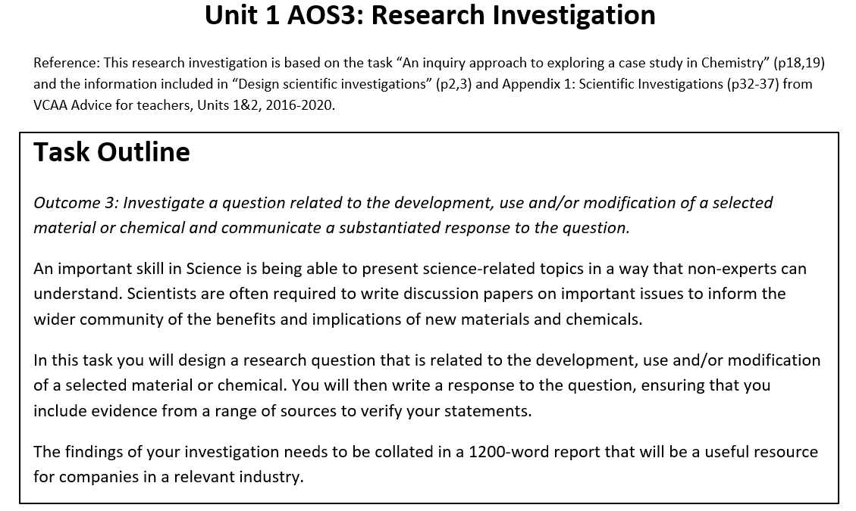
Notes:
Cristy
This is the task outline for the Research Investigation which we have based this task on “An inquiry approach to exploring a case study in Chemistry” (p18,19) and the information included in “Design scientific investigations” (p2,3) and Appendix 1: Scientific Investigations (p32-37) from VCAA Advice for teachers, Units 1&2, 2016-2020.

Slide 5
Unit 1 AOS3
The Task has been divided into four phases
Issue selection and planning
Research
Investigation
Reporting
Notes:
Cristy
The task has been divided into four phases;
Issue selection and planning phase
Research phase
Investigation phase
Reporting phase
The requirements of each phase are outlined in the booklet to guide the students in their work.

Slide 6
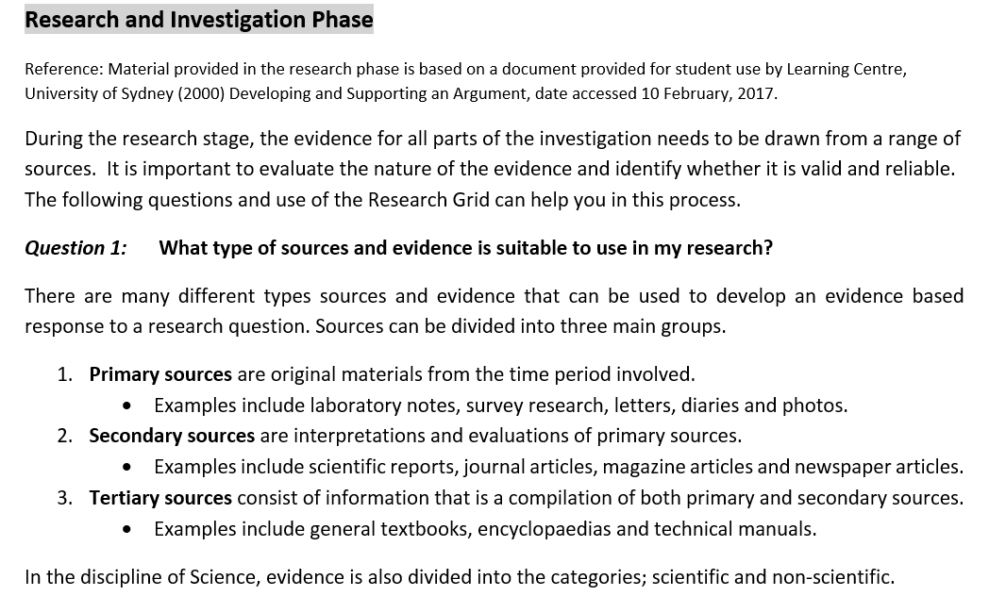
Unit 1 AOS3
Notes:
Cristy
There is a research guide to help the students understand how to choose sources and ascertain whether the evidence they obtain is valid,

Slide 7
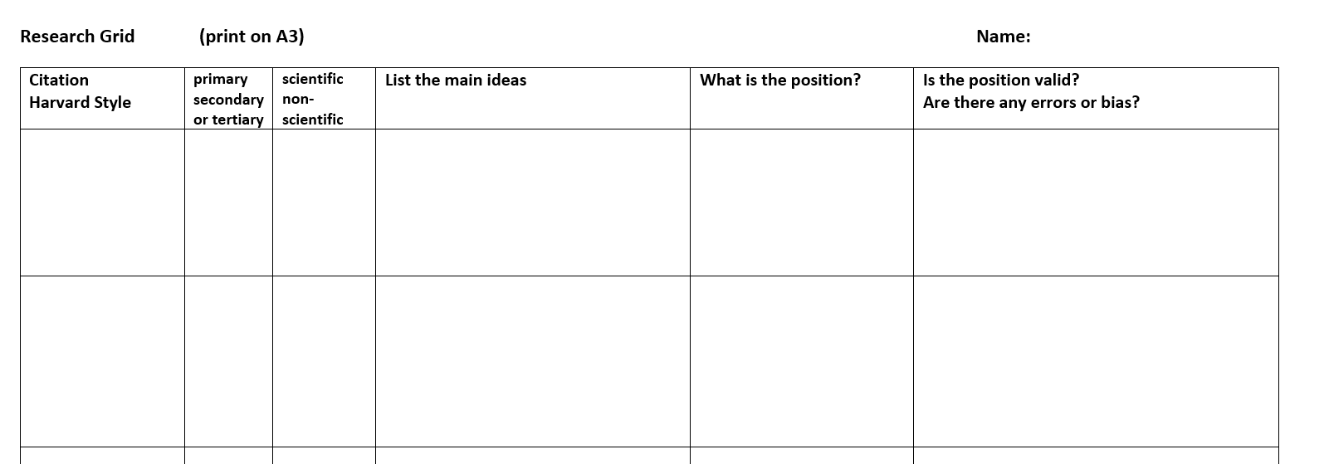
Unit 1 AOS3
Notes:
Cristy
The research grid has been developed for students to document, organise and authenticate their work.

Slide 8
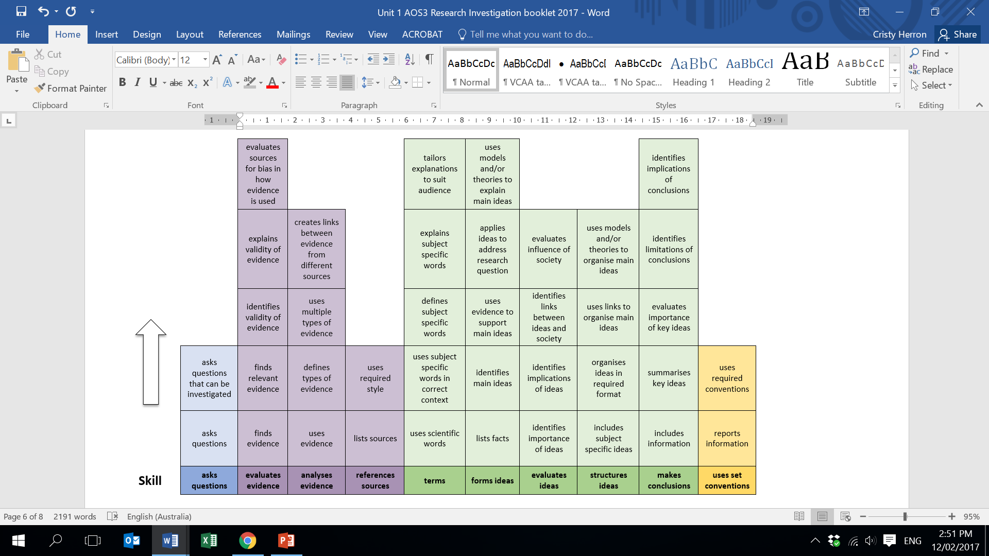
Notes:
Cristy
This is the skills rubric used to assess students for AOS3.
The rubric has been divided into several parts, to differentiate between skills used in different phases of the task.
Blue – Planning phase
Purple – Research phase
Green – Investigating and reporting phase
Yellow – Reporting phases follows set conventions

Slide 9
Unit 1 AOS3
Research Investigation Rubric:
Planning and Research
Notes:
Cristy
The rubric has been divided into several parts with the blue and purple representing the planning and research phase.

Slide 10
Unit 1 AOS3
Research Investigation Rubric:
Planning and Research
Notes:
Cristy
In order to demonstrate how the descriptions are written for progressively higher levels of the skill, very simply for asking a research question, a low level of the skill asks questions without considering the scope or parameters of the task, while a higher level asks questions that can be investigated within an appropriate timeframe.

Slide 11
Unit 1 AOS3
Research Investigation Rubric:
Communicating ideas and follows conventions
Notes:
Cristy
The green and yellow sections of the rubric is for the assessment of students communicating their investigation findings and following reporting conventions.

Slide 12
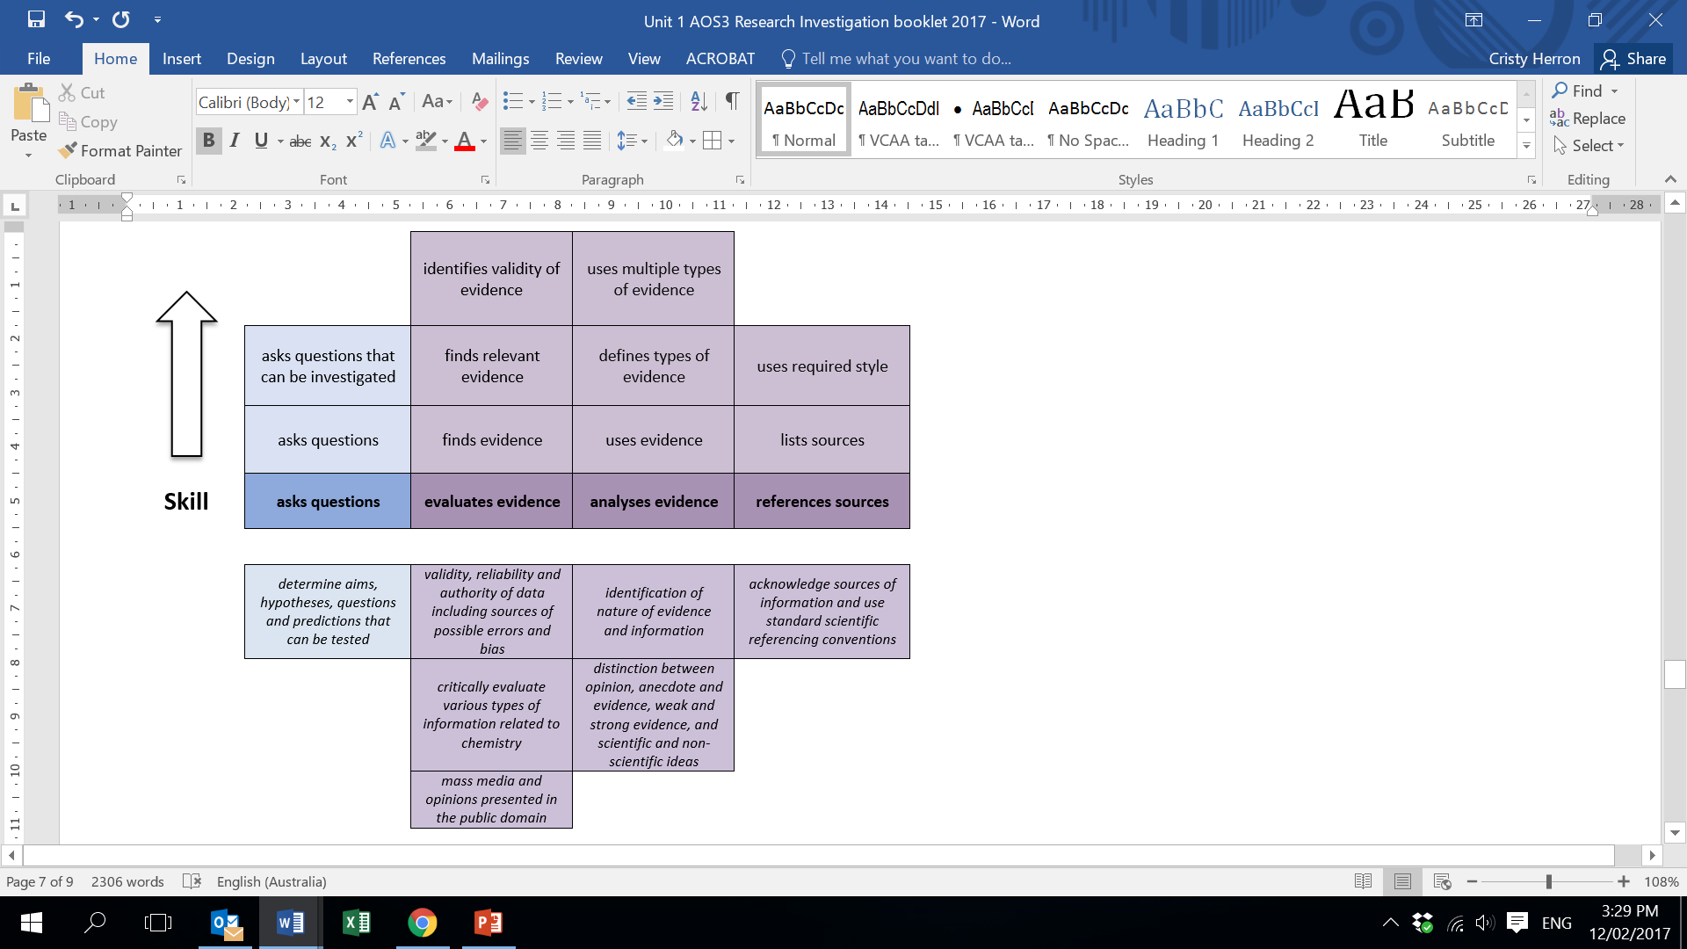
Unit 1 AOS3
Correlation with Chemistry Study Design Key Skills
Notes:
Cristy
Each of the criterion or skills can be matched to the key science skills and key knowledge descriptor given for AOS3.

Slide 13
Unit 1 AOS3
Correlation with Chemistry Study Design Key Skills
Notes:
Cristy
Each of the criterion or skills can be matched to the key science skills and key knowledge descriptor given for AOS3.

Slide 14
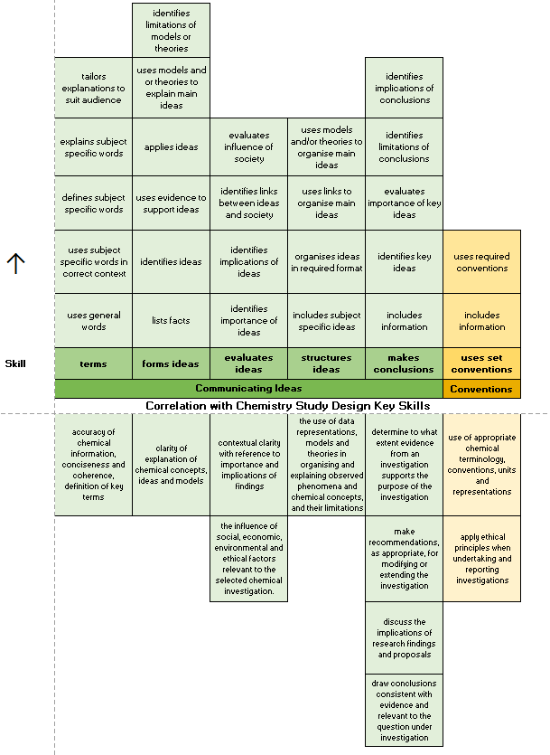
Unit 1 AOS3
Notes:
Cristy
Each of the criterion or skills can be matched to the key science skills and key knowledge descriptor given for AOS3.

Slide 15
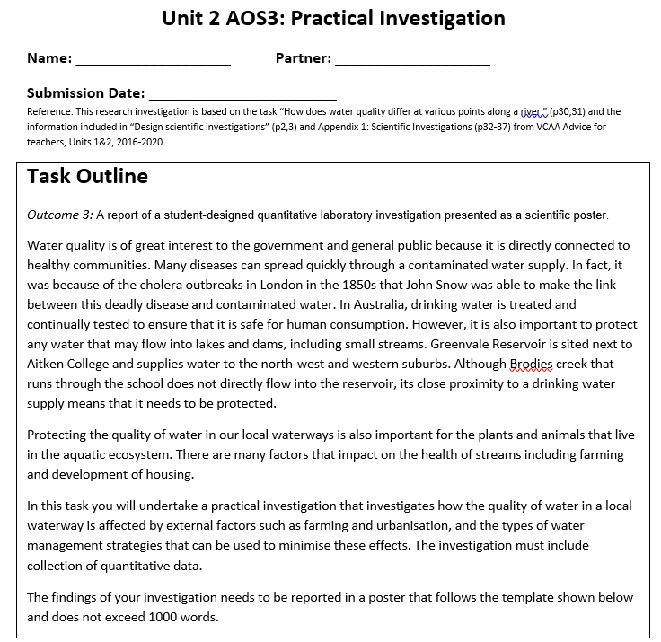
Notes:
Cristy
And the same connections between year levels and sciences has been made with the Unit 2 AOS3: practical investigation.

Slide 16
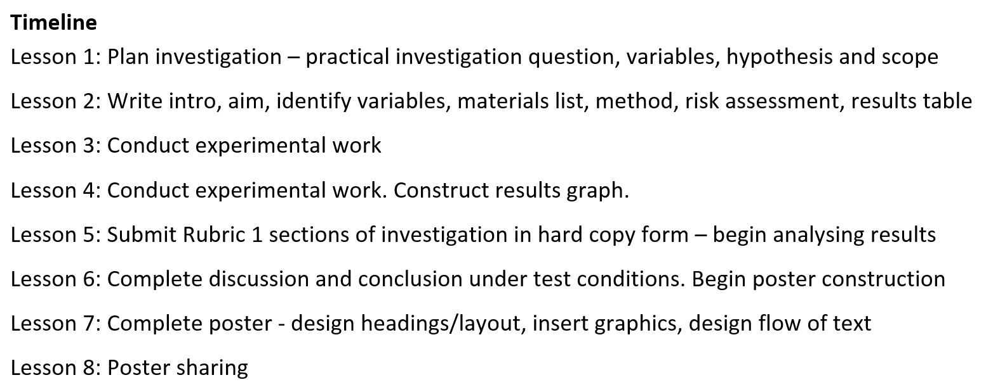
Unit 2 AOS3
Notes:
Cristy
A timeline is used to keep students on track, and for authentication purposes the rubric was split into 2 parts to allow students to work in pairs for the planning and conducting phases, but individually for the evaluating and communicating phases.

Slide 17
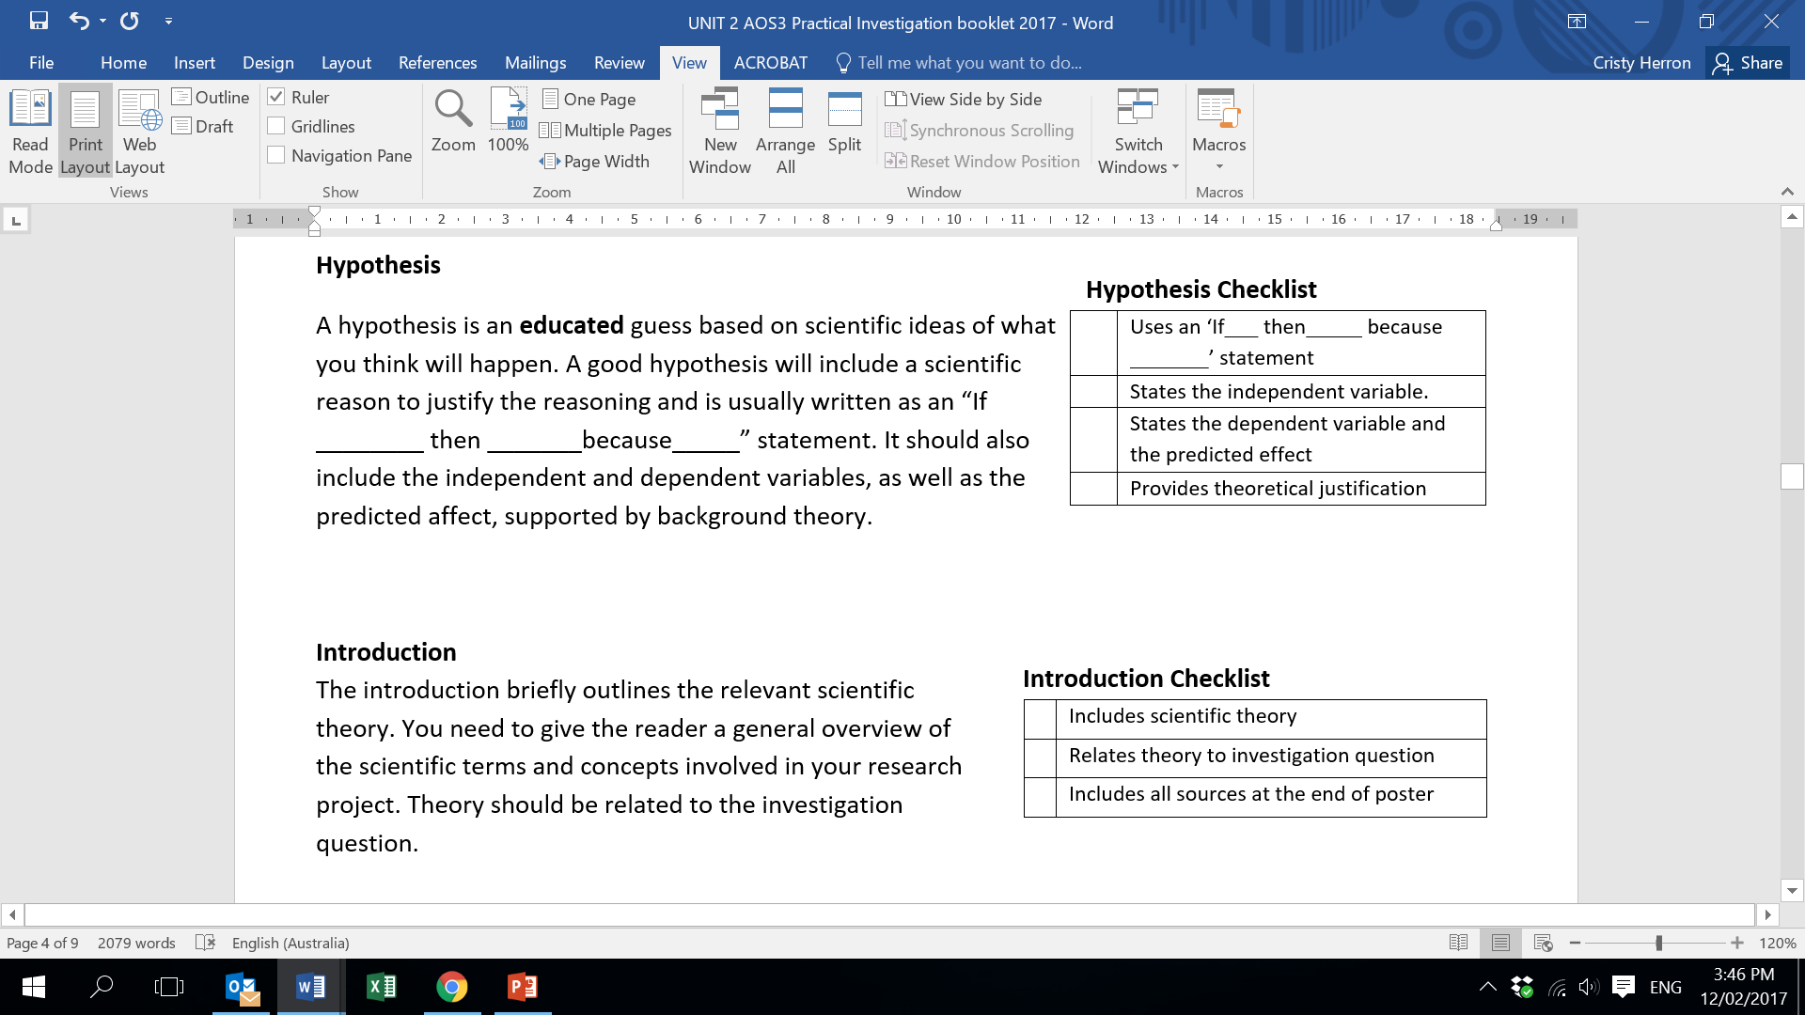
Unit 2 AOS3
Notes:
Cristy
The booklet includes a similar step-by-step process for students to follow, including checklists to ensure students meet all the necessary aspects of the task.
The same connections between year levels and sciences has been made with the AOS3: practical investigation. In fact, it was in the junior science classes when these checklists were first used to guide students through practical tasks.

Slide 18
Unit 2 AOS3
Notes:
Cristy
The requirements for each part of the task is given in detail along with a checklist of conventional requirements.

Slide 19
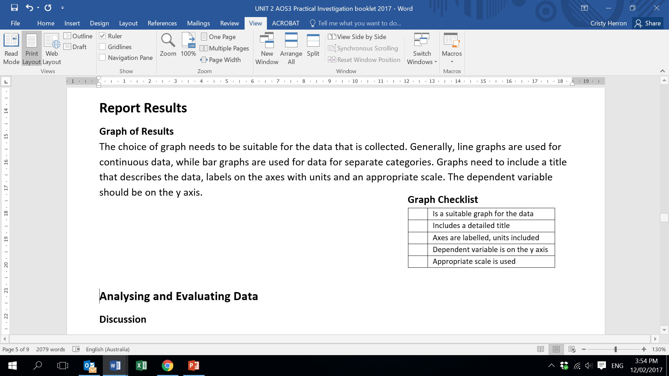
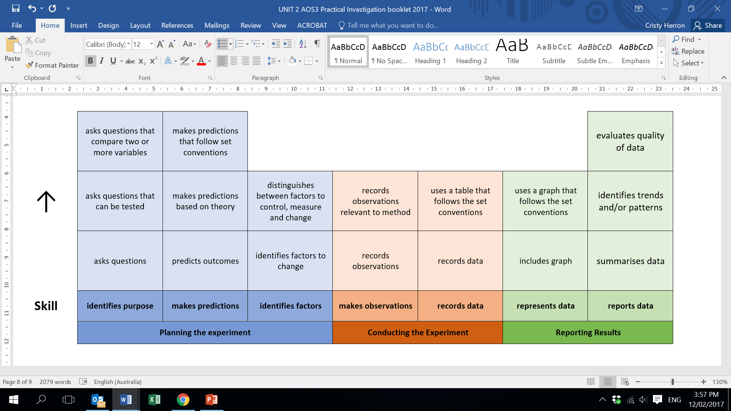
Unit 2 AOS3
Notes:
Cristy
Using the checklist and the assessment rubric as a guide, students are made more aware of how to follow the ‘set conventions’ as shown in the rubric.

Slide 20
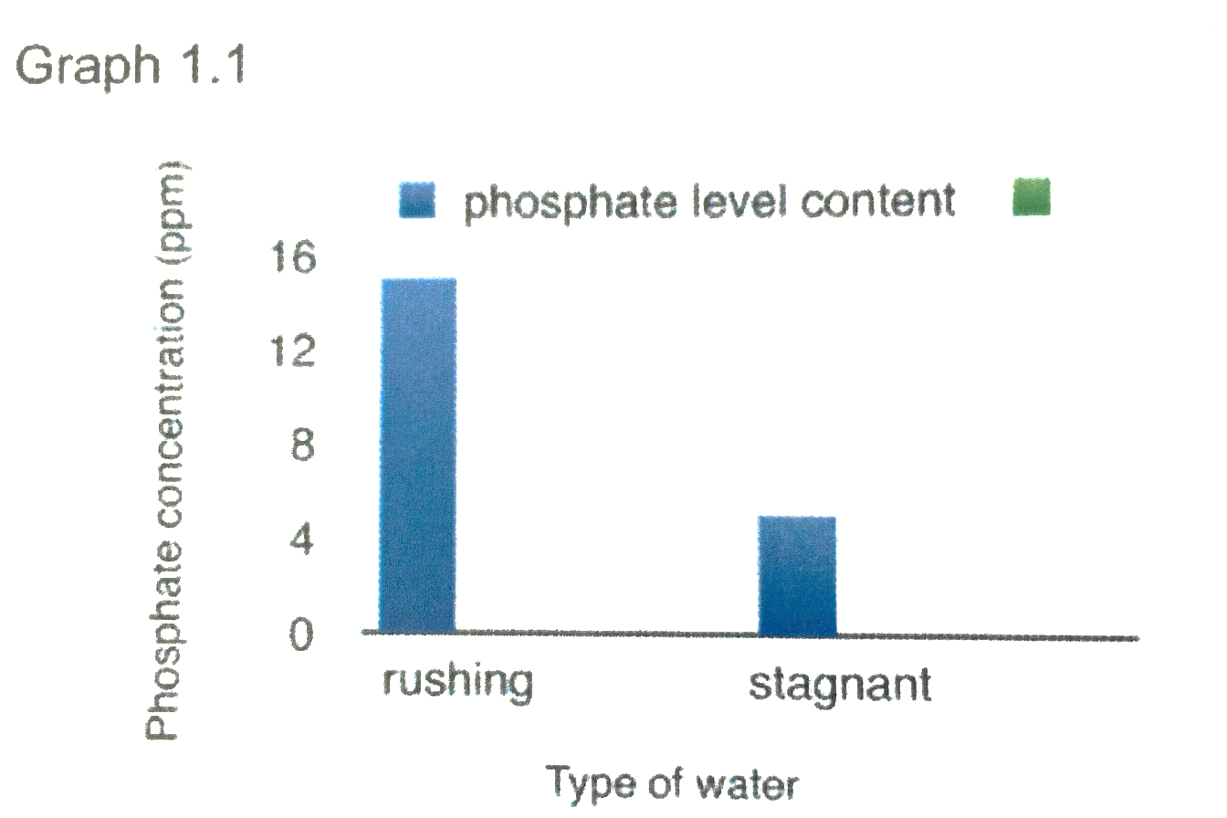
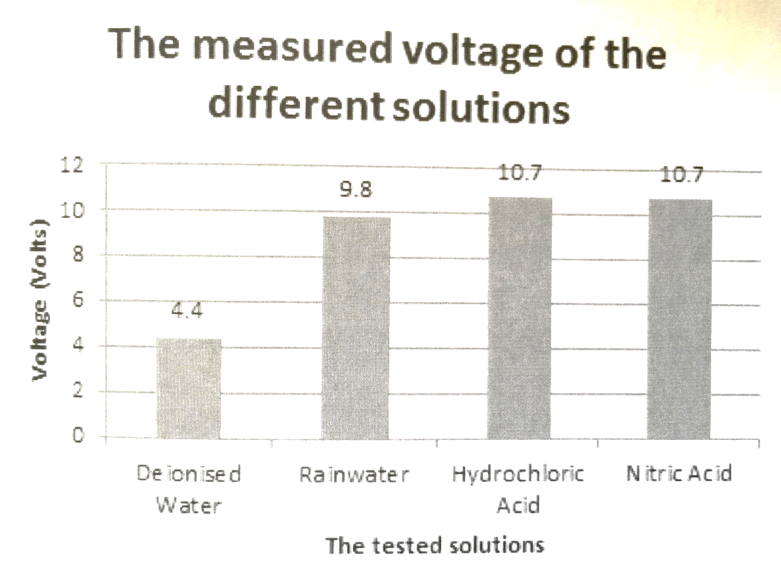

Slide 21
Unit 2 Chemistry
Practical Investigation Rubric: Planning, conducting and reporting results
Notes:
Cristy
The Skills for Unit 2 AOS3 task is divided into 2 rubrics.
Rubric 1 – planning, conducting and reporting
Rubric 2 – Analysing/Evaluating and communicating (poster)

Slide 22
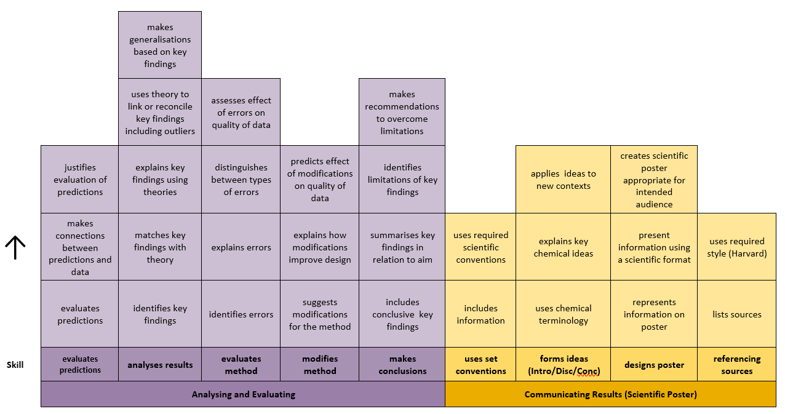
Unit 2 AOS3
Practical Investigation Rubric: Analysing and Evaluating and communicating results
Notes:
Cristy
Rubric 2 is completed under test conditions. This not only ensures authentication, but also helps students stay on track,

Slide 23
Unit 2 AOS3
Notes:
Cristy
This timeline is used to keep students on track with completing the rubric skills, and for authentication purposes. The rubric was split into 2 parts to allow students to work in pairs for the planning and conducting phases, but individually for the evaluating and communicating phases. This ensures authentication.

Slide 24
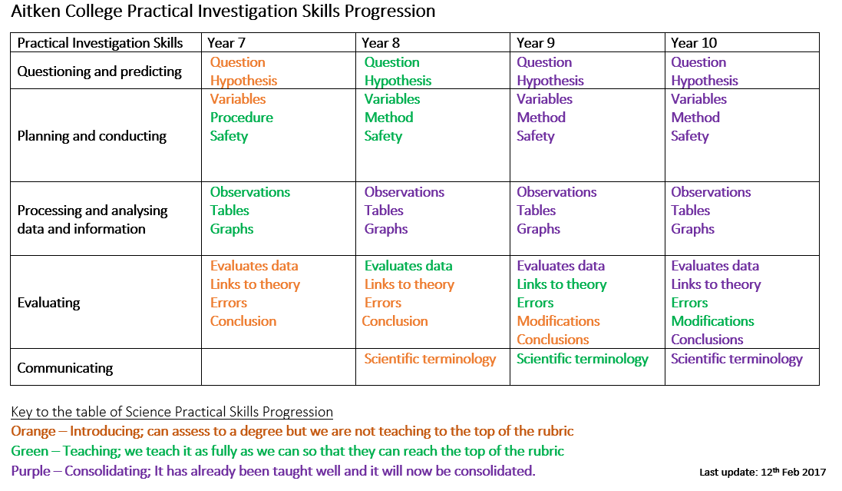
Notes:
Adele
One of the key ideas behind using skills based rubrics is that the same rubric can be used across the year levels and the sciences for assessment of experimental tasks. As a faculty we made a plan for how we would introduce the investigation skills from year 7 to 10. In year 7 there is a focus on teaching the foundational aspects. In Year 8 and 9 we begin to introduce more of the skills and start to move into the consolidation phase with skills such as how to draw tables and graphs while in Year 10 most of the skills are being consolidated. The expectation is that by the time students start Unit 1&2 they are confident in being able to use the rubrics to help them reach their potential in the tasks.

Slide 25
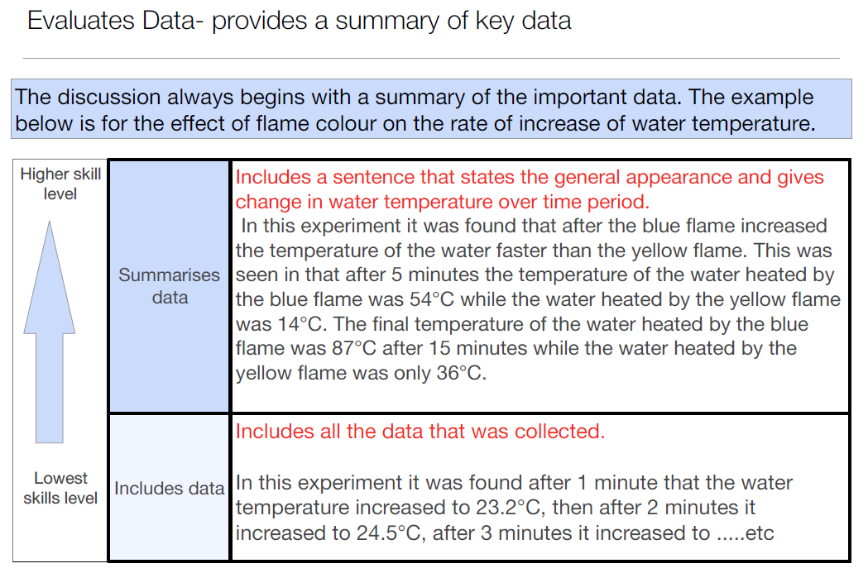
Notes:
And this is certainly what we found in the junior levels in that students can make progress during the year.
In Year 7, in their first major practical report they were provided with a model for the levels of each skill for a very similar experiment.

Slide 26
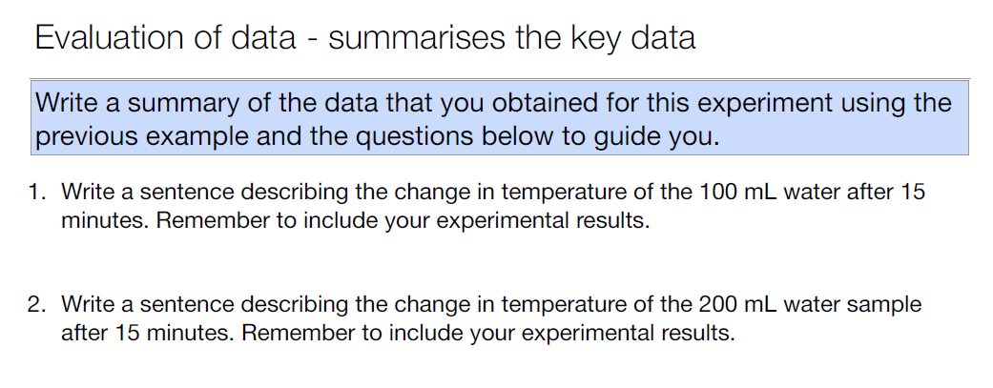
Notes:
So they then wrote their own answers using the model as the basis of their answers.

Slide 27
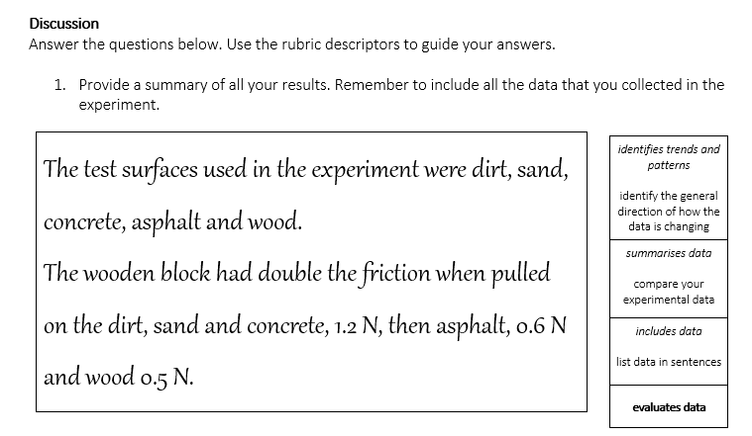
Year 7 Student Design Forces Investigation
Notes:
In this second task the students wrote their discussion in response to questions with the relevant skills next to their work. In this students answer you can see that they have summarized the data from the experiment.

Slide 28
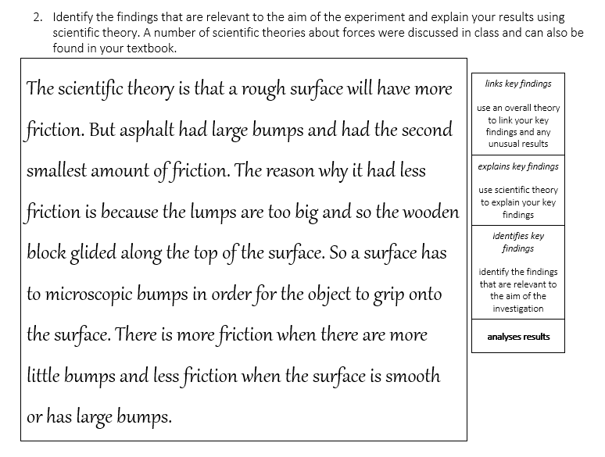
Year 7 Student Design Forces Investigation
Notes:
While in the next section where they analysed their results they identified and explained the key findings and also used an overall theory to link their findings and any unusual results.

Slide 29
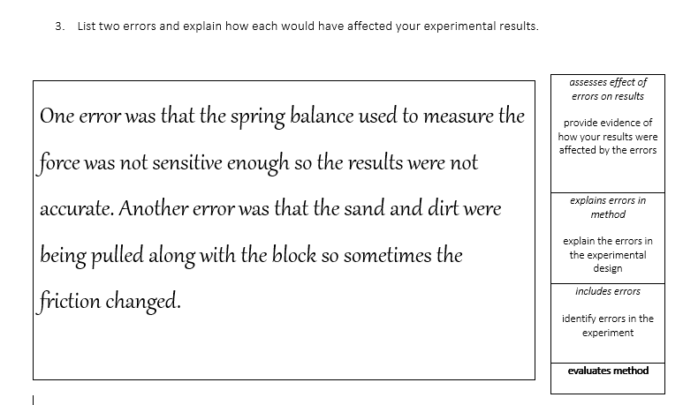
Year 7 Student Design Forces Investigation
Notes:
With their discussion on the errors, explained the errors in the method, however they didn’t assess the effect of the errors on the results.

Slide 30
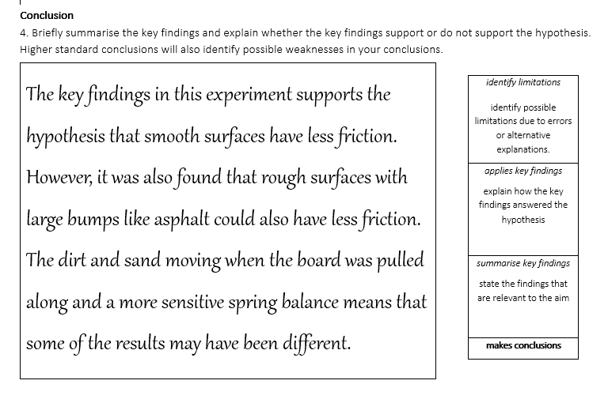
Year 7 Student Design Forces Investigation
Notes:
Finally with the conclusion they summarized their key findings, discussed how the findings answered their hypothesis and discussed the limitations of the experiment.

Slide 31
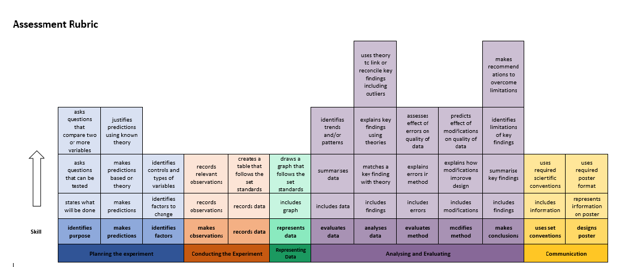
Notes:
Another benefit of using similar rubrics across year levels and the sciences is that it is possible to track student progress during the year and potentially from year to year.

Slide 32
Year 9: Improvement in skills
Notes:
Students in year 9 complete a student design investigation in first term for Physical Sciences and also in third term for Chemical Sciences. A comparison of uptake in skills between showed that 36% more of the students were able to use theory toe explain their key findings. 53% were able to explain errors in their method, 53% were able to describe their modifications and 46% were able to summarise their key findings in the conclusion.

Slide 33
Year 12 - Determination of the enthalpy changes in chemical reactions by use of calorimetry
This investigation involved the calibration of calorimeter and the use calorimetry to measure the enthalpy changes in a number of chemical reactions.
In part A the students determined the calibration factor for the calorimeter using two different techniques with the first being electrical calibration and the second being chemical calibration. In Part B the students determined the enthalpy change in an exothermic reaction, dissolution of calcium chloride while in Part C, the students determined the enthalpy change in an endothermic reaction, the dissolution of potassium nitrate.
Student 1
In Part A the temperature changes were 4.8ºC for trial 1 and 4.6ºC for trial 2. The temperature changed in a linear manner as the system as electrical energy is being transformed into thermal energy. Technique 2 also showed similar changed in temperature 4.9ºC and 4.8ºC.
Part B had differences in temperature of 3.5ºC, 3.4ºC and 3.5ºC. Part C had a change in temperature of 1.8ºC, 1.8ºC and 1.7ºC.
Student 2
Using the electric heating method the calculated calibration factor was 357 J.ºC⁻¹ while using the chemical calibration technique gave a calibration factor of 526.8 J.ºC⁻¹. The heat of dissolution of calcium chloride was -42.7 kJ.mol⁻¹ using the first calibration factor and -63.08 kJ.mol⁻¹ using the second calibration factor.
The heat of dissolution of potassium nitrate was +24.3 kJ.mol⁻¹ using the first calibration factor and +35.9 kJ.mol⁻¹ using the second.
The heat of dissolution values calculated using chemical calibration for both calcium chloride and potassium nitrate were more accurate in that they were closer to the known value of -82.8 kJ.mol⁻¹ for dehydrated calcium chloride and +35.0 kJ.mol⁻¹ for potassium nitrate.
evaluates quality of data
summarises data
lists data
reports data
Notes:
We are now going to give you an opportunity to use the rubrics to assess a couple of students for two of the skills, reporting data and also modifying the method.
When marking students work I usually start from the bottom to see whether they have achieved the first skill and then progress upwards.
For reporting data I would say that student 1 has listed the data but they haven’t summarized the data, while student 2 has not only summarized the data but they have also evaluated the quality of the data.

Slide 34
Year 12 - Determination of the enthalpy changes in chemical reactions by use of calorimetry
Student 1
The two calibration factors from part A did not result in an enthalpy of dissolution for calcium chloride that was close to the expected value of -89.9 kJ.mol⁻¹. This may have been due to the calcium chloride becoming hydrated which would have lowered the enthalpy value. Modifications to the design of the experiment would have been to heat the calcium chloride before use to make sure that it was dehydrated before use.
Student 2
A modification to the design of the experiment is to specify that the calcium chloride be heated before use to ensure that only dehydrated calcium chloride was present. Monohydrated calcium chloride has an enthalpy of dissolution of -49 kJ.mol⁻¹ compared to -82.9 kJ.mol⁻¹ for dehydrated calcium chloride as energy is required to break the ion-dipole bonds between the water and calcium chloride. By ensuring that all of the calcium chloride was dehydrated before the reaction then this would mean that there would be more energy released when it was dissolved improving the accuracy of the result.
predicts how modifications improve the quality of the data
explains how modifications improve the design
identifies modifications
modifies method
Notes:
With modification skills student 1 explained how the modifications would improve the design of the experiment while student 2 discussed how the modification would improve the quality of the data.

Slide 35
Key Ideas
Rubrics based on developmental progressions enables
  introduction of key skills from year 7 in preparation for VCE
  skill progression to be made visible to students
  consistent assessment across all year levels and sciences
  tracking of student progress
Notes:
Final notes

Slide 36
Using Skills Based Rubrics in Area of Study 3
Reflections from the classroom
STAV VCE Chemistry Conference 2017
Cristy Herron Adele Hudson
cherron@aitkencollege.edu.au ahudson@aitkencollege.edu.au
Resources can be obtained from www.mychemhub.com

