Slide 1

A practical report template for the analysis and evaluation of primary data
Adele Hudson and Sumiran Jyot
Aitken College
STAV VCE Conference, 15 February 2023, University of Melbourne
ahudson@aitkencollege.edu.au sjyot@aitkencollege.edu.au
Resources – www.mychemhub.com
Notes:
ADH

Slide 2
Principles behind curriculum design
Design of projects is based on 7 principles of GIST
Focus
hands-on learning
context-based learning
problem solving tasks
collaborative learning
Notes:
ADH

Slide 3
BENEFITS OF Context- BASED learning
For students
Stronger connection to subject
Stronger connections within class
Stronger connections to content
For teachers
Efficient way to develop new SACs by use new context with same measurement techniques
Unique contexts decrease potential for plagiarism
Notes:
ADH

Slide 4
TASK OBJECTIVES
Students
work collaboratively
are scaffolded in design
experience familiar structure across Unit 1& 2 and Unit 3&4
further develop experimental skills in volumetric analysis (11 & 12), and colourimetry (11)
apply understanding of calculations in stoichiometry and concentrations
focus on error analysis; prepares students for Q8, VCAA VCE Chem exam
Notes:
ADH

Slide 5
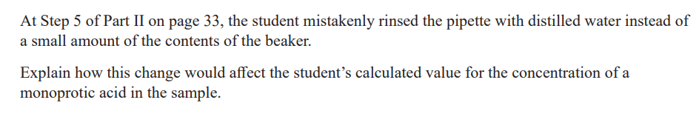
TASK OBJECTIVES
Students
work collaboratively
are scaffolded in design
further develop skills in volumetric analysis (11 & 12), and colourimetry (11)
apply understanding of calculations in stoichiometry and concentrations
focus on error analysis; prepares students for Q8, VCAA VCE Chem exam
Notes:
ADH

Slide 6
TASK OVERVIEW
 | Unit 2 AOS2 | Unit 4 AOS1
Lesson 1 | Planning and design | Planning and design
Lesson 2 | Experiment: Make citric acid biosorbent | Experiment: Set up treatment of beverages
Lesson 3 | Experiment: Add biosorbent to wastewater | Experiment: Volumetric analysis of vitamin C on control & treated samples
Lesson 4 | Experiment: Volumetric analysis of citric acid | Complete calculations, write observations and error analysis
Lesson 5 | Experiment: Analyse control and treated copper wastewater | Complete analysis and evaluation under test conditions in 50 min
Lesson 6 | Complete analysis and evaluation under test conditions in 50 min
Notes:
SUJ

Slide 7
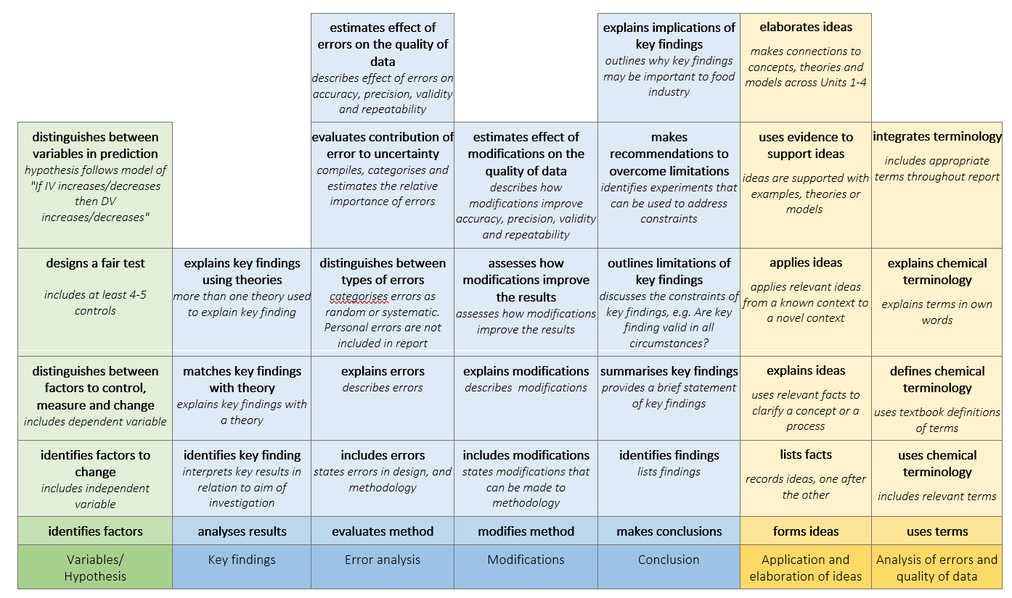
ASSESSMENT RUbRIC
Unit 1&2 and Unit 3&4
Note: Rubric will be updated to 40 marks in 2024
Notes:
SUJ

Slide 8
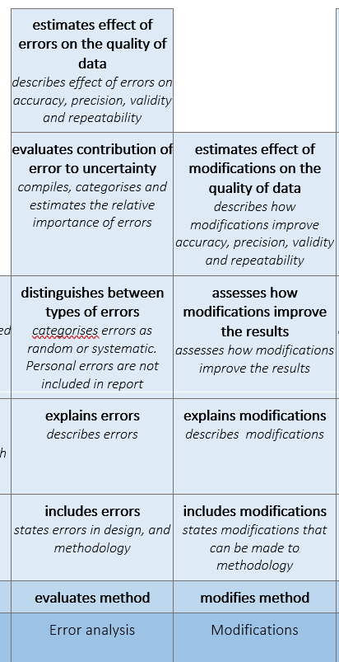
ASSESSMENT RUbRIC
Unit 1&2 and Unit 3&4
Error analysis
Categorises errors as random or systematic
Students estimate relative importance of errors
Estimates the effect on data
Notes:
SUJ

Slide 9
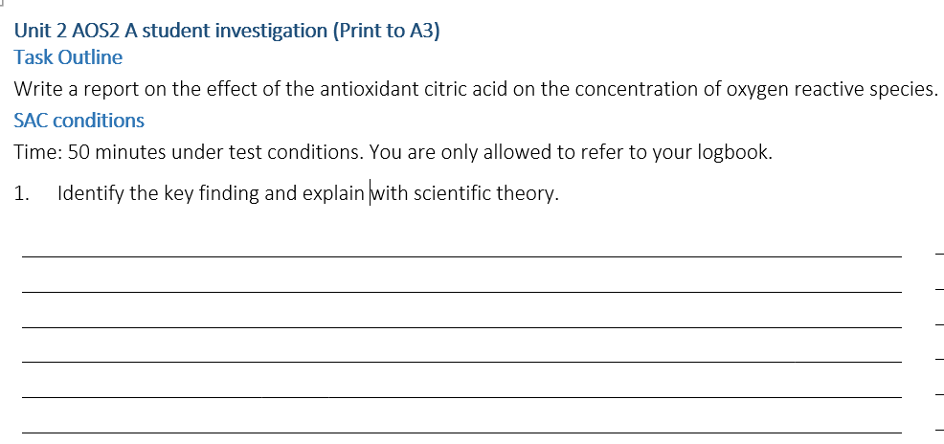
TEMPLATE
Three sections
Identify and explain key finding
Error analysis
Conclusion
Notes:
SUJ

Slide 10
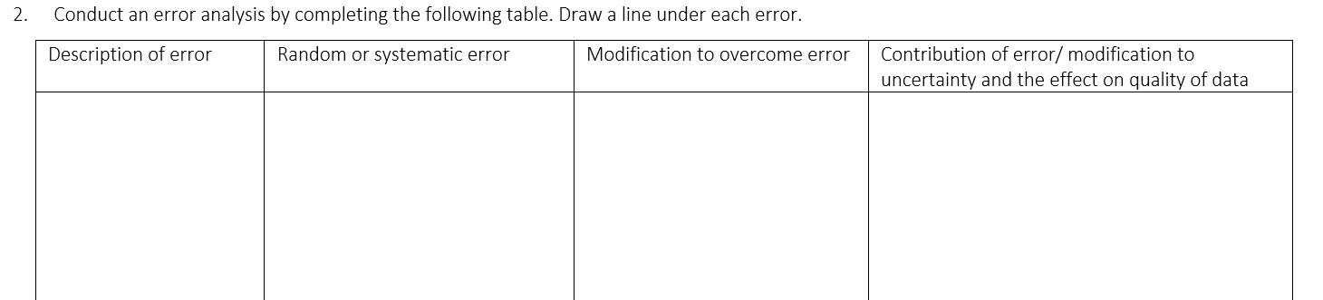
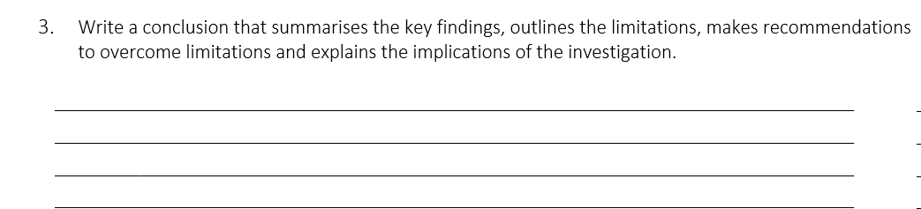
TEMPLATE
Three sections
Identify and explain key finding
Error analysis
Conclusion
Notes:
SUJ

Slide 11
Unit 2 AOS2
The production of citric acid biosorbents for removal of heavy metals
Context
Heavy metal pollution of waterways is a concern in that it has detrimental effects on the natural environment and human health. Copper is a heavy metal which is used extensively in manufacturing and agriculture and has a range of entry points to the water cycle, such as storm water runoff from roads or mining sites or waste streams from mining or manufacturing.
Citric acid is used as a natural chelating agent for the binding of metals in soil remediation and has been shown to accumulate high levels of copper (Shinta, 2021). In this assessment task you will investigate how to make a biosorbent using natural substrates and citric acid for removal of copper from wastewater streams.
Notes:
ADH

Slide 12
Unit 2 AOS2
The production of citric acid biosorbents for removal of heavy metals
Task outline
Work in a group of four to plan an investigation into the use of citric acid biosorbents for the removal of the heavy metal, copper from industrial wastewater.
Use volumetric analysis to measure the concentration of the citric acid before and after binding with the biosorbent.
Individually complete the logbook during class time. The analysis and evaluation of your results will be completed individually in 50 minutes under test conditions
Treat a copper contaminated wastewater sample with the citric biosorbent and the amount remaining will be measured using colourimetry.
Notes:
ADH

Slide 13
Unit 2 AOS2
The production of citric acid biosorbents for removal of heavy metals
Planning and design
Complete the aim, variables and hypotheses in your logbook. You will need to determine as a team;
whether you will select straw, wheat bran or coir as substrate
the most effective process to bind the citric acid to the substrate
how to use biosorbent to remove copper sulphate from wastewater.
Notes:
ADH

Slide 14
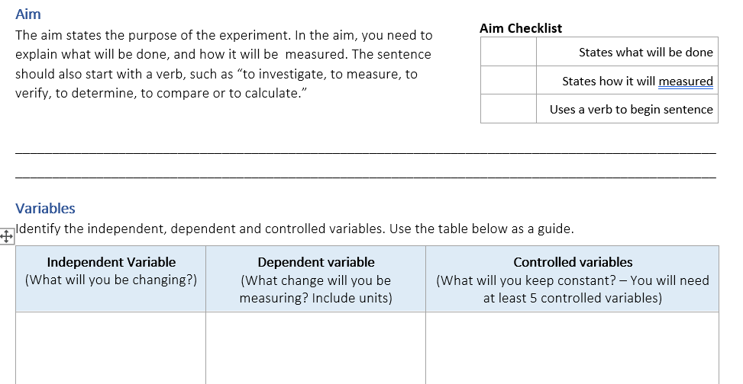
Unit 2 AOS2
The production of citric acid biosorbents for removal of heavy metals
Planning and design
Complete the aim, variables and hypotheses in your logbook. You will need to determine as a team;
whether you will select straw, wheat bran or coir as substrate
the most effective process to bind the citric acid to the substrate
how to use biosorbent to remove copper sulphate from wastewater.
Notes:
ADH

Slide 15
Unit 2 AOS2
The production of citric acid biosorbents for removal of heavy metals
Write the procedure to make 1000 mL of 3.0 % m/v citric acid solution, with 500 mL for treatment and control. Insert details into Risk Assess.
Tasks
Update the procedure for volumetric analysis of citric acid. Write a procedure for adding the biosorbent to the copper sulphate wastewater sample. Insert details into Risk Assess. Design the results table for the volumetric analysis.
Write the procedure for binding citric acid to the substrate and treating the simulated wastewater with the biosorbent. Insert details into Risk Assess.
Update the procedure for the measurement of copper sulphate by colourimetry. Insert details into Risk Assess. Design the results table for the colourimetric analysis.
Notes:
ADH

Slide 16
Unit 2 AOS2
The production of citric acid biosorbents for removal of heavy metals
Conducting investigation
Lesson 2 Preparation of biosorbent
24 -60 hours drying time
Lesson 3 Volumetric analysis of citric acid
Two students measure control
Two students measure treated sample
Lesson 4 Colourimetric analysis of copper sulphate
Two students measure control
Two students measure treated sample
Notes:
ADH

Slide 17
Unit 2 AOS2
The production of citric acid biosorbents for removal of heavy metals
Procedures and laboratory technician notes are included in booklet
Conducting investigation
Lesson 2 Preparation of biosorbent
24 -60 hours drying time
Lesson 3 Volumetric analysis of citric acid
Two students measure control
Two students measure treated sample
Lesson 4 Colourimetric analysis of copper sulphate
Two students measure control
Two students measure treated sample
Notes:
ADH

Slide 18
Unit 4 AOS1
Effect of transportation conditions on the vitamin C content in beverages
Context
Vitamin C is an important micronutrient for bone healing, production of collagen and helping our body absorb iron. Although reasonably stable in solid form, vitamin C readily degrades in aqueous solutions. This poses a challenge for beverage manufacturers to maintain the vitamin C concentration between production and consumption. In this investigation you will investigate the effect of factors related to transportation on the vitamin C concentration in beverages.
Notes:
ADH

Slide 19
Unit 4 AOS1
Effect of transportation conditions on the vitamin C content in beverages
Task outline
Work in pairs to plan an investigation into the effect of transportation conditions on the vitamin C content in beverages
Select one of the following treatments:
Fluorescent light, UVA light, moderate heat, room temperature
Individually complete the logbook during class time. The analysis and evaluation of your results will be completed individually in 50 minutes under test conditions
Analyse vitamin C content using redox titration. One team member will analyse control, the other the treated sample
Notes:
SUJ

Slide 20
Unit 4 AOS1
Effect of transportation conditions on the vitamin C content in beverages
Conducting investigation
Lesson 1 Plan and design investigation
Lesson 2 Set up treatment of beverages
Lesson 4 Complete calculations, error analysis and observations
Lesson 3 Volumetric analysis of vitamin C
1st student measures control
2nd student measures treated sample
Lesson 5 Complete write up under test conditions
Notes:
SUJ

Slide 21
Unit 4 AOS1
Effect of transportation conditions on the vitamin C content in beverages
Procedures and laboratory technician notes are included in booklet
Conducting investigation
Lesson 1 Plan and design investigation
Lesson 2 Set up treatment of beverages
Lesson 4 Complete calculations, error analysis and observations
Lesson 3 Volumetric analysis of vitamin C
1st student measures control
2nd student measures treated sample
Lesson 5 Complete write up under test conditions
Notes:
SUJ

Slide 22
A practical report template for the analysis and evaluation of primary data
Adele Hudson and Sumiran Jyot
Aitken College
STAV VCE Conference, 15 February 2023, University of Melbourne
ahudson@aitkencollege.edu.au sjyot@aitkencollege.edu.au
Resources – www.mychemhub.com
Notes:
ADH

