Slide 1

Collaboration in Chemistry
Building Confidence and Exam Readiness
Adele Hudson
Braemar College
Jisha Mathew
Hume Anglican Grammar
www.mychemhub.com

Slide 2
STAGE 1
Building a Collaborative Classroom
STOP LIGHTS

Slide 3
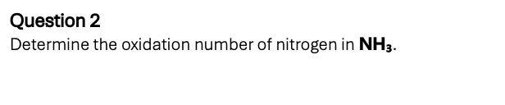
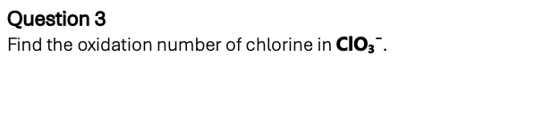
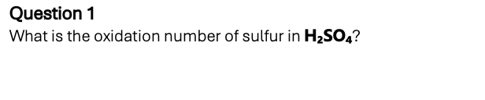
STAGE 1
Building a Collaborative Classroom
STOP LIGHTS

Slide 4
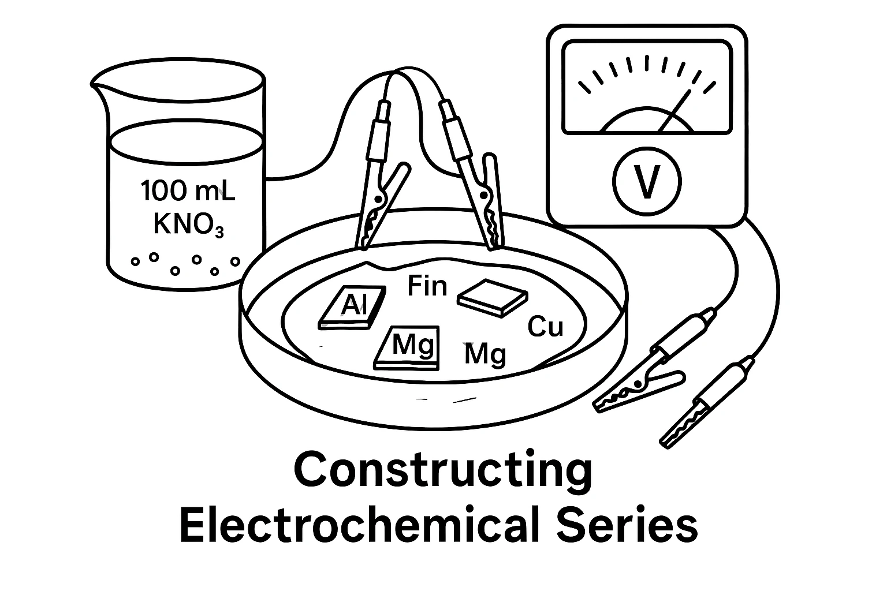
STAGE 1
Building a Collaborative Classroom
EXPERIMENTS

Slide 5
STAGE 1
Building a Collaborative Classroom
Focus points for presentation:
How was the order of electrochemical series determined?
Was it the same as the Databook?
If not, why is it different?
EXPERIMENTS
Is your series different from the other groups?
If yes, why do think it is?

Slide 6

STAGE 1
Building a Collaborative Classroom
TRIPLE D
Deep Dive Duos

Slide 7
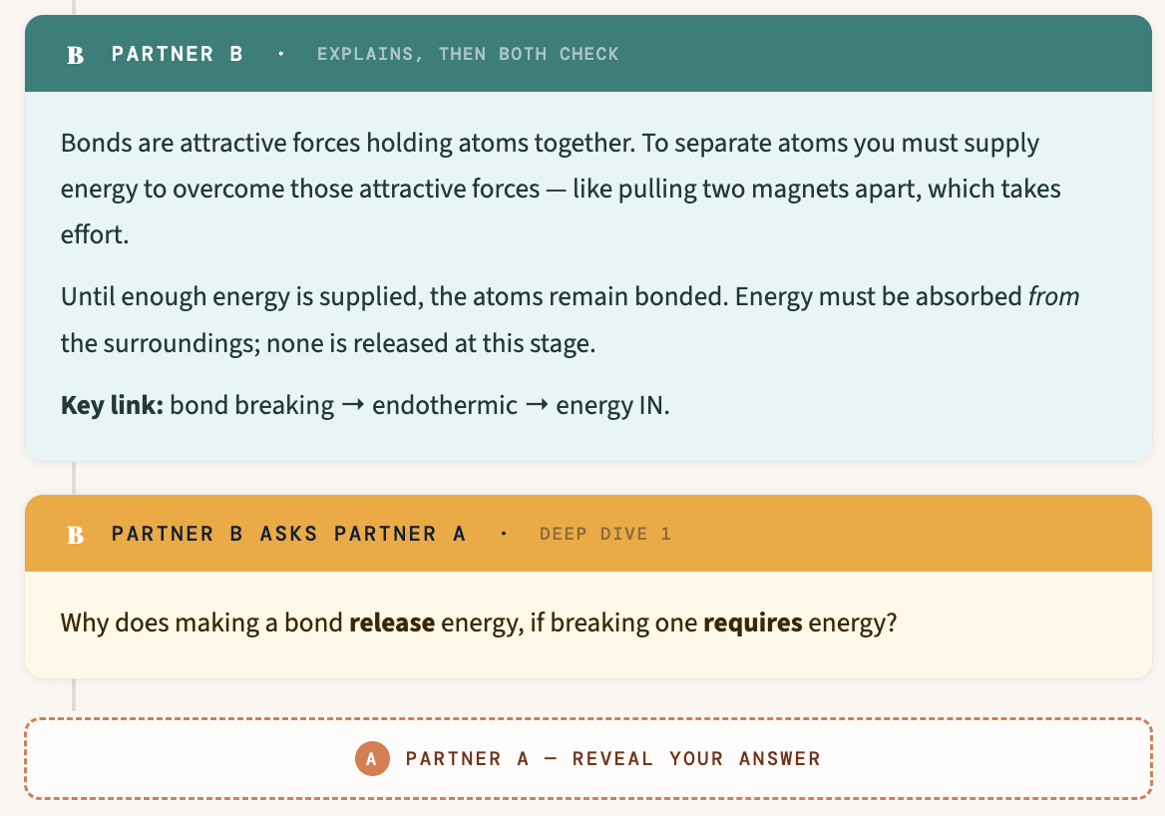
STAGE 1
Building a Collaborative Classroom
TRIPLE D
Deep Dive Duos

Slide 8
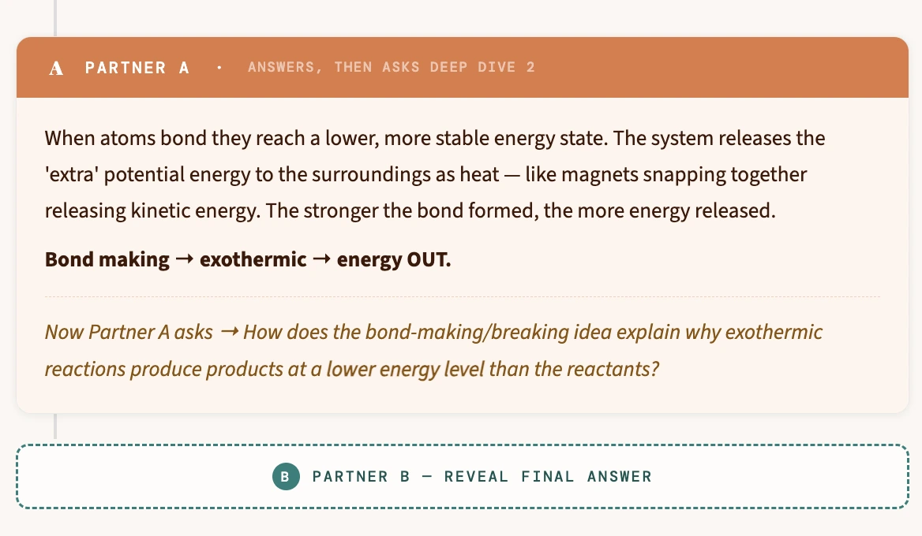
STAGE 1
Building a Collaborative Classroom
TRIPLE D
Deep Dive Duos

Slide 9
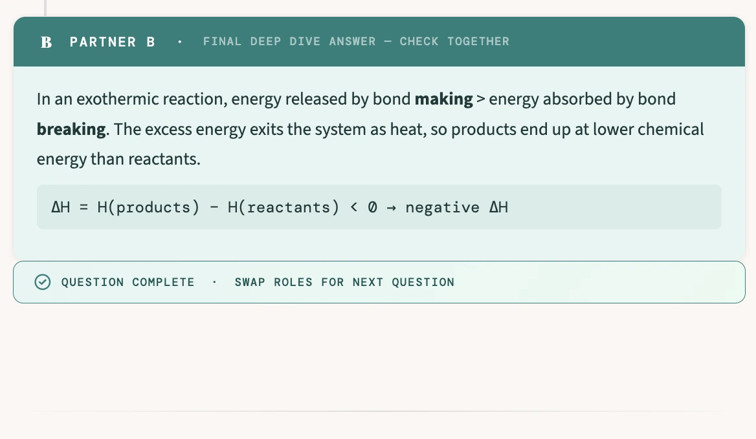
STAGE 1
Building a Collaborative Classroom
TRIPLE D
Deep Dive Duos

Slide 10
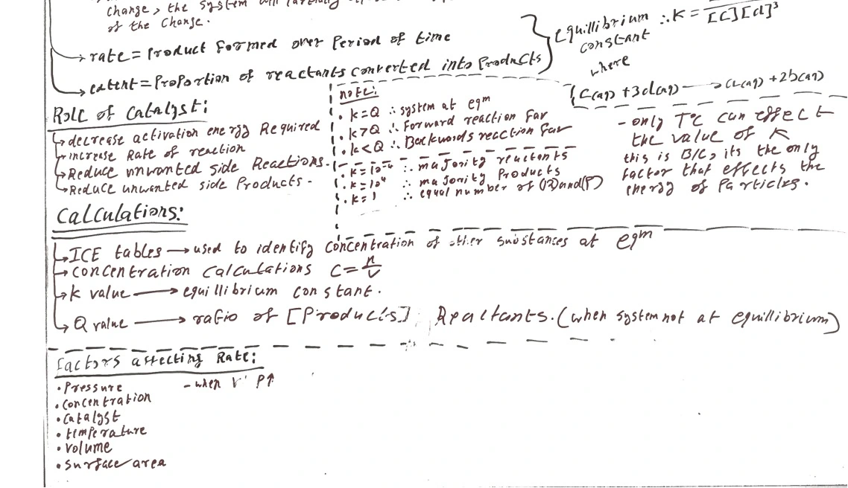
STAGE 1
Building a Collaborative Classroom
Whiteboards & Peer Teaching
Equilibrium revision
Student work

Slide 11
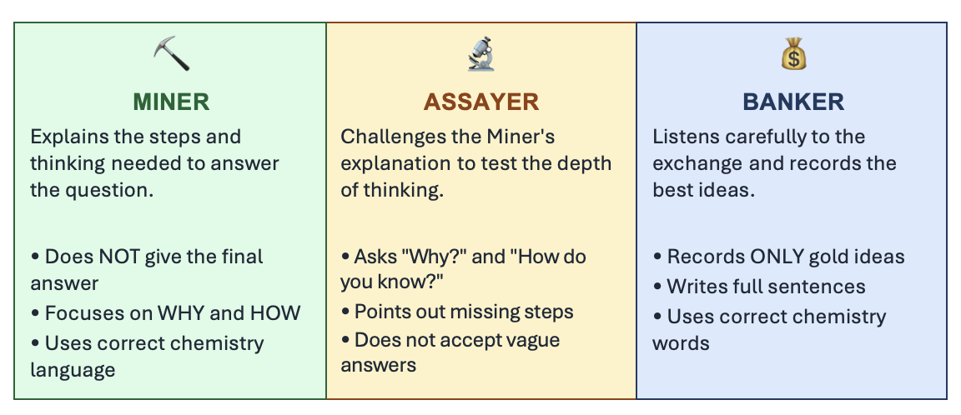
STAGE 1
Building a Collaborative Classroom
Dig for Gold

Slide 12
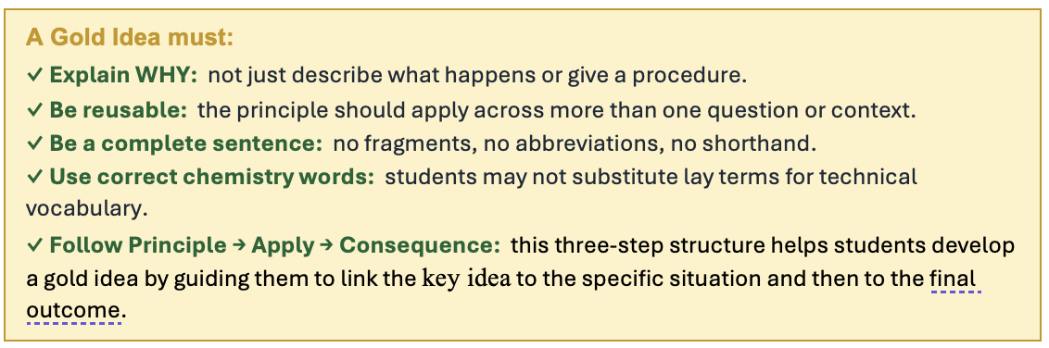
STAGE 1
Building a Collaborative Classroom
Dig for Gold
"Could you use this idea to answer a different question on the same topic?"
If yes → bank it. If no → refine it first.

Slide 13
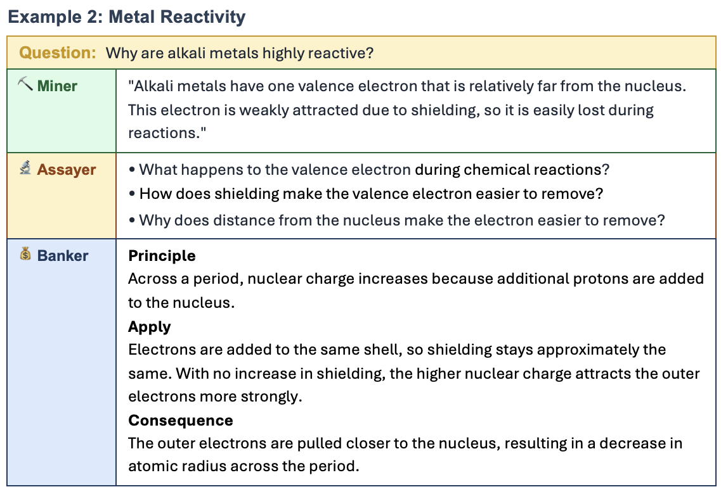
STAGE 1
Building a Collaborative Classroom
Dig for Gold

Slide 14
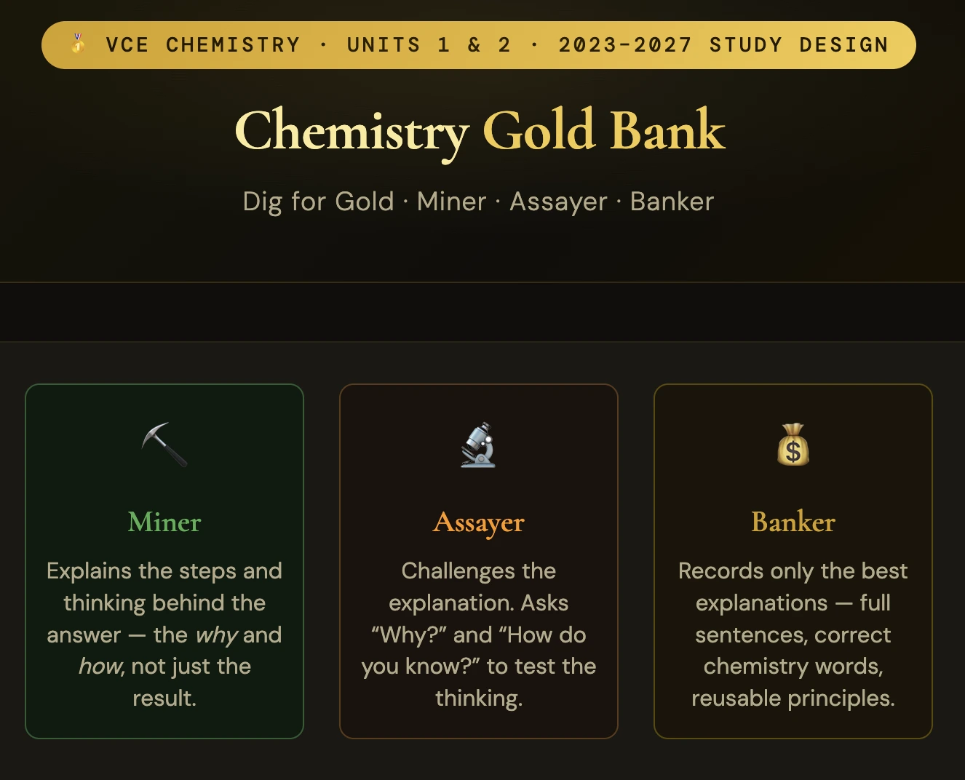
STAGE 1
Building a Collaborative Classroom
Gold Bank

Slide 15
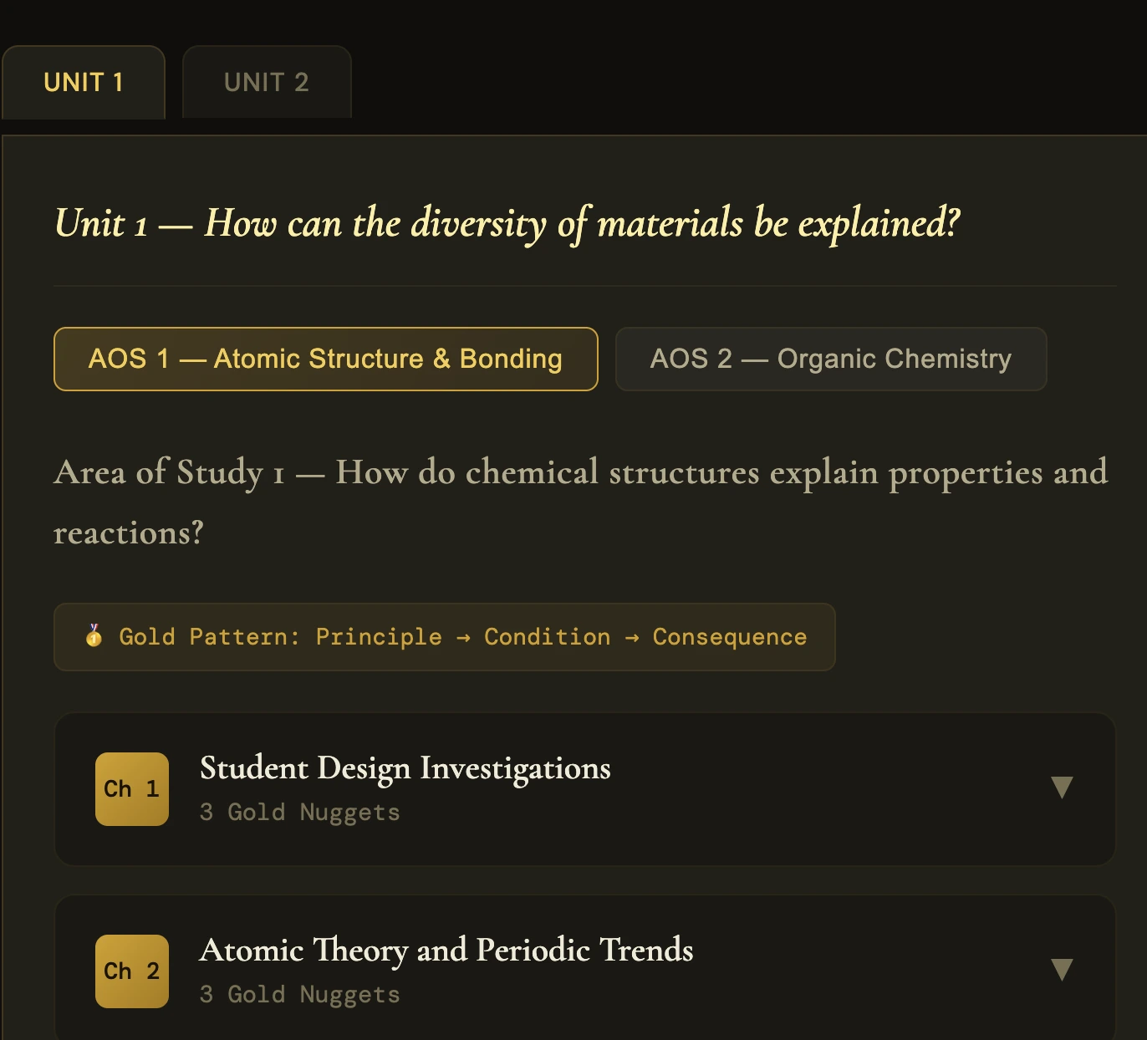
STAGE 1
Building a Collaborative Classroom
Gold Bank

Slide 16
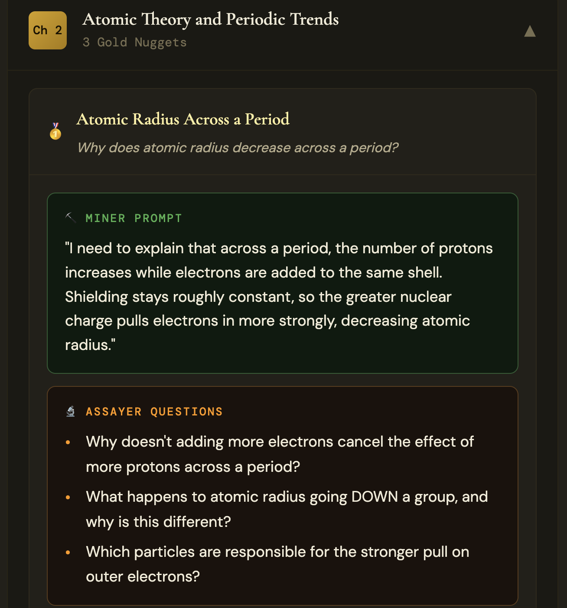
STAGE 1
Building a Collaborative Classroom
Gold Bank

Slide 17
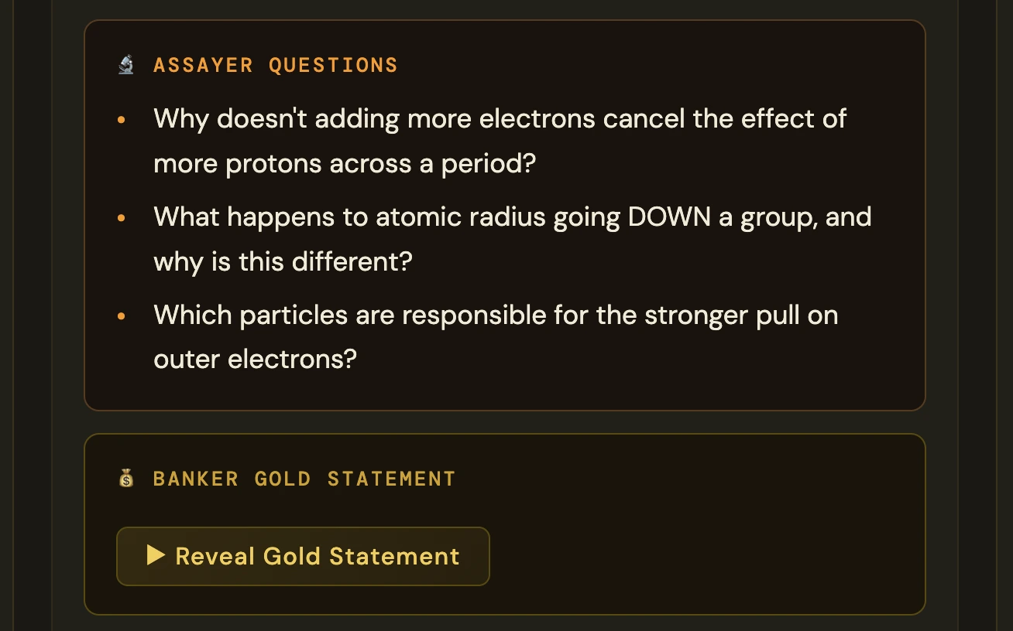
STAGE 1
Building a Collaborative Classroom
Gold Bank

Slide 18
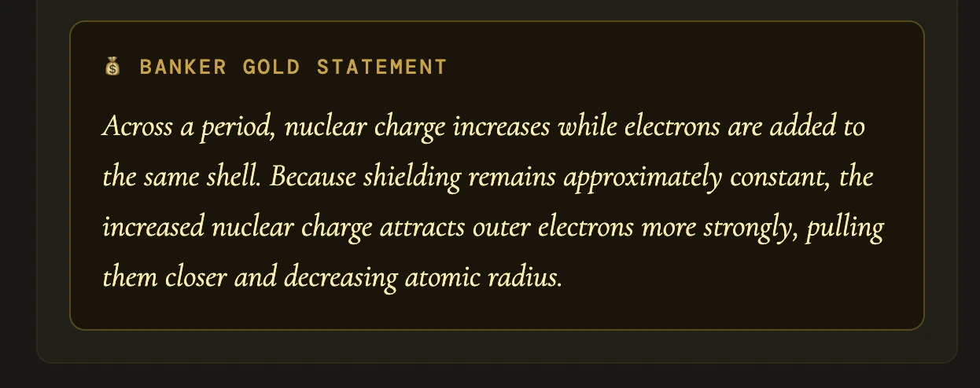
STAGE 1
Building a Collaborative Classroom
Gold Bank

Slide 19
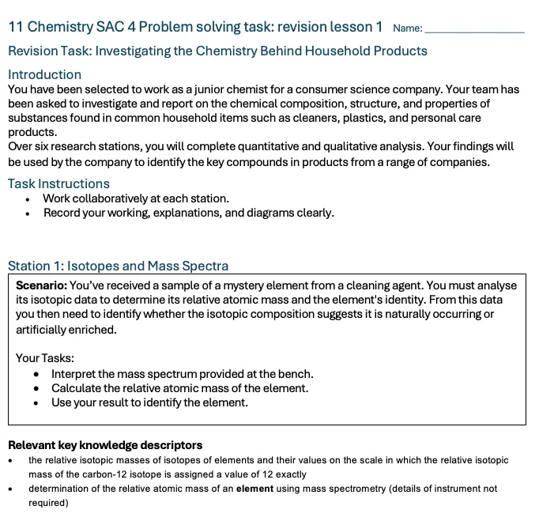
STAGE 2
Preparing for SACs
Station Activities

Slide 20
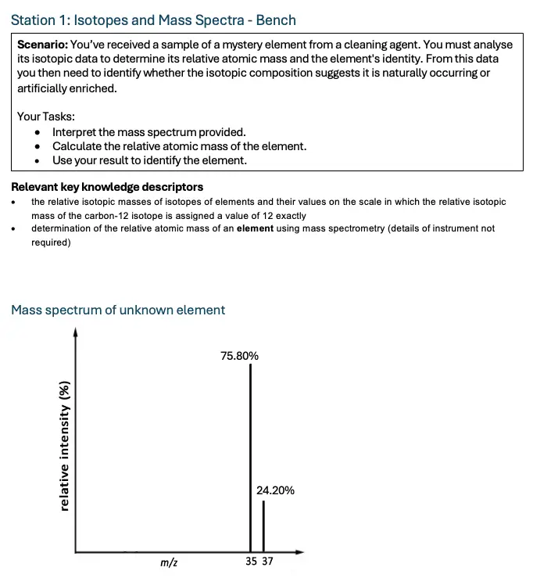
STAGE 2
Preparing for SACs
Station Activities

Slide 21
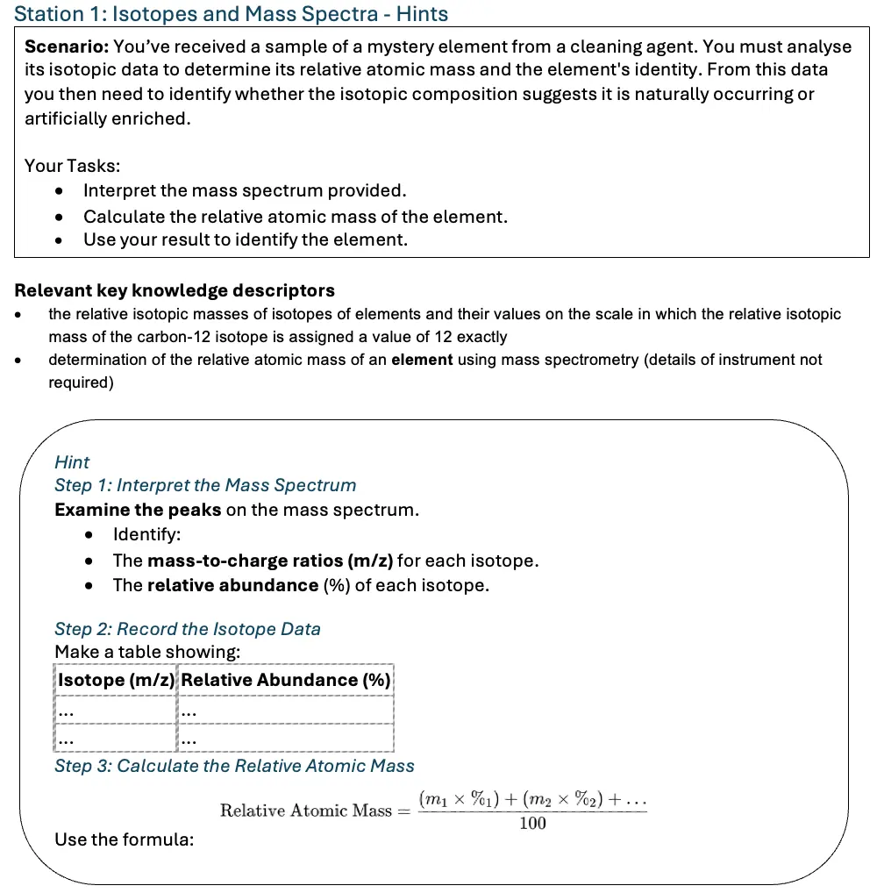
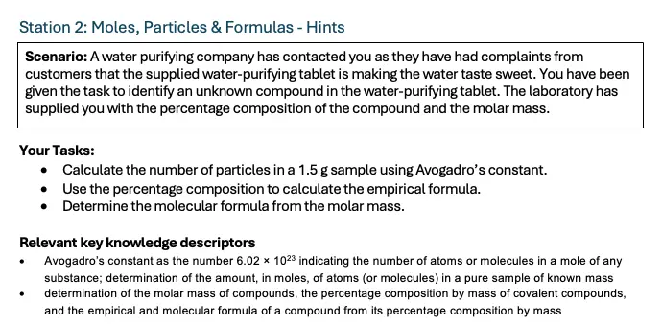
STAGE 2
Preparing for SACs
Station Activities

Slide 22
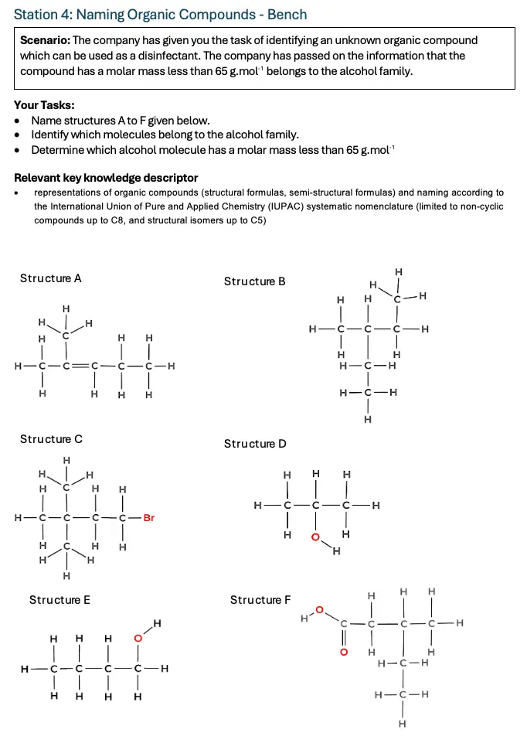
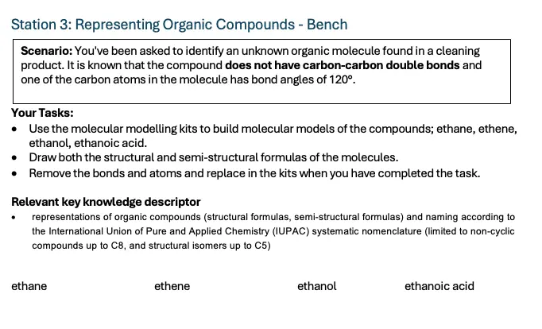
STAGE 2
Preparing for SACs
Station Activities

Slide 23
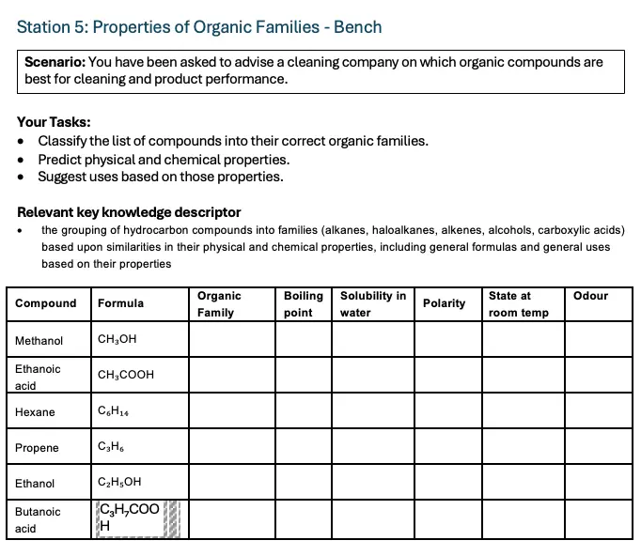
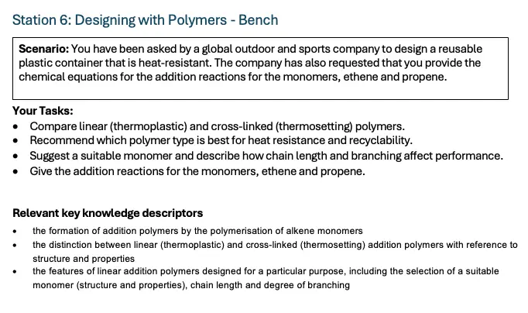
STAGE 2
Preparing for SACs
Station Activities

Slide 24
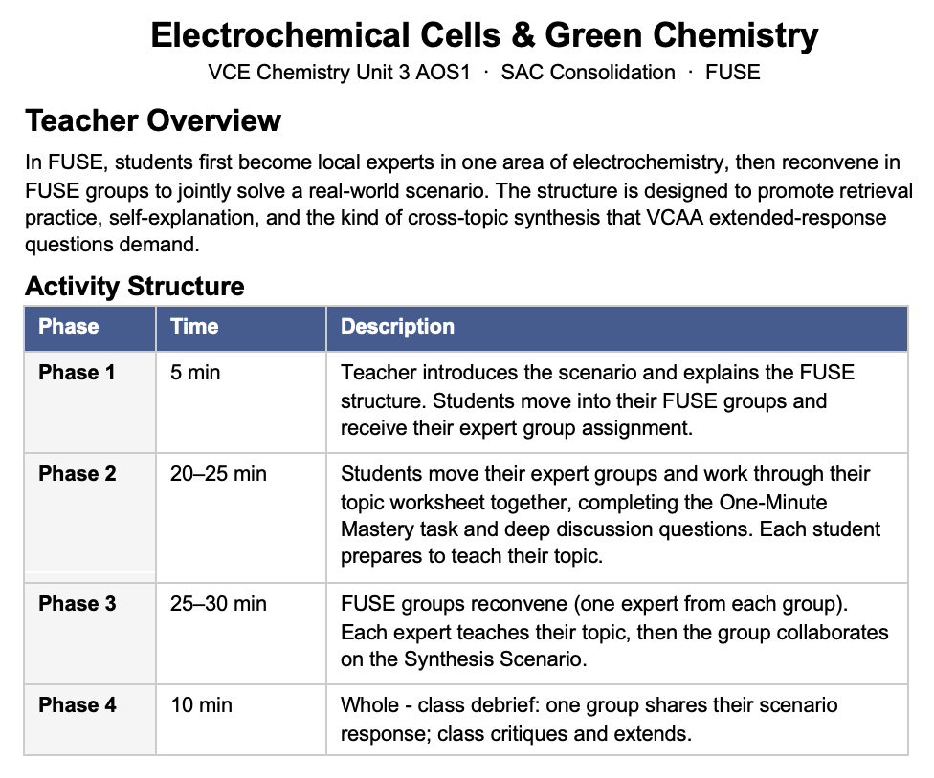
STAGE 2
Preparing for SACs
FUSE
A New Take on Jigsaw
Form, Understand, Share, Explain

Slide 25
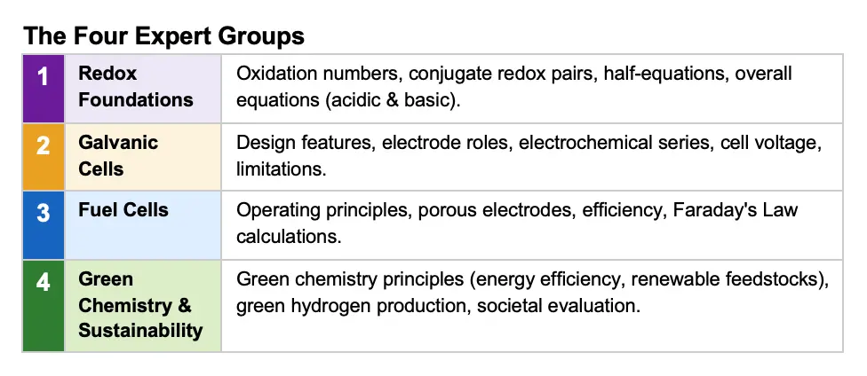
STAGE 2
Preparing for SACs
FUSE
A New Take on Jigsaw
Form, Understand, Share, Explain

Slide 26
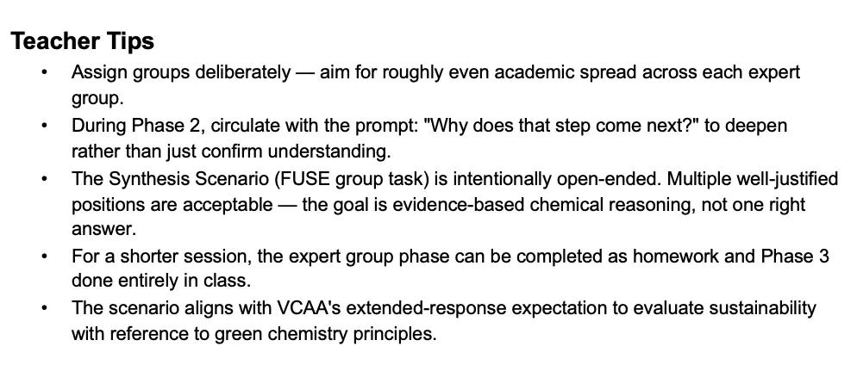
STAGE 2
Preparing for SACs
FUSE
A New Take on Jigsaw
Form, Understand, Share, Explain

Slide 27
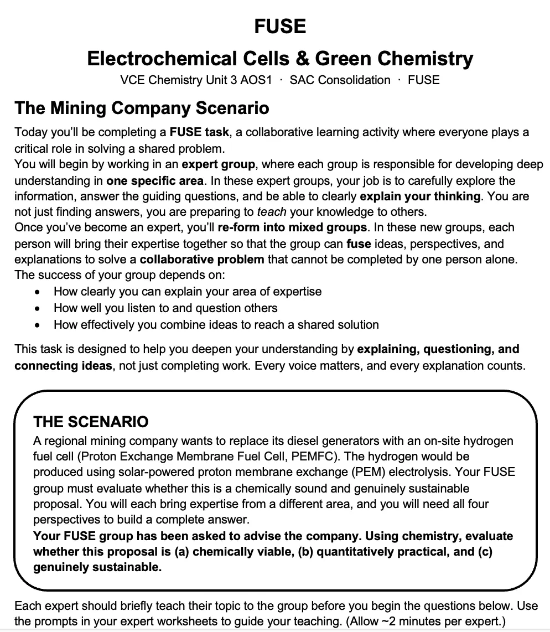
STAGE 2
Preparing for SACs
FUSE
A New Take on Jigsaw
Form, Understand, Share, Explain

Slide 28
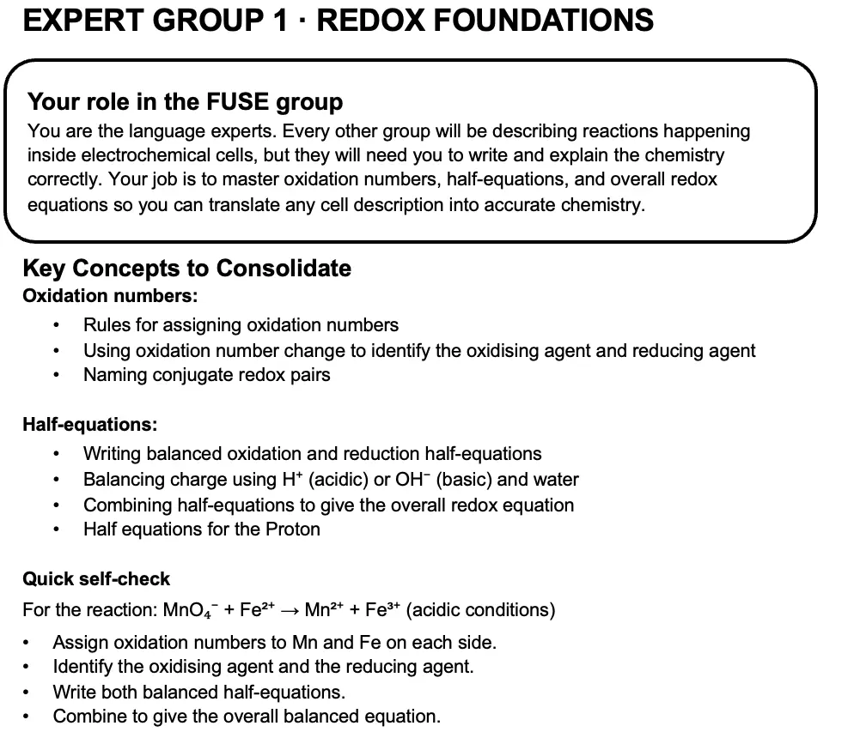
STAGE 2
Preparing for SACs
FUSE
A New Take on Jigsaw
Form, Understand, Share, Explain

Slide 29
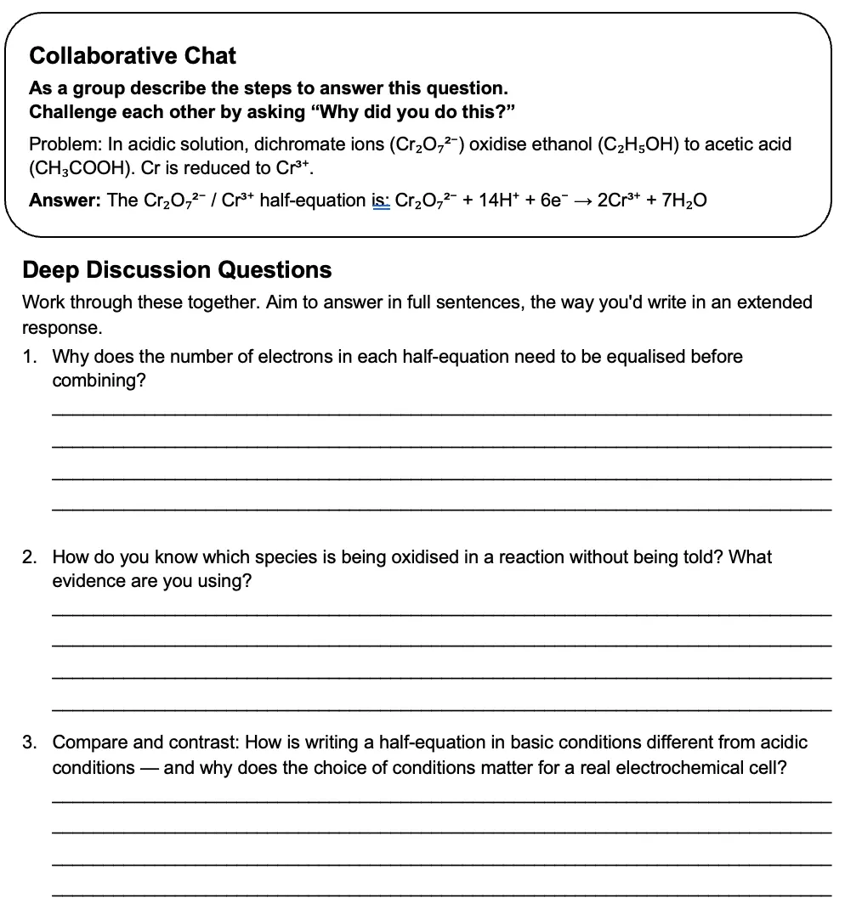
STAGE 2
Preparing for SACs
FUSE
A New Take on Jigsaw
Form, Understand, Share, Explain

Slide 30
STAGE 2
Preparing for SACs
FUSE
A New Take on Jigsaw
Form, Understand, Share, Explain

Slide 31
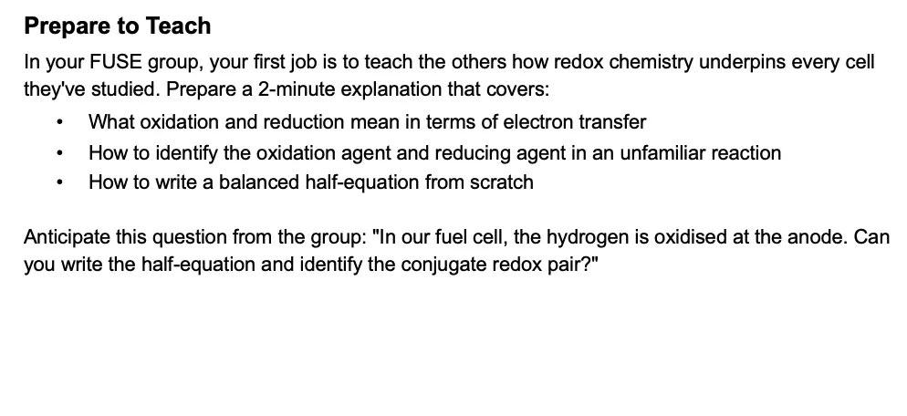
STAGE 2
Preparing for SACs
FUSE
A New Take on Jigsaw
Form, Understand, Share, Explain

Slide 32
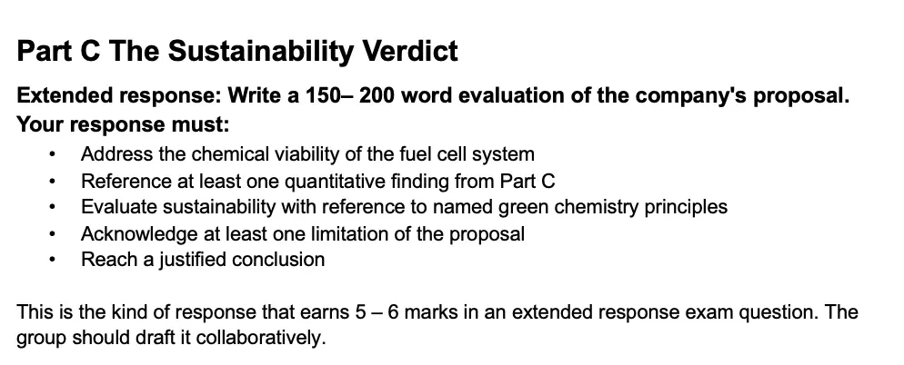
STAGE 2
Preparing for SACs
FUSE
A New Take on Jigsaw
Form, Understand, Share, Explain

Slide 33
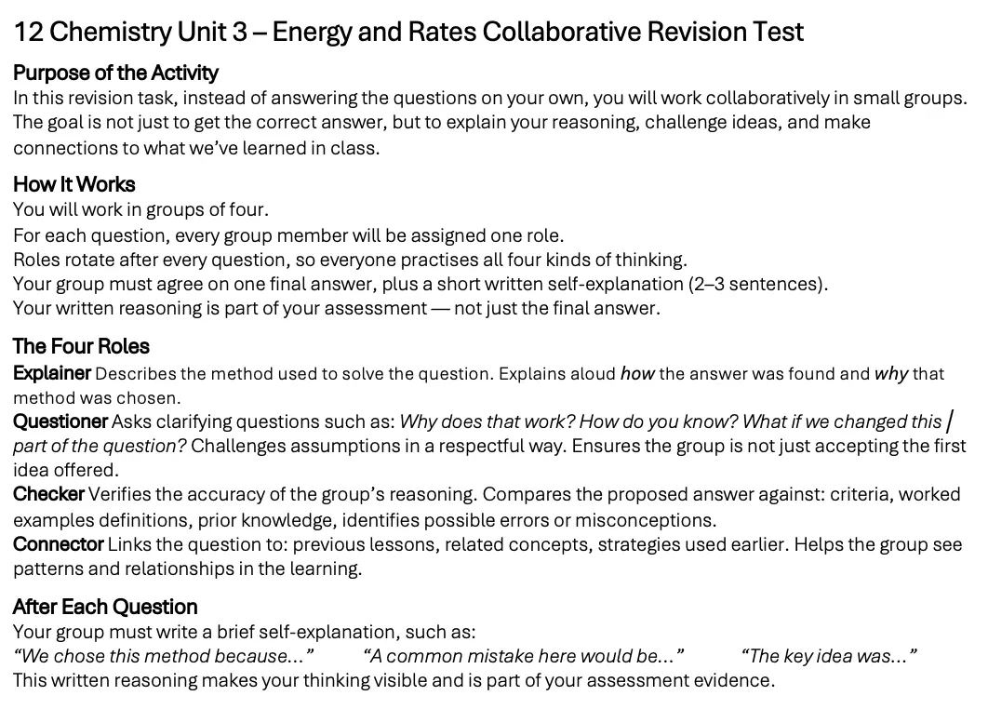
STAGE 2
Preparing for SACs
Collaborative Revision Task

Slide 34
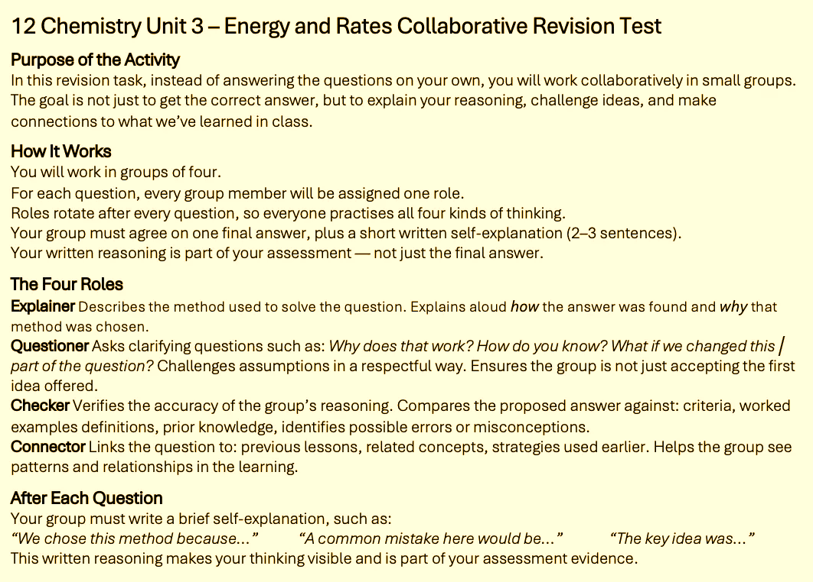
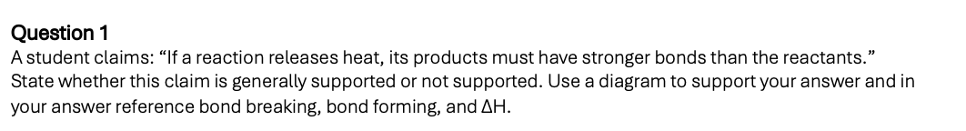
STAGE 2
Preparing for SACs
Collaborative Revision Task

Slide 35
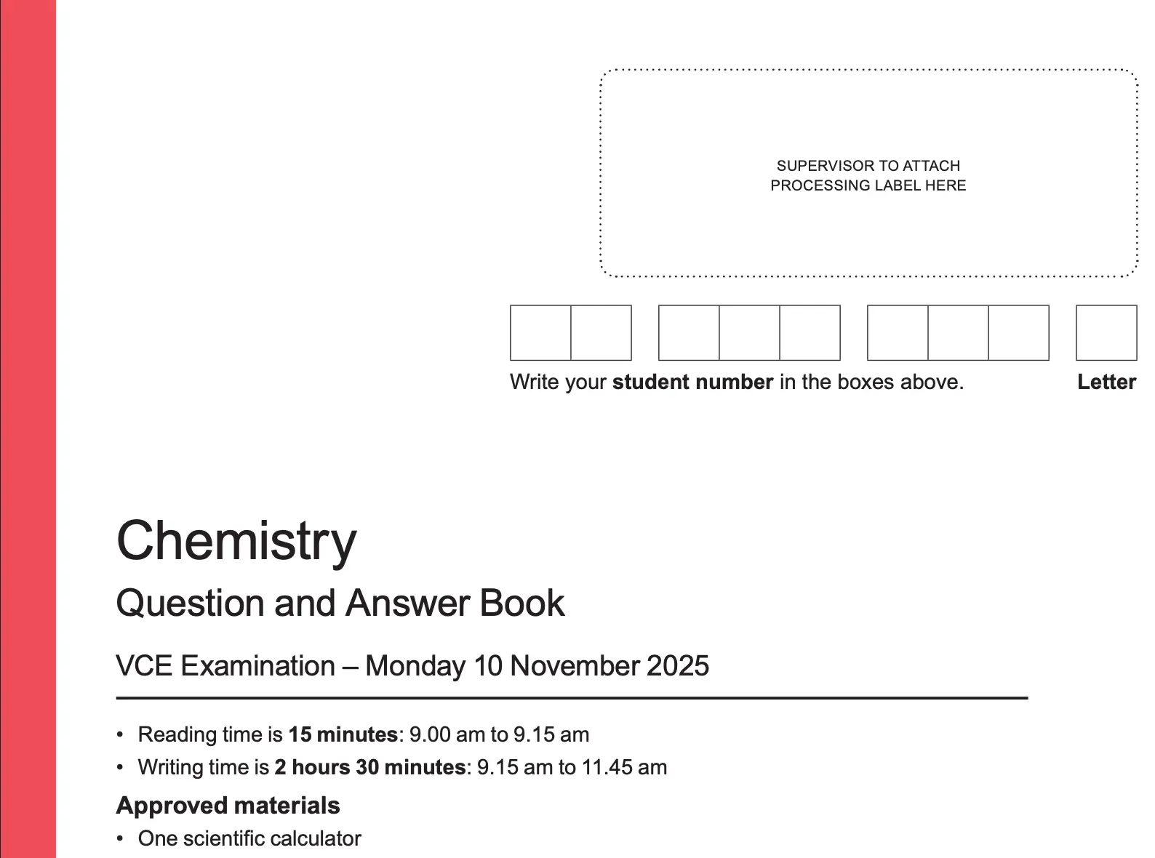
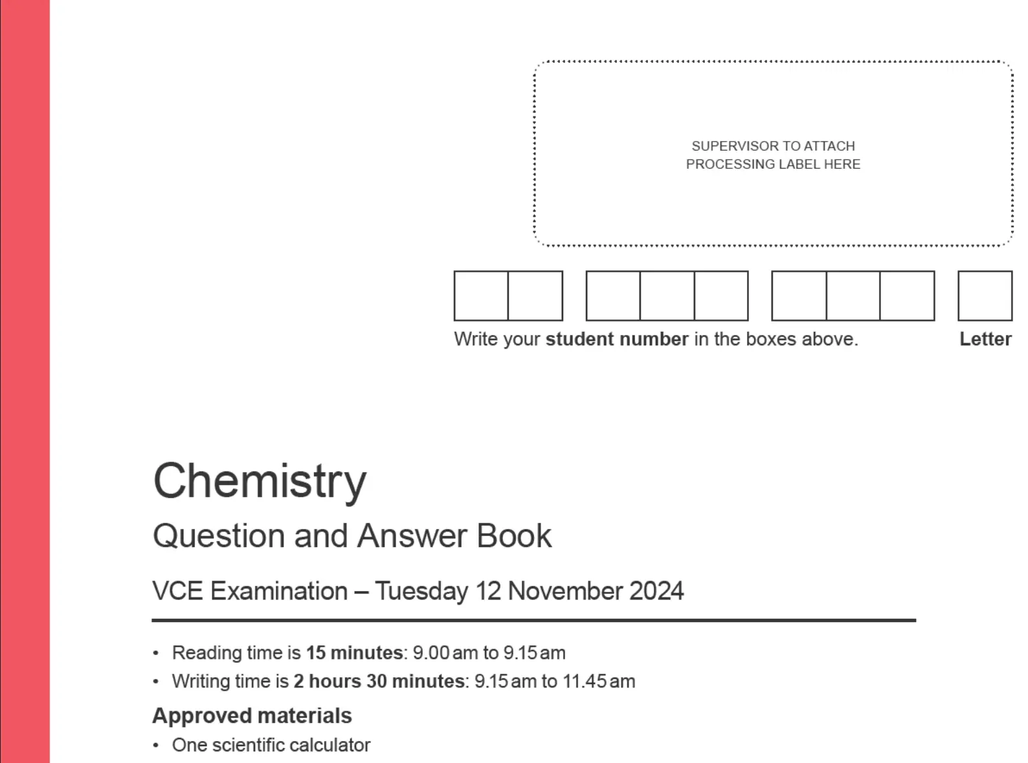
STAGE 3
Preparing for exams
Collaborative Exam Task

Slide 36
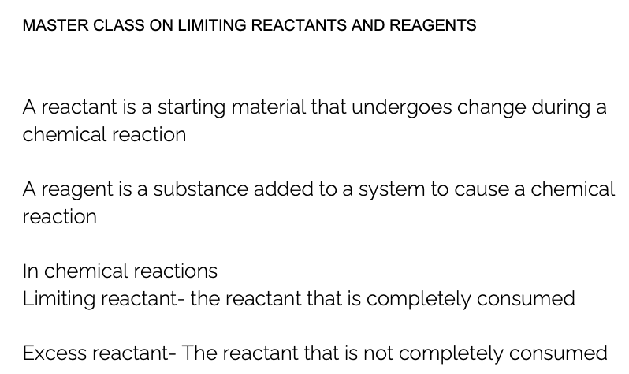
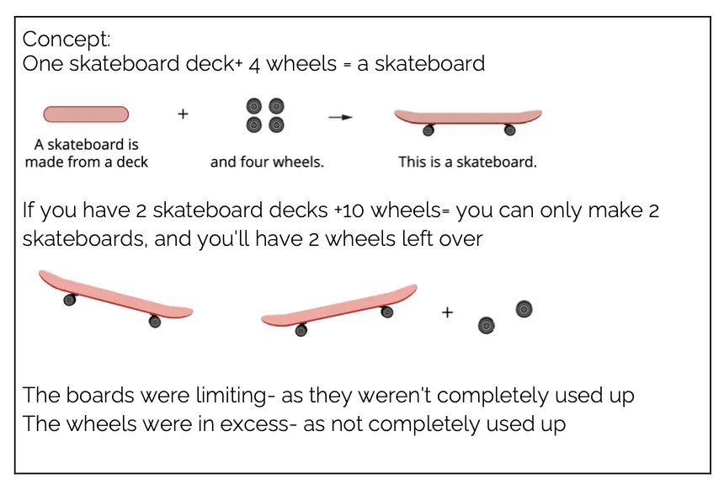
STAGE 3
Preparing for exams
Masterclass

Slide 37
Questions?
Collaboration in Chemistry
Building Confidence and Exam Readiness
Adele Hudson
Braemar College
Jisha Mathew
Hume Anglican Grammar
www.mychemhub.com

