Slide 1

Pathways to Understanding
Using Schema to Support
VCE Chemistry Exam Readiness
Adele Hudson
Braemar College
Kshitija Dhuna
Aitken College College
www.mychemhub.com

Slide 2
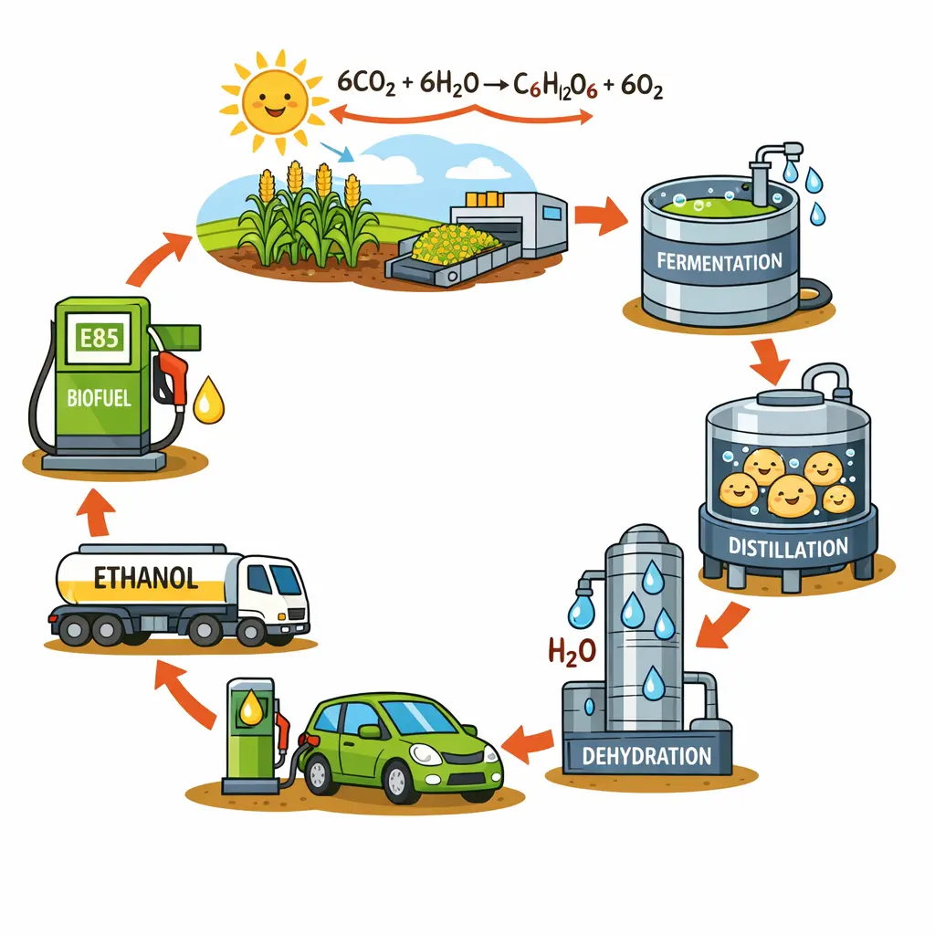
Case study

Slide 3
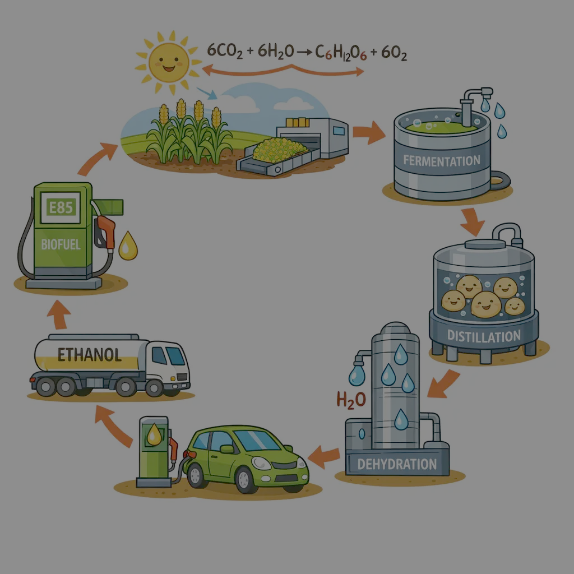
Case study
Bioethanol is renewable

Slide 4

Student achievement in VCE Chemistry Exams

Slide 5

Student achievement in VCE Chemistry Exams

Slide 6
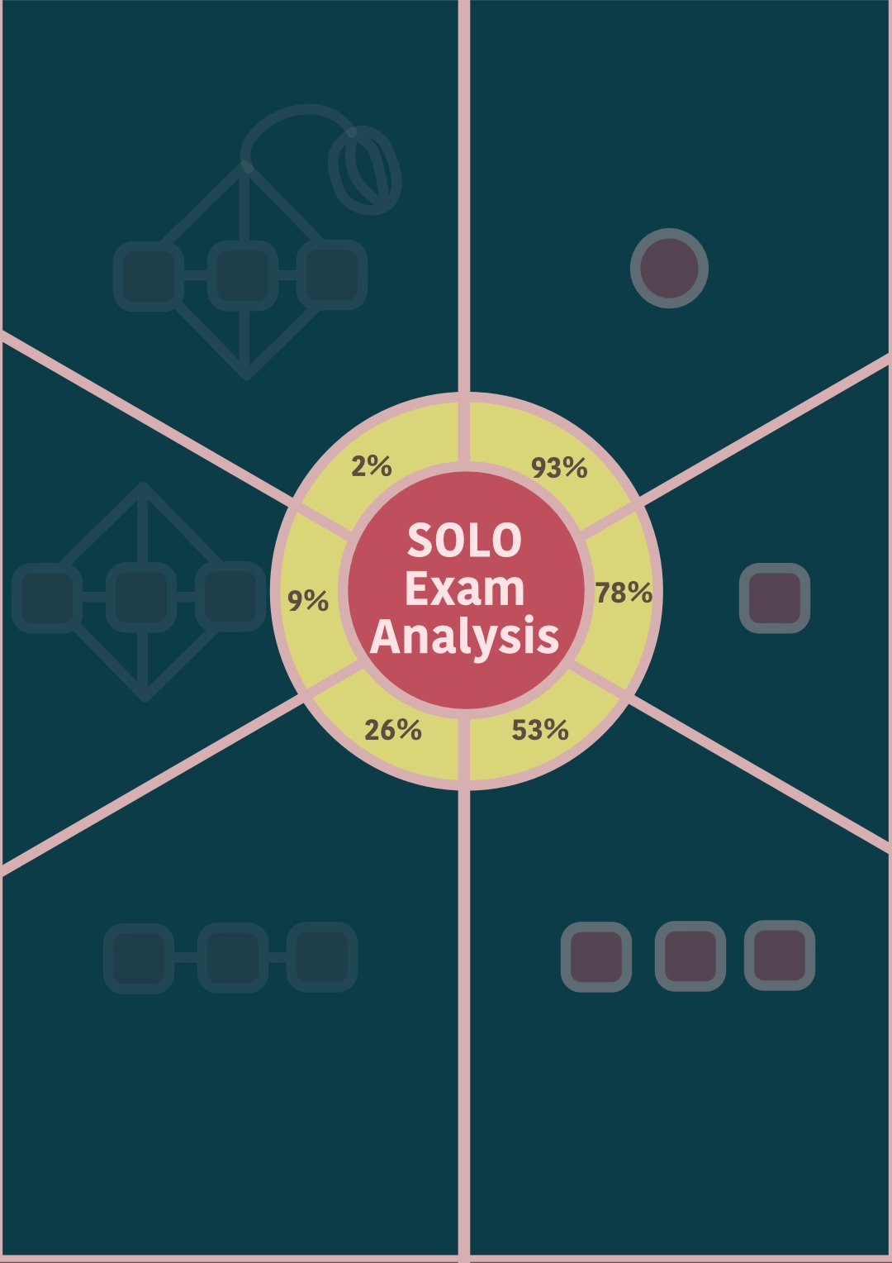
Student achievement in VCE Chemistry Exams
The shallow information sticks.
The depth fades.
And then as we move through the year,
even the limited understanding quietly disappears.

Slide 7
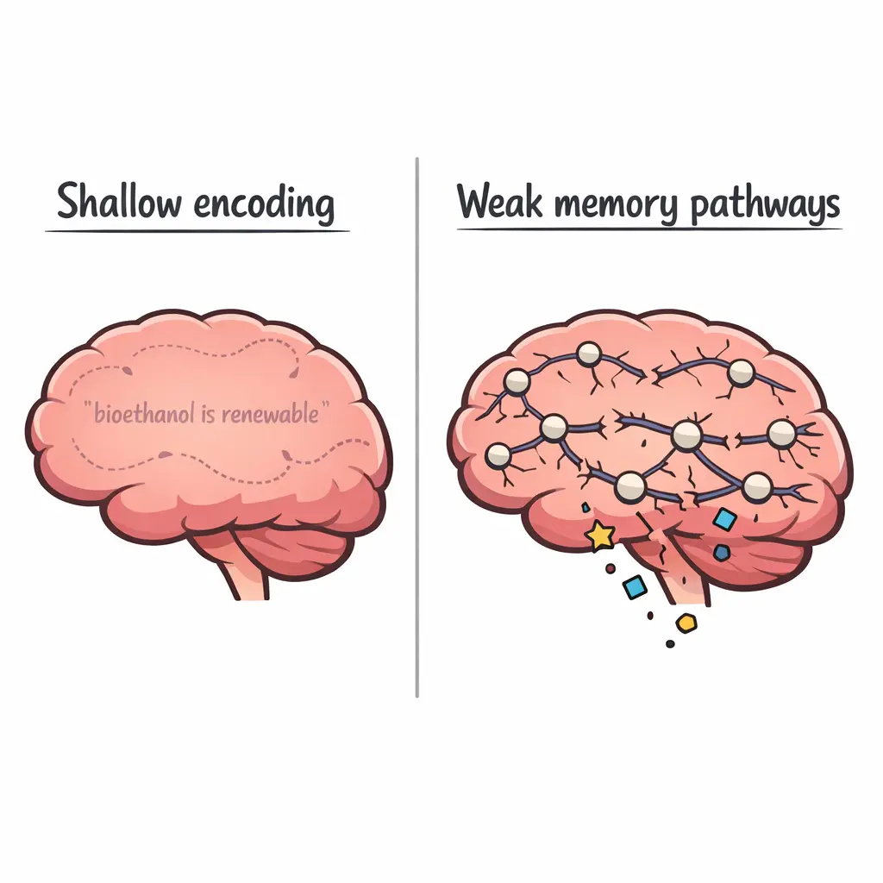
why shallow learning doesn’t stick

Slide 8

schemas: mental frameworks
knowledge blocks: chunks of related information

Slide 9
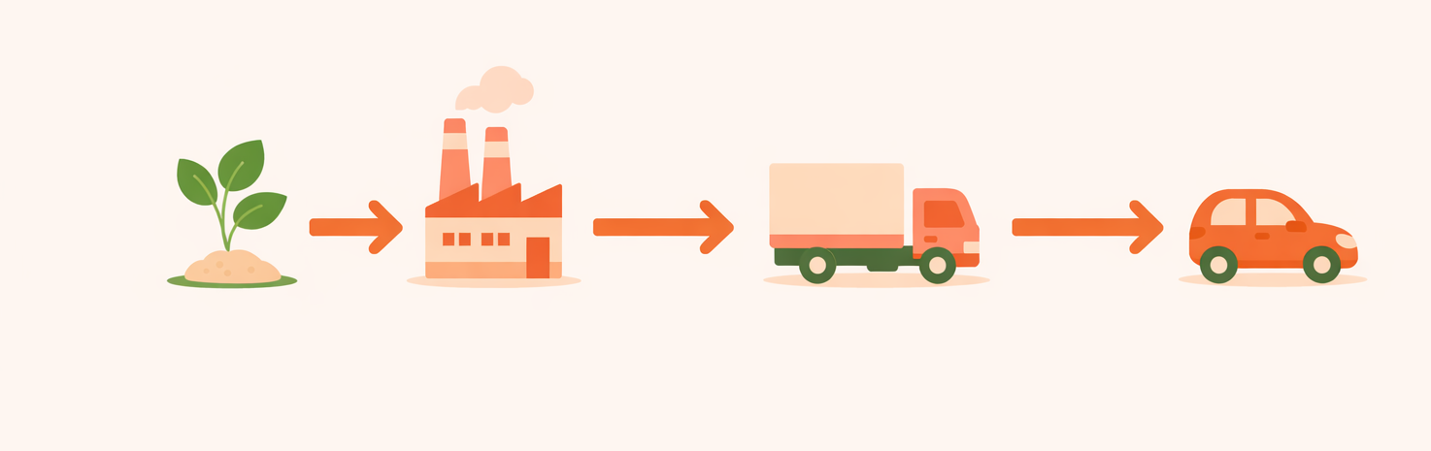
Visual Schema

Slide 10
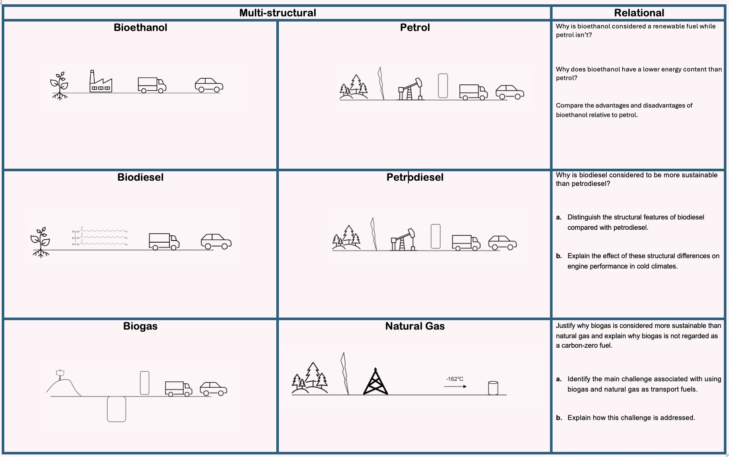
Visual Schema

Slide 11
Visual Schema

Slide 12
Visual Schema

Slide 13
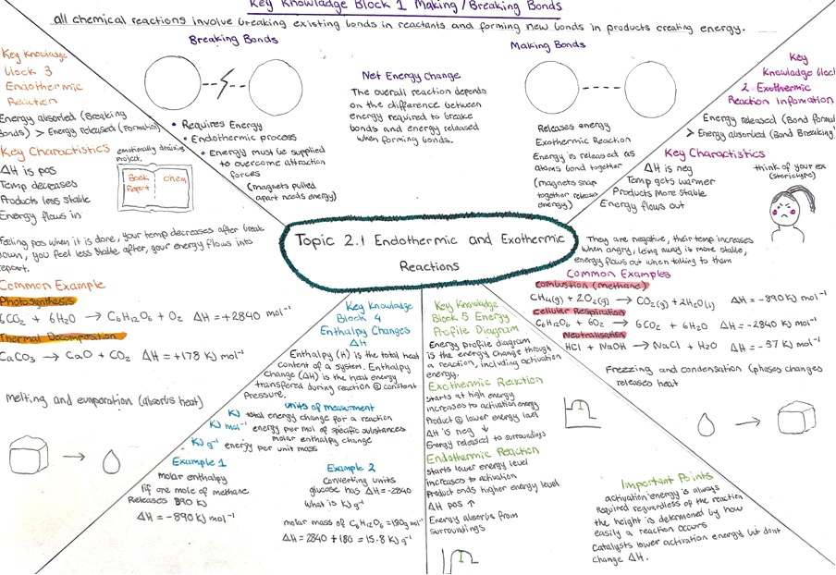
Visual Schema

Slide 14
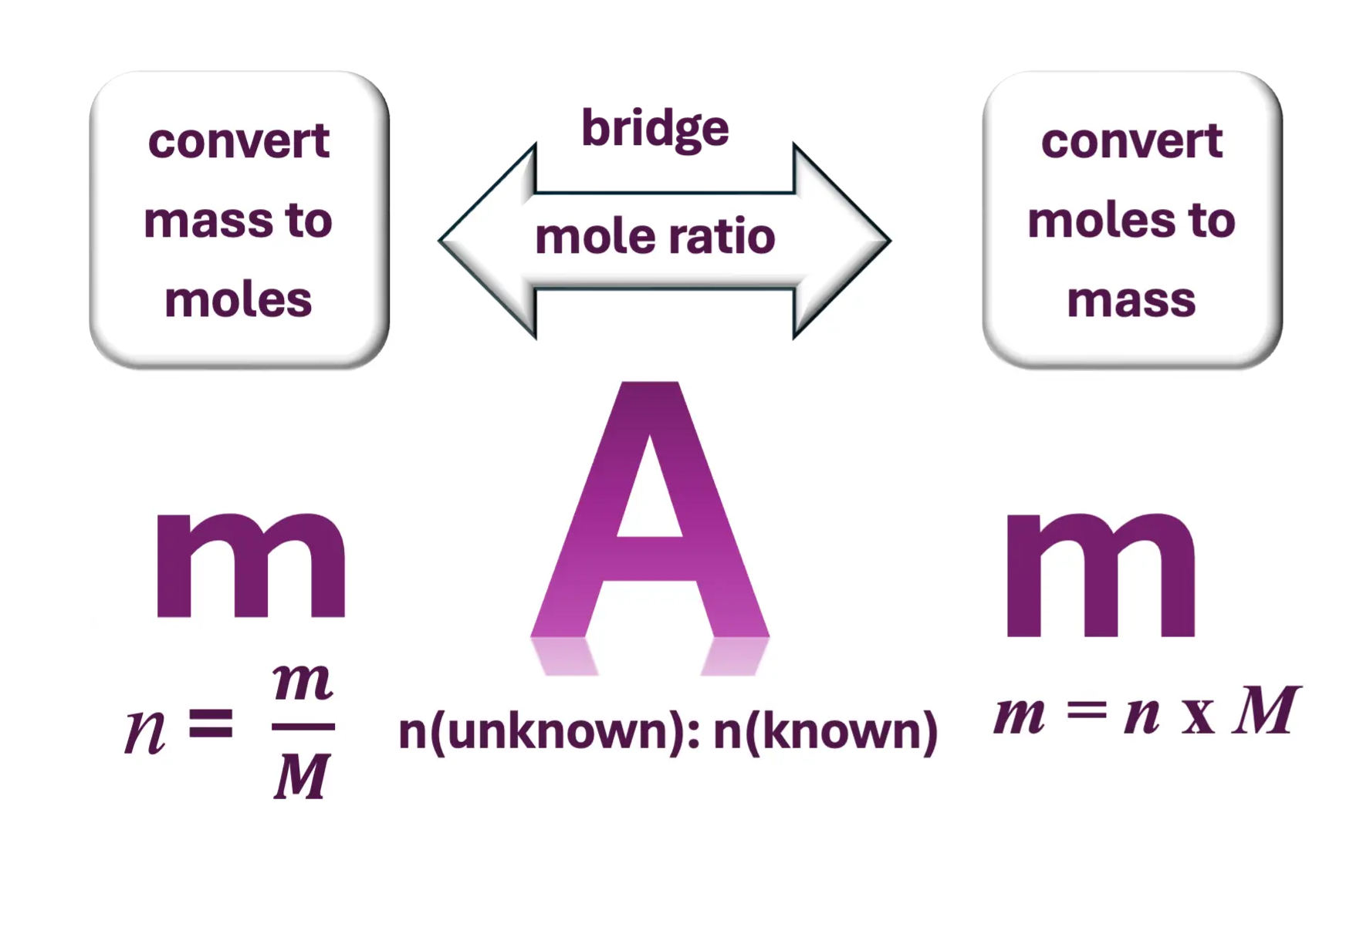
Content Specific Schema
bridge method

Slide 15
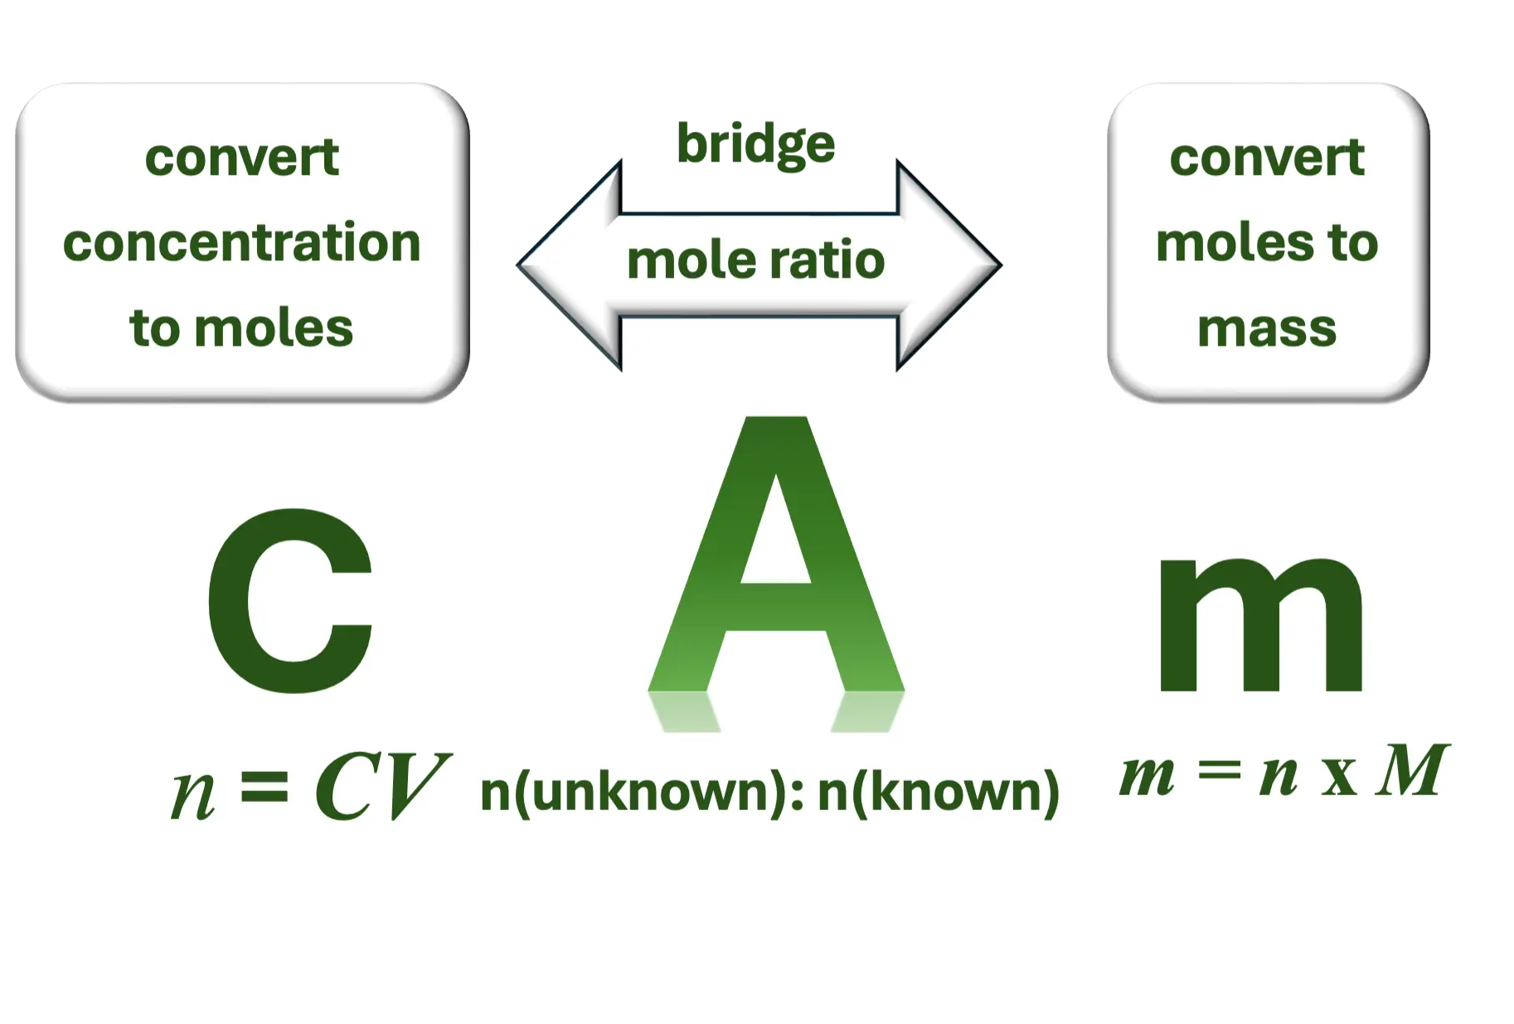
Content Specific Schema
bridge method

Slide 16
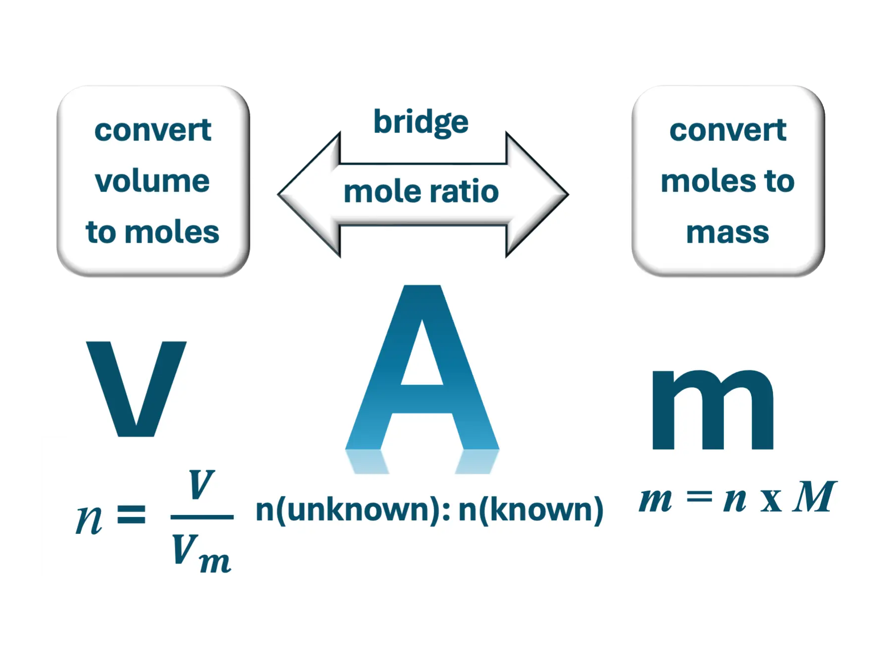
Content Specific Schema
bridge method

Slide 17
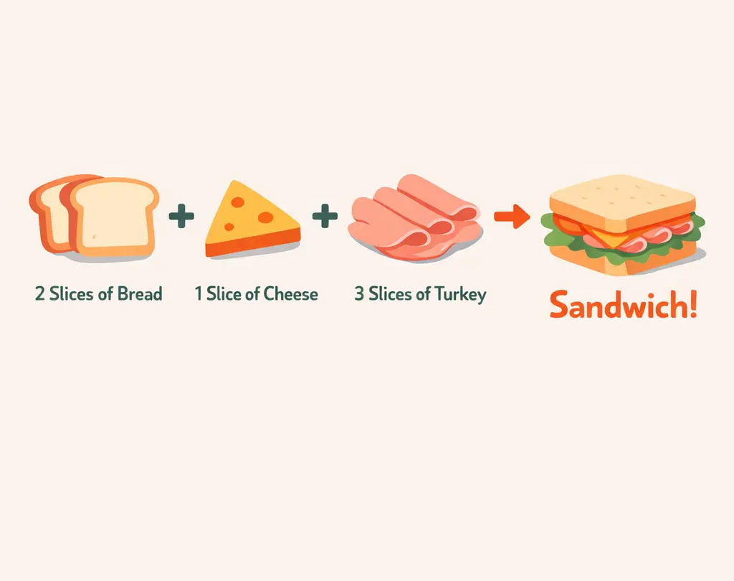
Content Specific Schema
Limiting Reactant BCA
To make one sandwich you need:
You have been given:
20 slices of bread
15 slices of cheese
18 slices of turkey
How many sandwiches can you make?
bread: 20/ 2 = 10
cheese: 15/1 = 15
turkey: 18/3 = 6
You can make 6 sandwiches because turkey is the limiting ingredient

Slide 18
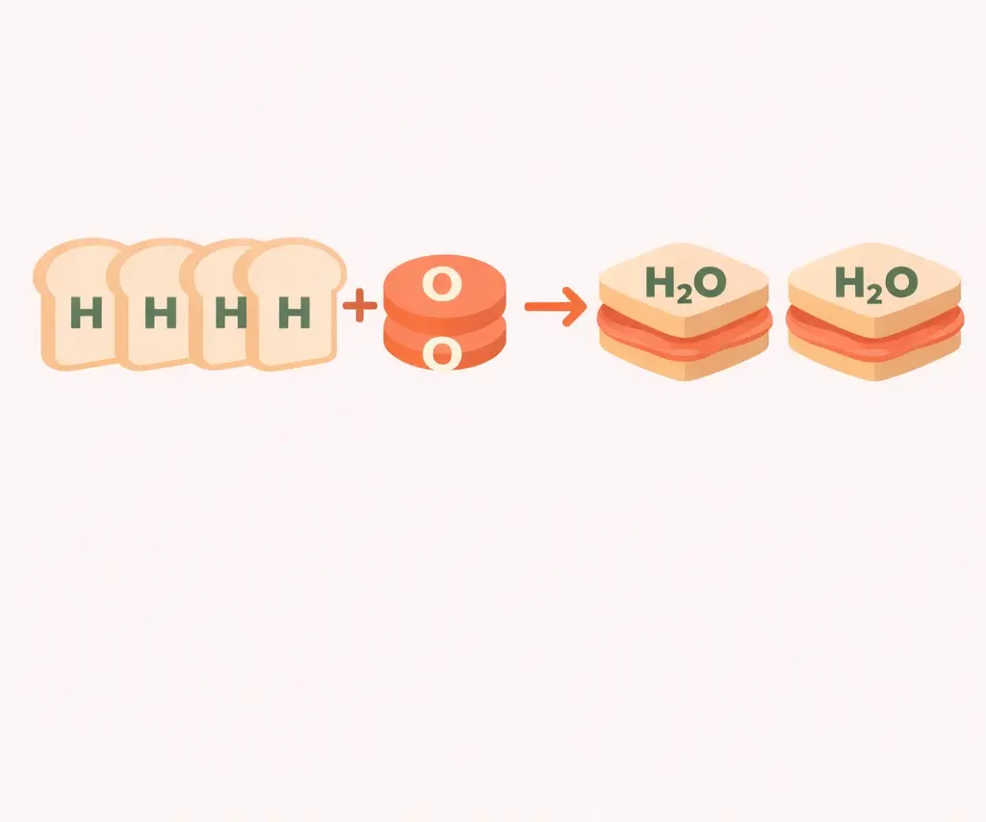
Content Specific Schema
Limiting Reactant BCA
Coefficient method to find the limiting reactant
You have been given:
4.0 moles of H₂
3.0 moles of O₂
How many sets of H₂O can you make?
H₂: 4.0/2 = 2
O₂: 3.0/1 = 3
H₂ makes less product than O₂, so H₂ is the limiting reactant.

Slide 19
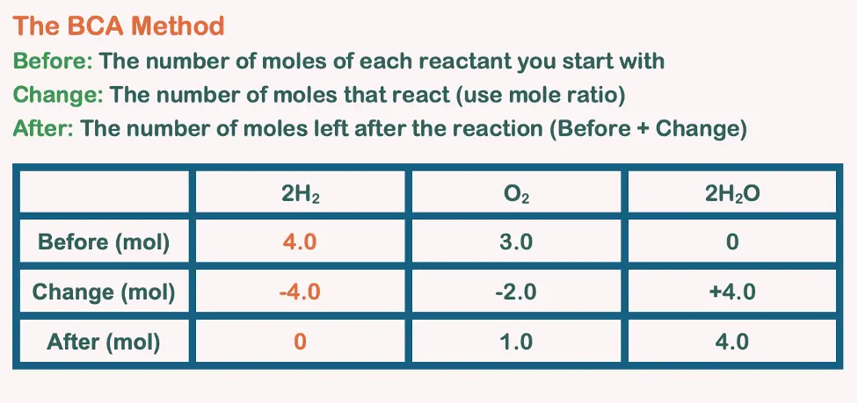
Content Specific Schema
Limiting Reactant BCA

Slide 20
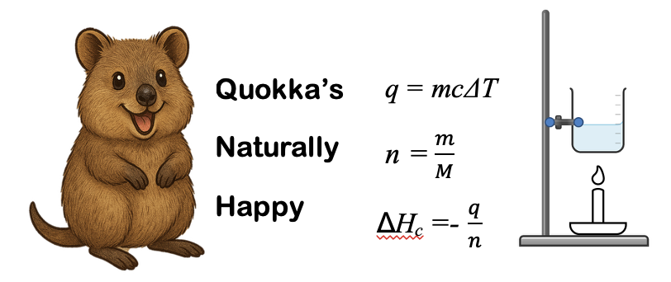
Content Specific Schema
Bomb
Calorimetry

Slide 21
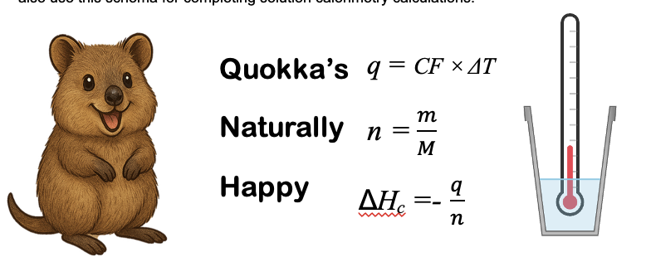
Content Specific Schema
Solution
Calorimetry

Slide 22
Universal Schema
Command Terms
Justify | State the claim → Present supporting evidence → Show reasoning connecting evidence to claim → Address counter arguments
Recall | Access stored knowledge → Identify relevant information → Present accurately → No elaboration required
Predict | Identify relevant principles → Apply to the situation → State the expected outcome → Acknowledge uncertainty

Slide 23
Universal Schema PAC
Step 1: Find the science principle or green chemistry concept
Step 2: Connect it to the specific example
Step 3: Explain why it matters in the real world
Principle
Apply
Consequence

Slide 24
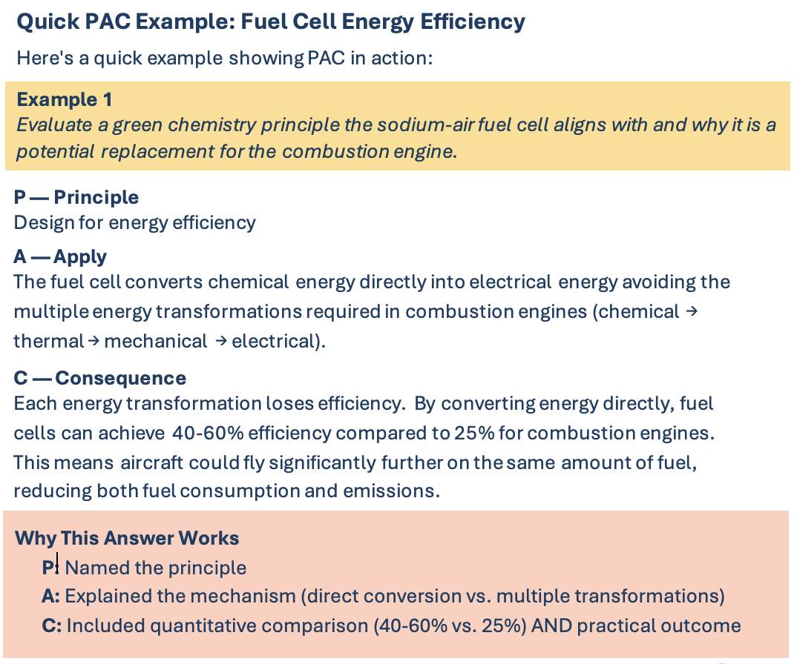
Universal Schema PAC

Slide 25
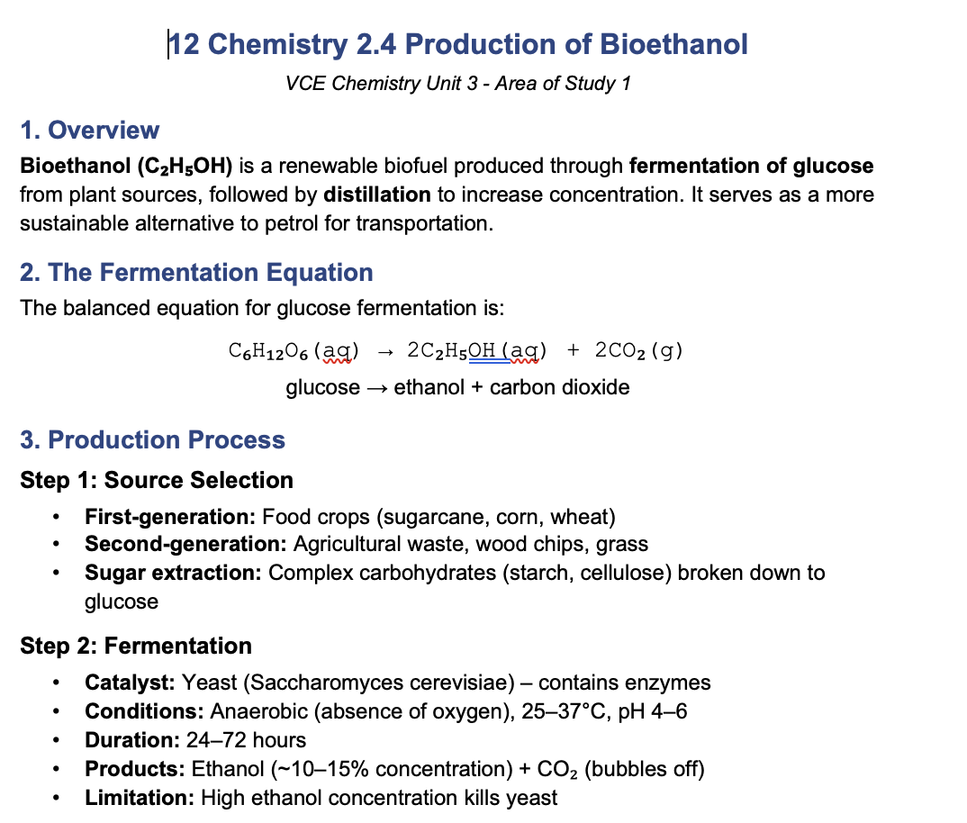
Tools for Retrieval
Summary Notes

Slide 26
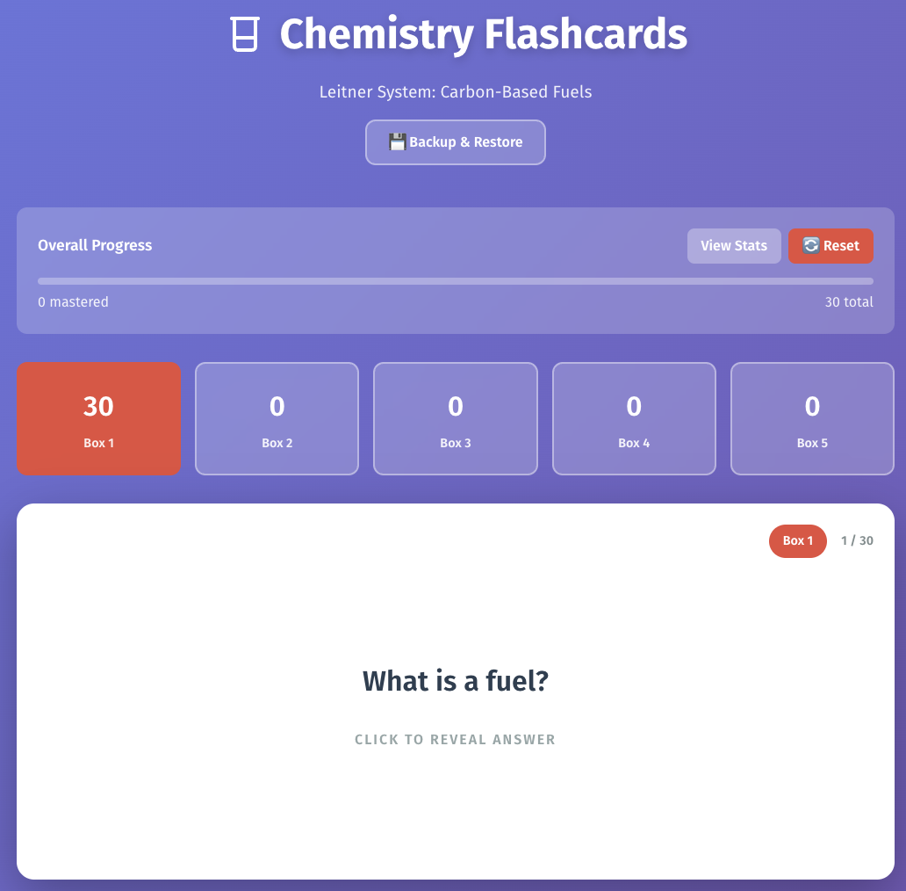
Tools for Retrieval
LIFT
Leitner Interactive Flashcard Trainer

Slide 27
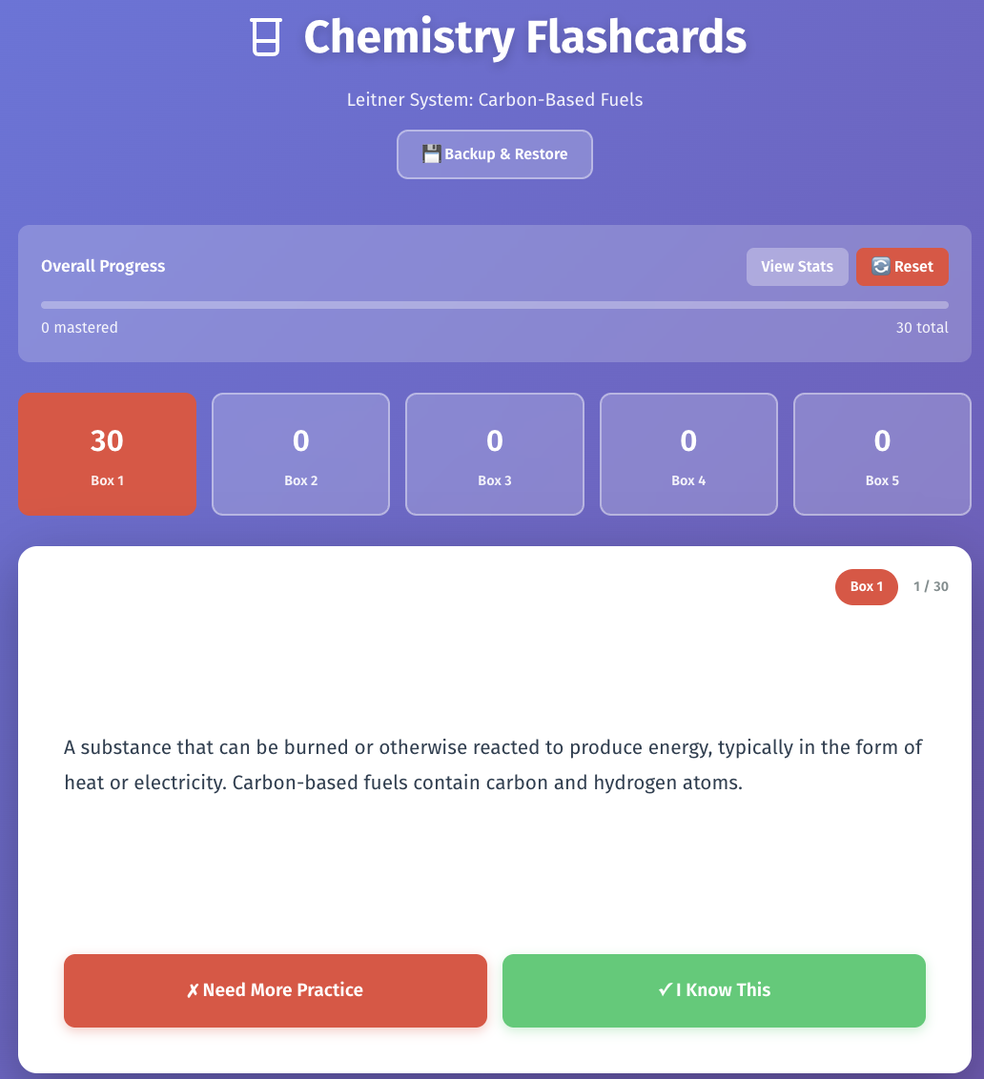
Tools for Retrieval
LIFT
Leitner Interactive Flashcard Trainer

Slide 28

Tools for Retrieval
LIFT
Leitner Interactive Flashcard Trainer

Slide 29
Tools for Retrieval
LIFT
Leitner Interactive Flashcard Trainer

Slide 30
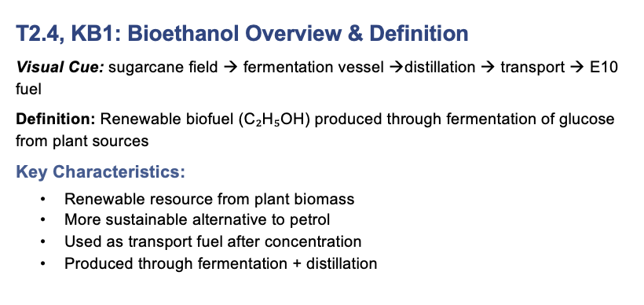
Tools for Retrieval
Knowledge Blocks

Slide 31
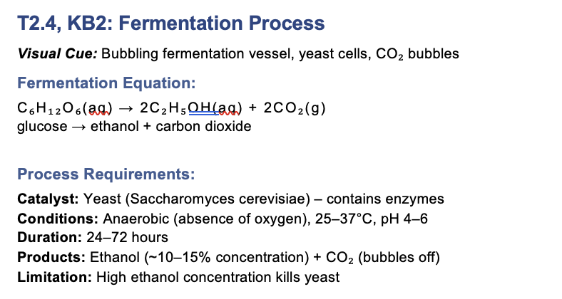
Tools for Retrieval
Knowledge Blocks

Slide 32

Tools for Retrieval
Power of the pen
Re-reading and highlighting notes creates illusions of competence

Slide 33
Summing Up

Slide 34
schemas: mental frameworks
knowledge blocks: chunks of related information

Slide 35
schemas
visual
universal
content specific
processes
concepts
command terms
PAC
MAM, CAM
BCA
QNH

Slide 36
retrieval tools
LIFT
summary notes
knowledge blocks
In addition to completion of HW questions, spaced tests, trial exam questions etc

Slide 37
Pathways to Understanding
Questions?
Using Schema to Support
VCE Chemistry Exam Readiness
Adele Hudson
Braemar College
Kshitija Dhuna
Aitken College College
www.mychemhub.com

